Slide 1
Chapter 19
Equine Breed Identification and Production Management

Slide 2
Veterinary Terminology
Mare
adult female horse over 4-years-old
Dam
term for a mare that has had a baby
Maiden horse
mare that has not been bred
Stallion or stud
adult male horse over 4-years-old

Slide 3
Veterinary Terminology
Sire
term for a stallion that has produced a baby
Foaling
term for parturition (act of giving birth) in horses
Foal
young horse, of either gender, not yet weaned

Slide 4
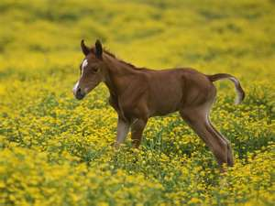
Veterinary Terminology
Filly
young female horse
Colt
young male horse
Gelding
castrated male horse

Slide 5
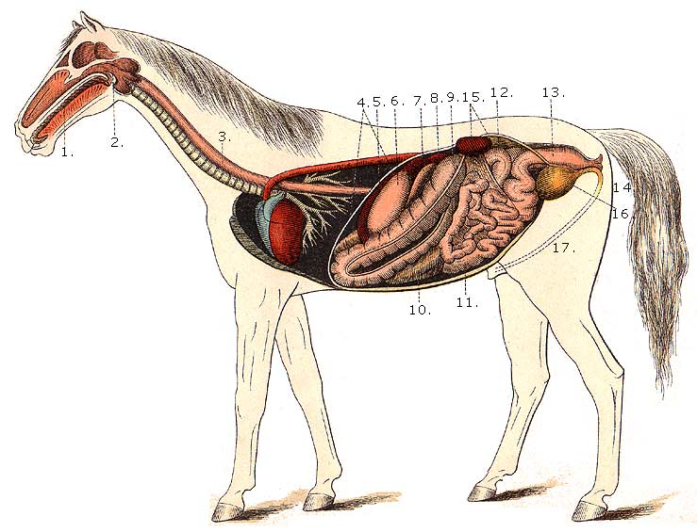
Biology
Equus caballus
Herbivores
Specialized digestive system
nonruminant
enlarged cecum
are not capable of
vomiting

Slide 6
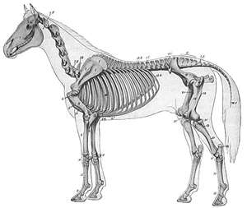
Biology
Hoofed animals
Very fragile legs
Warm-blooded
205 bones
Can live into their 20s

Slide 7
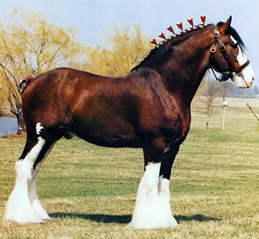
Breeds of Horses
Classes according to body type, size, and use
Riding horses
Draft horses
Ponies

Slide 8
Riding Horses
A horse ridden for pleasure and showing purposes
Are further classified by gaits and purposes they provide
Popular breeds:
Quarter Horse
Paint
Appaloosa
Tennessee Walking Horse

Slide 9
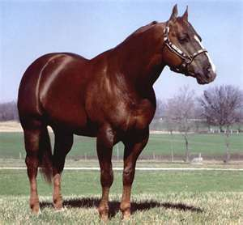
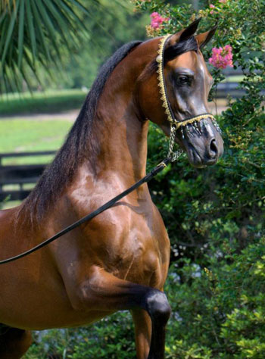
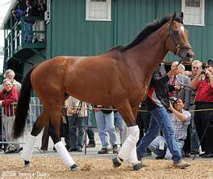
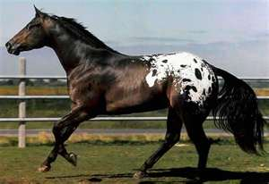
Common Riding Horse Breeds
Quarter Horse, Arabian,
Thoroughbred, Appaloosa

Slide 10
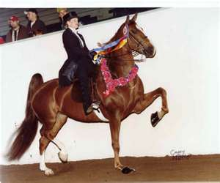
Gaited Horses
Breeds that have rhythmic movements at the walk and run and touch the ground at different times, making for a smooth ride
Popular breeds:
Tennessee Walking Horse
American Saddlebred
Rocky Mountain Horse

Slide 11
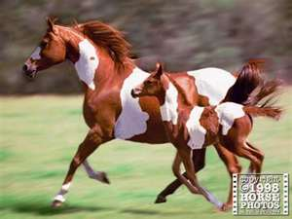
Stock Horses
Used to work farms and ranches, especially cattle
Hardy and athletic
Agile and fast
Popular breeds:
Quarter Horse
Appaloosa
Paint Horse

Slide 12
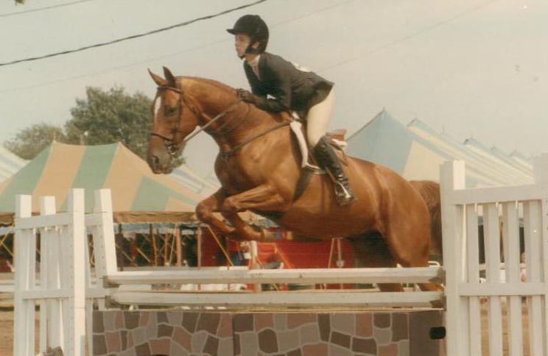
Hunters and Jumpers
Bred for fox hunting and cross country riding
Tall, athletic, and muscular
Have speed and endurance
Popular breeds
include Thorough
bred and a variety
of warm bloods

Slide 13
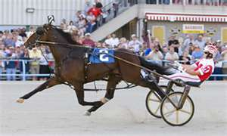
Racehorses
Bred for speed and used for racing
Horse racing – a popular sport
Kentucky Derby, Belmont Stakes
Popular breeds
Quarter Horse
Thoroughbred
Standardbred
Morgan Horse

Slide 14
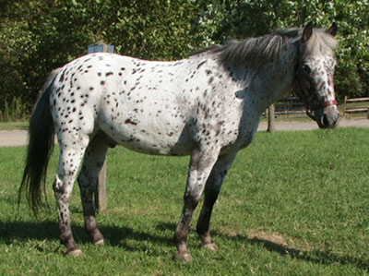
Ponies
Small type of horse
Commonly used by children
Stand under 14.2 hands in height
Gentle and intelligent
Popular breeds
Shetland
Welsh
Pony of the Americas

Slide 15
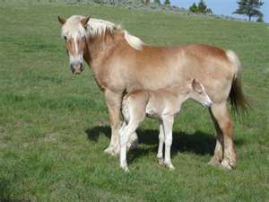
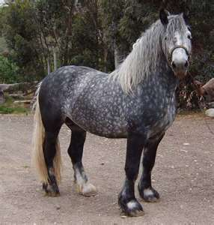
Draft Horses
Large and muscular
Used to pull heavy loads
Also known as work horses
Popular breeds:
Clydesdale
Belgian
Percheron

Slide 16
Breed Selection
Must consider cost involved in purchasing, in caring for, and in maintaining a horse
Prices range depending on breed and purpose
Disposition of horse important
Size of horse should be optimal for size of the rider’s height and weight

Slide 17
Nutrition
Concentrates: grains and supplements that provide energy and protein
oats (most common)
corn
wheat
barley
Non-Monogastric digestive system
large cecum to break down protein

Slide 18
Nutrition
Maintenance diet requires 1 pound of protein per 1,000 lbs of body weight
Avoid dusty and moldy food
Feed grains that are cracked, ground, or shelled for easier metabolism
Common supplements are soybean meal and linseed oil for skin and coat

Slide 19
Behavior
Herd animals that prefer to live in groups
Within each group exists a hierarchy
Are suspicious by nature
May be spooked or startled by noise
Some behaviors that are normal for horses may be dangerous for humans

Slide 20
Behavior
Normal horse behavior includes:
Behavior consistent with other herd animals
Displaying fight or flight instinct
Vocal communication (neighing, snorting, etc)
Grooming other horses
Nuzzling
Ears forward and alert
Tail down and quiet

Slide 21
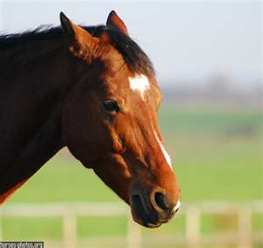
Behavior
Abnormal horse behavior includes:
Biting
Kicking
Pawing
Chewing
Striking
Head tossing
Ears moving quickly
Ears flattened on head
Tail swishing

Slide 22
Basic Training
May be ridden, driven, used as pack animals, and kept as companions
All horses should be taught:
to lead on a rope
to tie on a post or chain
to work on a long line
basic commands such as walk, jog or trot, and lope
to stop and back up

Slide 23
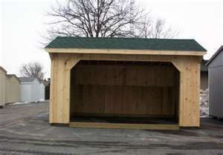
Equipment and Housing Needs
Barn or shed for protection
Stall size
at least 10 x 10 feet
8 feet in height
Cross tie area
at least 5 x 12 feet
reinforce lower 5 feet in case of kicking
Paddock or pasture
at least 1 acre per horse

Slide 24
Restraint and Handling
Calm horse using a low, even tone voice
Use a halter to properly lead horse
Approach from front and slightly to the left or near side
Hold lead rope in neat loops with left hand; hold lead rope close to halter with right
Tying should be done with a slip knot

Slide 25
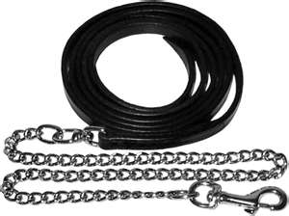
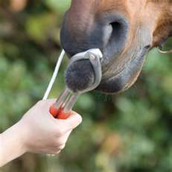
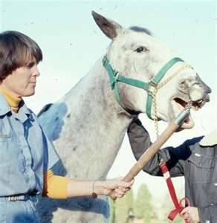
Restraint and Handling
Twitch – for a nervous or difficult horse
Chain shank – used for better control
Tail tying - generally used with a sedated horse
Hobbles – leg restraints

Slide 26
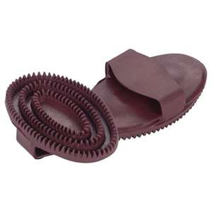
Grooming
Need regular and consistent grooming
Brushing
Body
Mane
Tail
Bathing
Hoof maintenance

Slide 27
Reproduction and Breeding
Horses have the lowest conception rate of all livestock
50% get bred
Mares estrus cycles begin at 12-15 months of age
Breeding should begin between 3-4 years of age

Slide 28
Reproduction and Breeding
Breeding age can continue into the late teens (15-18 years)
Estrus cycles are every 21 days and last 4-6 days
Signs: relaxed vulva, “winking,” increased urination, vocal, and slight mucous discharge from vulva

Slide 29
Reproduction and Breeding
Broodmare – mare bred to foal
Best kept in open pasture to allow exercise
Keep with other broodmares
Breeding methods:
In hand breeding – handling mare and stallion to allow natural breeding
In pasture breeding – turning mare and stallion out together to breed
Artificial Insemination

Slide 30
Veterinary Care

Slide 31
Basic Health Care and Maintenance
Daily monitoring
Management and prevention are key
Have an equine veterinarian
Vaccine schedule
Health program
Sanitation and disinfectant program
Nutritional program

Slide 32
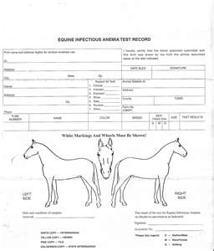
Health Testing
Highly susceptible to contagious diseases and organisms
Coggins test – every 6 months to a year
Equine Infectious Anemia (EIA)

Slide 33
Dental Care
Can live into their 30s
Prime years are 3-12
Examination of teeth determines age
Appearance of temporary teeth
smaller size
whiter color
Shape of permanent teeth

Slide 34
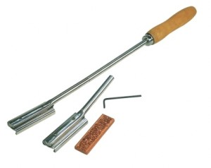
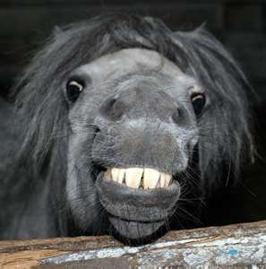
Dental Care
Degree of wear
Cups wear on the inside and center of the tooth
Adult male: 40 teeth
Adult female: 36 teeth
Up to age 12 – teeth are OVAL
After 12, teeth change to TRIANGULAR shape and slant forward
http://www.youtube.com/watch?v=nHrJkMoZk50&safety_mode=true&persist_safety_mode=1

Slide 35
Hoof Care
Farrier – person who trims and shoes horses
Trimming schedule every 4-6 weeks
Proper length and shape
Required hoof care is necessary for the balance and comfort of the horse
Bare feet if on soft bedding or in pasture
Shoes needed if on hard surfaces

Slide 36
Castration
Done around 6 months of age
Done to prevent reproduction and to allow for ease of handling
Performed while horse is standing
Incision usually remains open

Slide 37
Assessment of Lameness
Evaluated by veterinarian
WALK - 4 beat gait, very relaxed
JOG - 2 beat gait for Western horses

Slide 38
Assessment of Lameness
TROT - 2 beat gait for English horses
LOPE - 3 beat gait for Western horses
CANTER - 3 beat gait for English horses
GALLOP - 4 beat gait at the run
Each foot hits the ground at a different time
Brief time when all 4 feet are not touching the ground

Slide 39
Vaccinations
Vaccine program begins at 4-5 months:
Tetanus
Flu
Rhino or EHV
Rabies
Strangles
West Nile
Potomac
Regular dewormer program

Slide 40
Common Diseases
Horses known to be fragile animals when it comes to diseases and injuries
Digestive systems and bones easily damaged
Can become gravely ill very quickly

Slide 41
Colic
Severe stomach pain that can lead to death
Stomach and intestines can twist
http://www.youtube.com/watch?v=SJ65h_v4KpA&safety_mode=true&persist_safety_mode=1

Slide 42
Colic
Causes: internal parasites, over feeding or drinking, mold or poor food sources, high fever, or eating or drinking shortly after exercise
Signs: Bloated abdomen, frequent lying down and standing, rolling, kicking or biting at abdomen, sweating, restlessness, constipation, and anorexia

Slide 43
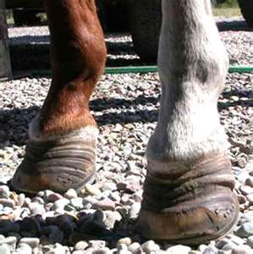
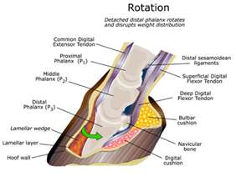
Laminitis
Also called “founder”
Inflammation of the lamina bone and tissue connecting the hoof wall to the foot

Slide 44
Laminitis
Causes: over feeding grain or rich hay, rapid change in diet, excessive cold water amounts, inflammation of the uterus post-labor, or over work
Signs: pain in hooves, reluctance to move, fever, and stand with a parked out appearance

Slide 45
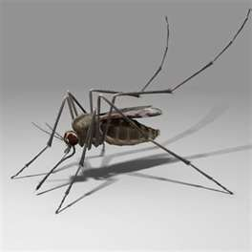
Equine Infectious Anemia
EIA or Swamp Fever
Virus transmitted through biting insects
Can be spread by infected needles

Slide 46
Equine Infectious Anemia
No vaccine
All horses MUST be tested yearly with a Coggins test done by the state Veterinary Lab and Department of Agriculture
Required for transport and showing
Signs: high fever, stiffness, weakness, weight loss, swelling, and anemia

Slide 47
Equine Encephalomyelitis
Equine Sleeping Sickness
EEE/WEE/VEE strains
Caused by a virus transmitted by mosquitoes
Vaccinate yearly
Use insecticides for prevention
Sings: lethargic, sleepy appearance, local paralysis of lips and bladder, and anorexia

Slide 48
Equine Influenza
Equine Flu
Highly contagious
Signs: fever, anorexia, depression, rapid breathing, cough, weakness, and ocular/nasal discharge
Vaccinate yearly
Outbreaks can cause statewide emergencies

Slide 49
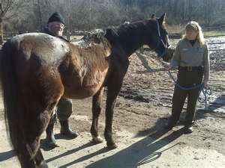
Common Parasites
External :
Flies
Mosquitoes
Mites
Ticks
Lice
Ringworm fungus

Slide 50
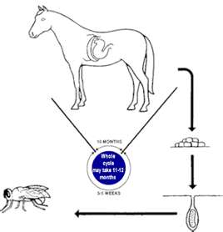
Common Parasites
Internal :
Roundworms
Bots (flies)
Pinworms
Strongyles (bloodsucking worms)

