Slide 1
Chapter 22
Sheep Breed Identification and Production Management

Slide 2
Veterinary Terminology
Ovine
veterinary term for sheep
Ewe
adult female
Ram
adult male
Lamb
young sheep under a year old

Slide 3
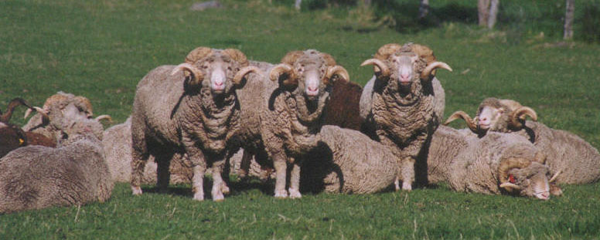
Veterinary Terminology
Lambing
labor process of sheep
Wether
castrated male sheep
Mutton
sheep meat from an animal over a year old

Slide 4
Biology
Ruminants
Cloven hooves
Bovine family
Range in size from 100-225 lbs.
Average life span: 7-13 years
Wool may weigh 15 lbs. or more

Slide 5
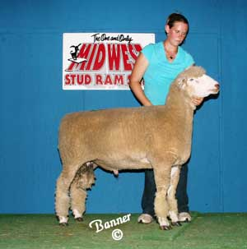
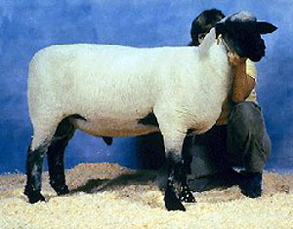
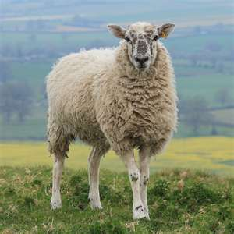
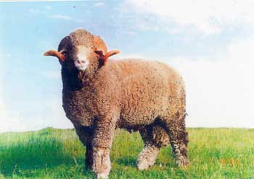
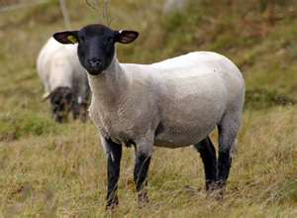
Breeds
The 6 major sheep breeds are:
Dorset
Suffolk
Hampshire
Rambouillet
Border Leicester
Columbia

Slide 6
Breed Selection
Sheep used for several purposes, mainly for meat and wool products
Lamb – a popular delicate meat
Mutton – a tougher meat
Chammy – by-product of sheep skin used for polishing cars

Slide 7
Nutrition
Carbohydrates and fats for energy
pasture, hay, silage, and grains
Protein
alfalfa, clover, linseed, and peanut oil
Vitamins
A, D, E, K (B is produced by rumen bacteria)
Minerals
salt, phosphorus, calcium, and potassium
Water
one gallon per day per sheep

Slide 8
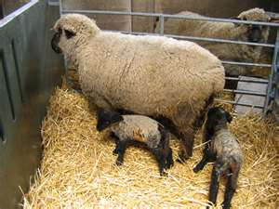
Behavior
Flock instinct
Several defense mechanisms:
stomping feet
butting heads
moving into the flock

Slide 9
Equipment and Housing Needs
Barns or sheds open to the south
Protection from weather
Well-bedded and dry
Ventilation
Electricity
Water
Troughs or feeders

Slide 10
Equipment and Housing Needs
Free stalls for does
Loose housing for young
Goats kept inside should be dehorned to prevent injury
Fencing - 60 inches or higher with 4-5 inches between strands

Slide 11
Restraint and Handling
Important to stay calm, quiet, and gentle
Sheep can be easily injured
Wool coat can be easily overheated
Capturing a sheep – best done within herd
“Rump” method

Slide 12
Grooming
Most breeds require regular shearing
Carefully done with clippers or shears
Usually done several times a year
Involves electric shears, shearing blades, trimmer disinfectant, shearing tables or chutes, blankets, and hoods

Slide 13
Basic Health Care and Maintenance
Signs of unhealthy sheep:
Poor wool or coat quality, loss of wool, discharge from eyes and nose, pale mucous membranes, anorexia, diarrhea, and standing alone from flock
Important to quarantine new sheep for 30 days
Yearly physical exams; updated vaccines
Dewormers every 3 months

Slide 14
Vaccinations
Programs will vary based on location and veterinarian recommendations
Lambs should begin program between 6-8 weeks old
Breeding programs may require boosters every 6 months – year or yearly

Slide 15
Breeding and Reproduction
Ewes reach maturity at 8-10 months
Rams reach maturity at 5-7 months
Breeding begins at 2-years-old
Estrus last 30 hours and cycles every 16-17 days
Gestation length: 148-150 days
Show no signs of heat

Slide 16
Foot Rot
Also called an abscess
Cause
Germ that gets in a scrape or cut
Infection results in lameness, limping
Treatment/Prevention
Trim away decaying area
Apply antiseptic
Keep pen clean and dry

Slide 17
Mastitis
Udder infection
Bacteria enters end of teat
Udder may feel hard and be hard to the touch
Treat with antibiotics and consult a veterinarian

Slide 18
Actinobacillosis
“Lumpy jaw”
Affects the head and jaw
Causes tumor like lumps of yellow pus to build up within jaw
Infection spreads to muscles, organs, and tissues
CANNOT be used for human consumption
Not fatal but can spread to other animals

Slide 19
Actinomycosis
“Wooden tongue”
Lesions on head and swelling at lymph nodes on neck
Hard lesions on tongue
Difficult to eat
Loss of weight
Death
Isolate from herd
Contamination through feed and water

Slide 20
Blue Tongue
Viral disease spread by gnats
Weakens immune system
Death due to secondary infection
Signs: fever, loss of appetite, sluggish behavior, swelling on mouth and ears, ulcers in mouth, and trouble eating
No treatments
Vaccinate at shearing

Slide 21
Enterotoxemia
Bacterial disease affecting lambs/show animals
Known as “overeating disease”
Affects show animals due to increased gains

Slide 22
Enterotoxemia
Bacteria produce toxins
Death with heads arched due to convulsions
No treatment
Vaccines and good management
2 and 6 weeks prior to labor

Slide 23
Johne’s Disease
Digestive and intestinal condition
Intestinal walls thicken
Signs: diarrhea, weight loss, or death
No treatment
Check history before purchase

Slide 24
Soremouth
Viral disease
Scabs in mouth and lips of lambs
Contagious and zoonotic
Handle with gloves
Healing can be done by removing scabs and rubbing iodine into sores
Vaccinate

Slide 25
Lamb Dysentery
Bacteria that affects lambs at 1-5 days old
Signs: appetite loss, depression, diarrhea, or sudden death
Spreads rapidly
Sanitation and good management

Slide 26
Polyarthritis
Lambs 3 to 5-weeks-old
Signs: inactive, weight loss, no weight gain, and reluctant to move
Painful
Treat with tetracycline antibiotics

Slide 27
Common Parasites
Common external parasites:
Lice, mange mites, ear mites, ringworm
All severely affect wool quality of coat
Common internal parasites:
Lungworms, whipworms, tapeworms, coccidian, liver flukes, stomach worms
Treat with topical dips, insecticide sprays, anthelmintics, waste control and removal, and pasture rotations

Slide 28
Sheep Production
Advantages:
Best suited livestock for grazing
Excellent scavengers
More efficient at converting food to meat
Dual purpose breeds (meat and hair)
Fast market return
Low amount of waste
Easy to raise
Require minimal space

Slide 29
Sheep Production
Disadvantages:
Wool prices low
Industry competition
Sheep are susceptible to disease
Easy prey
Meat production low

