Slide 1
Surgical Instruments Review
Vet Science CDE

Slide 2
Muzzle- Basket

Slide 3
Centrifuge

Slide 4
Endotracheal tube

Slide 5
OB Chains and handles

Slide 6
Rumen Magnet

Slide 7
Silver Nitrate Sticks

Slide 8
Squeeze Chute

Slide 9
Elastrator

Slide 10
Hoof Knife

Slide 11
Dental Float

Slide 12
Twitch- Chain

Slide 13
Laryngoscope

Slide 14
Dehorner- Electric

Slide 15
Dental Scaler

Slide 16
Ear Notcher

Slide 17
Autoclave

Slide 18
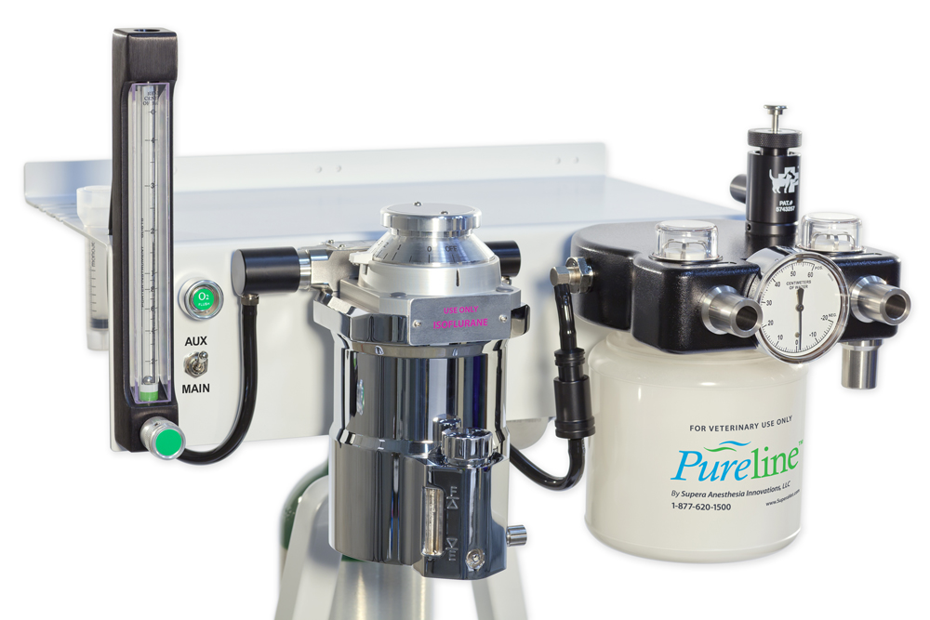
Anesthesia Machine

Slide 19
Catch Pole

Slide 20
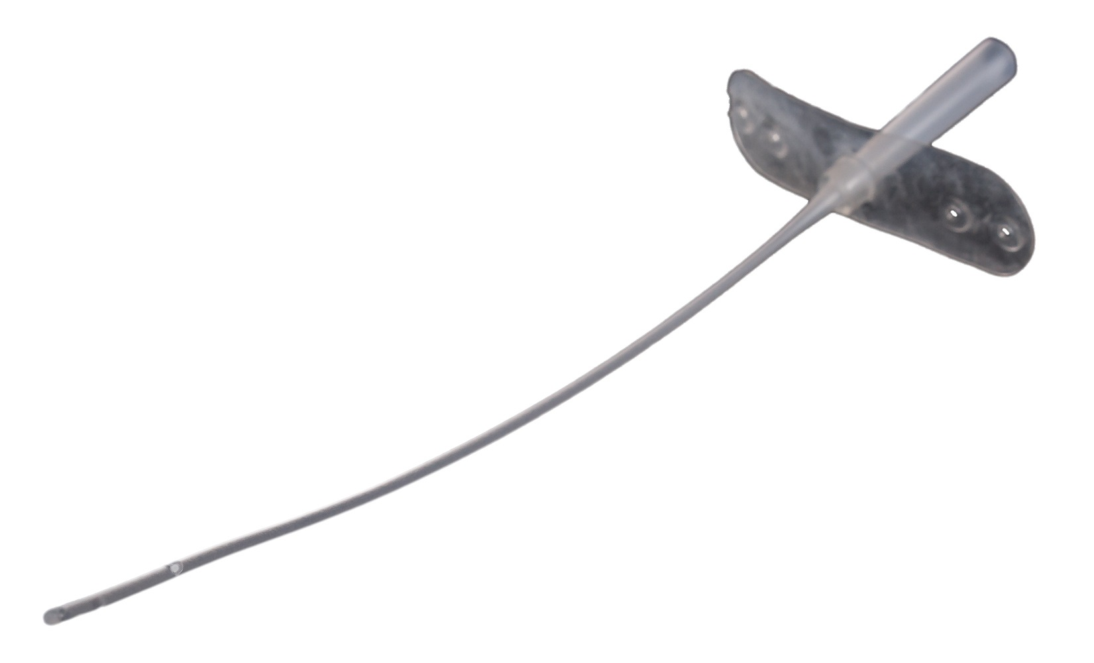
Catheter- Tomcat Urinary

Slide 21
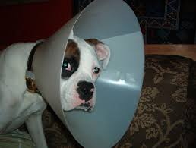
Elizabethan Collar

Slide 22
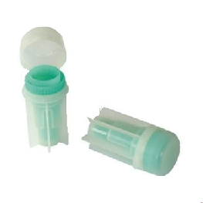
Fecalyzer

Slide 23
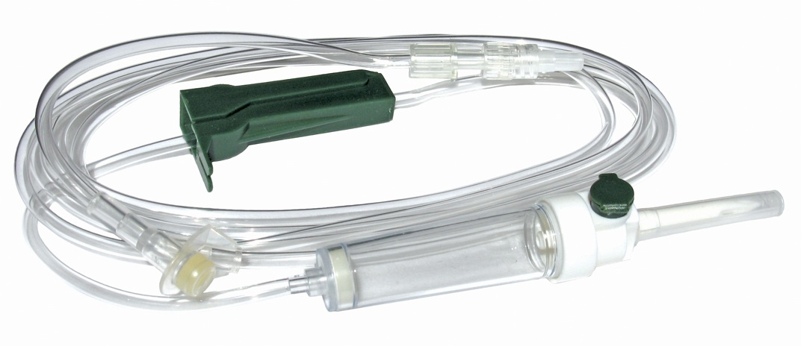
IV administration set

Slide 24
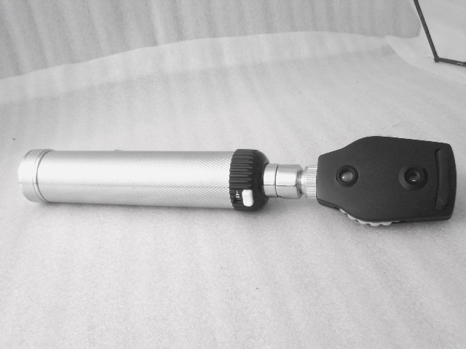
Opthalmascope

Slide 25
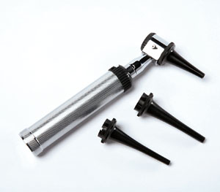
Otoscope

Slide 26
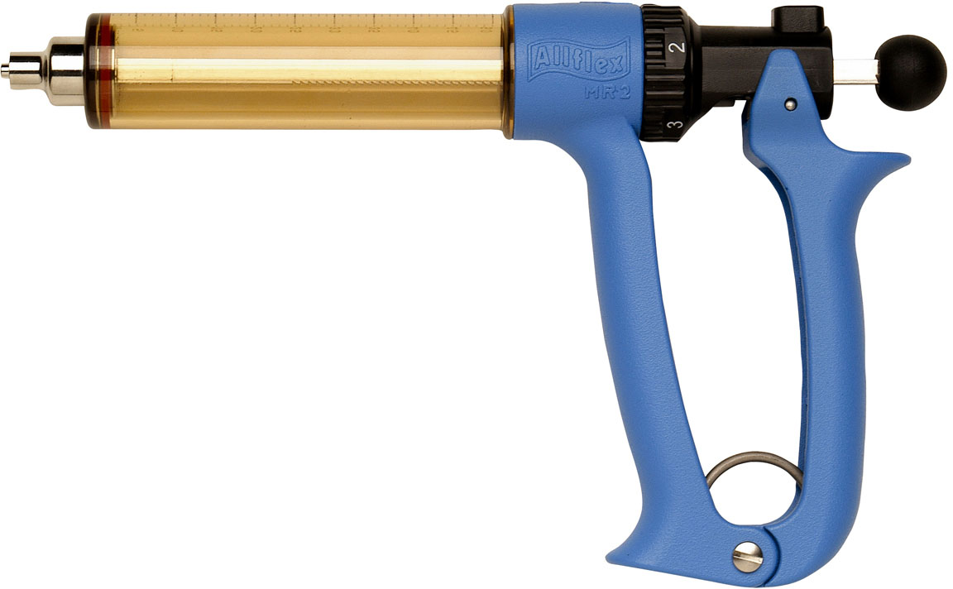
Syringe- automatic, multidose

Slide 27
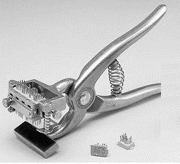
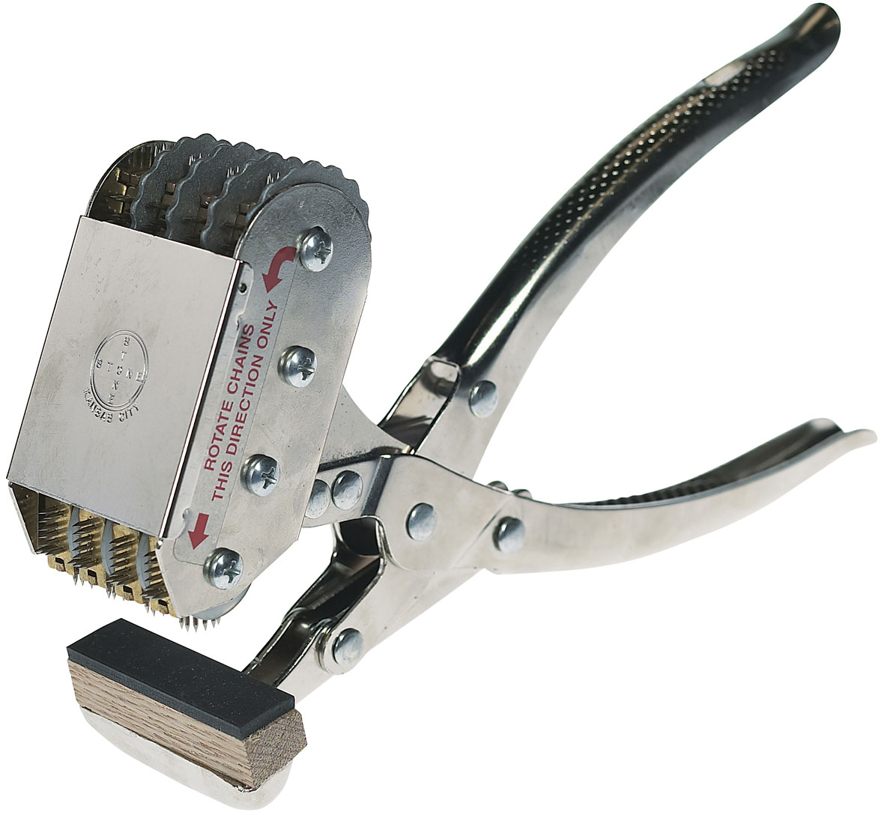
Tattooing Instrument- small and large

Slide 28
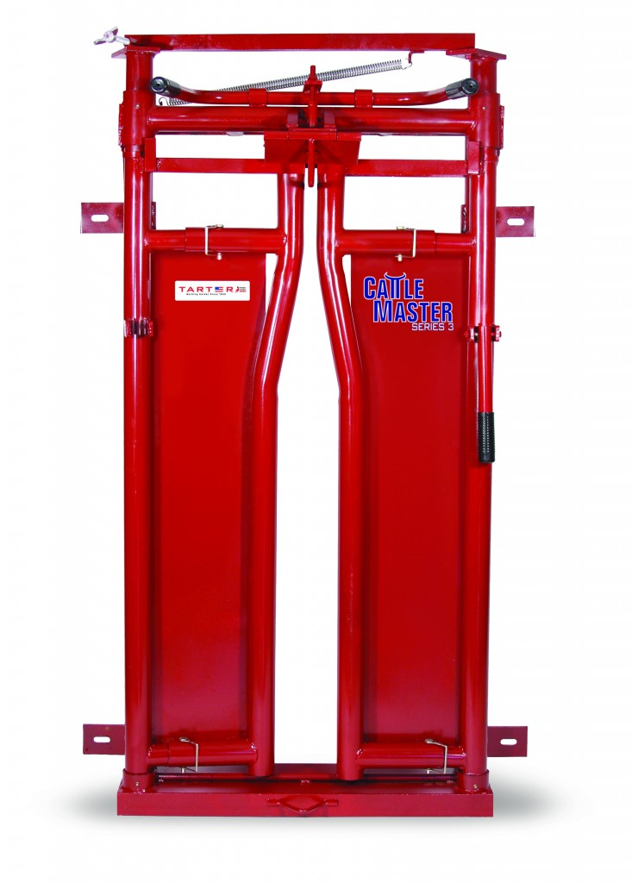
Headgate

Slide 29
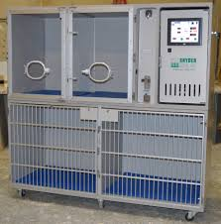
Small Animal Oxygen Cage

Slide 30
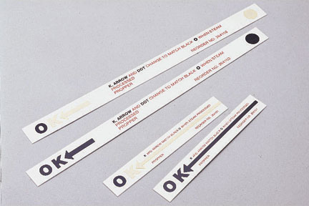
Autoclave Tape Indicator

Slide 31
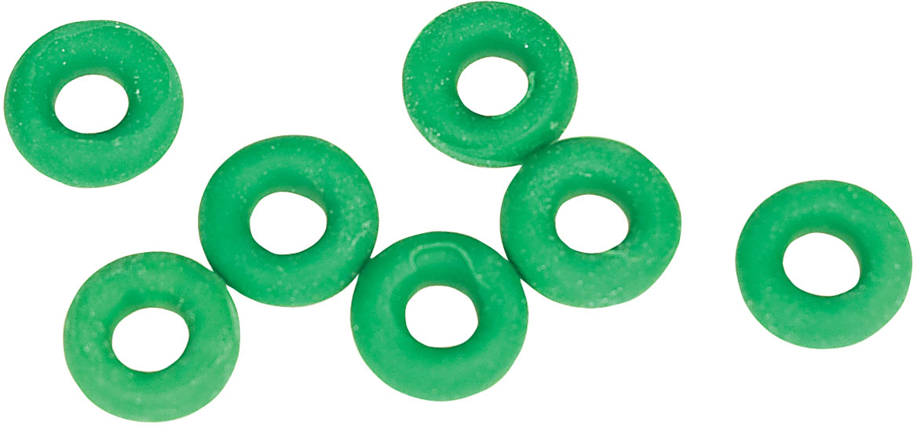
Bands (castration or docking)

Slide 32
Pig Tooth Nippers

Slide 33
Staple Remover

Slide 34
Ambubag

Slide 35
Balling Gun

Slide 36
Hog Snare

Slide 37
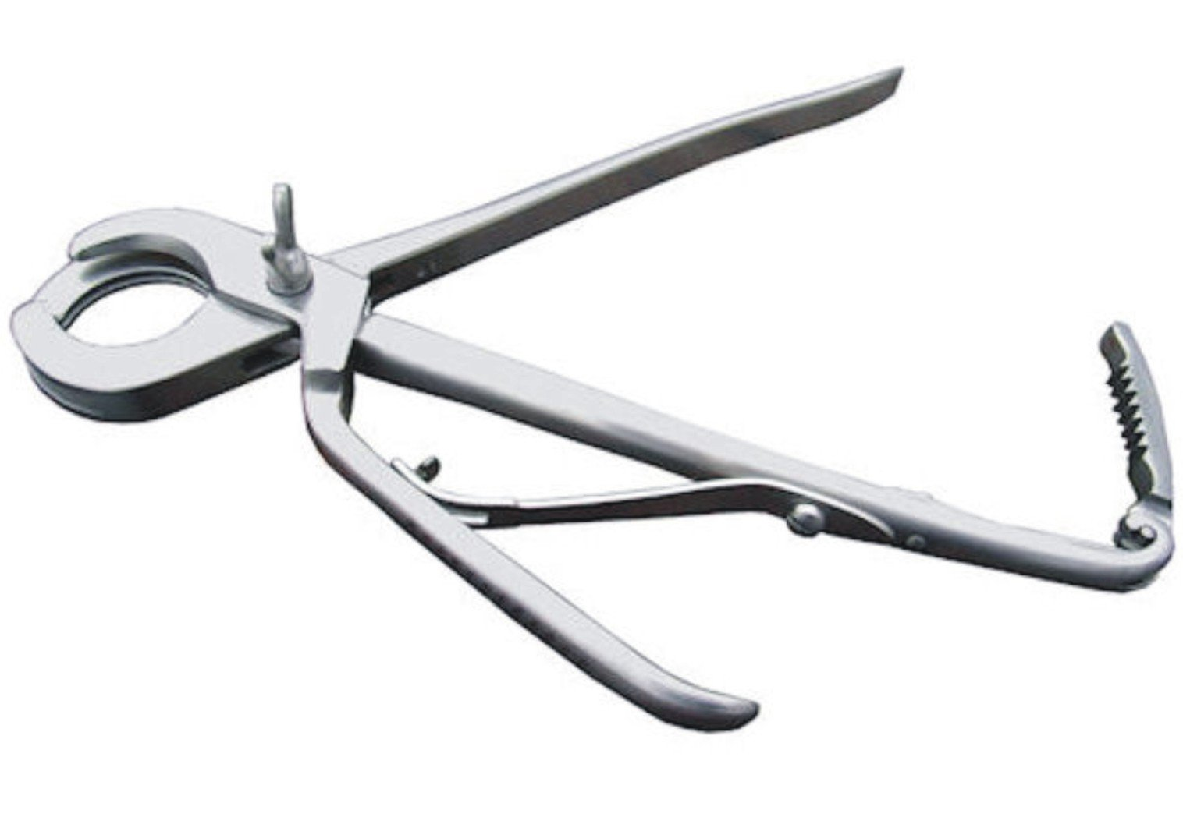
Emasculator

Slide 38
Dehorner- Barnes

Slide 39
Feeding Tube for small animals

Slide 40
Gravity Feeder and tube

Slide 41
Hoof Rasp

Slide 42
Twitch- Humane

Slide 43
Endoscope

Slide 44
Forceps- Babcock tissue

Slide 45
Laparoscope

Slide 46
Scissors- Suture wire cutting

Slide 47
Fecal Loop

Slide 48
Speculum- Small Animal Oral

Slide 49
Speculum- Vaginal

Slide 50
Suture needle- cutting

Slide 51
Suture needle- taper

Slide 52
Tonometer

Slide 53
Tourinquet

Slide 54
Trocar and cannula

Slide 55
Fetal extractor- calf

Slide 56
Forceps- Alligator

Slide 57
Scissors- Bandage

Slide 58
Scissors- Lister Bandage

Slide 59
Scissors- Littauer suture removal

Slide 60
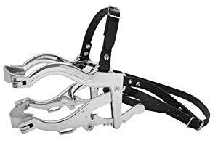
Speculum- Large Animal Oral

Slide 61
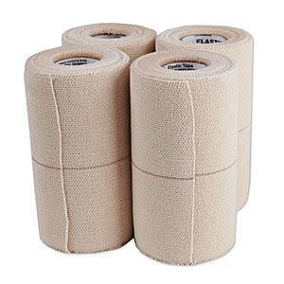
Bandaging Material- Elasticon

Slide 62
Drench Gun- small ruminent

Slide 63
Rectal Prolapse Ring-swine

Slide 64
Bandaging Material- Roll Gauze

Slide 65
Bandaging Material- Vetwrap

Slide 66
Catheter- Butterfly

Slide 67
Catheter- IV

Slide 68
Cold Sterile Tray

Slide 69
Scissors- Mayo Dissecting

Slide 70
Scissors- Metzenbaum

Slide 71
Needle Holders- Mayo Hegar

Slide 72
Needle Holders- Olsen Hegar

Slide 73
Forcep- Brown Adson Thumb

Slide 74
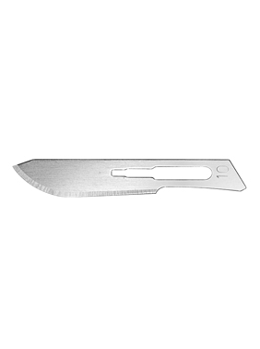
Scalpel Blade

Slide 75
Forcep- Rat Tooth Thumb

Slide 76
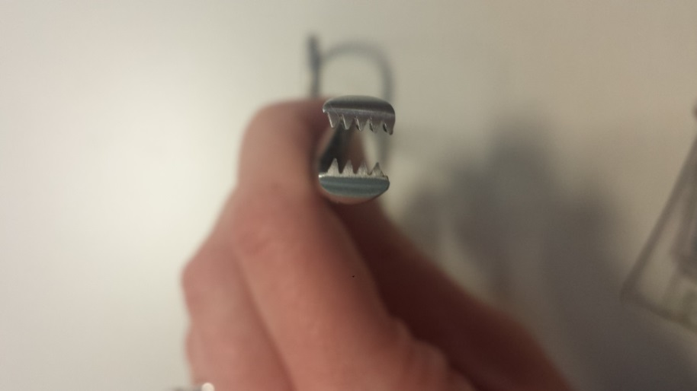
Forcep- Allis Tissue

Slide 77
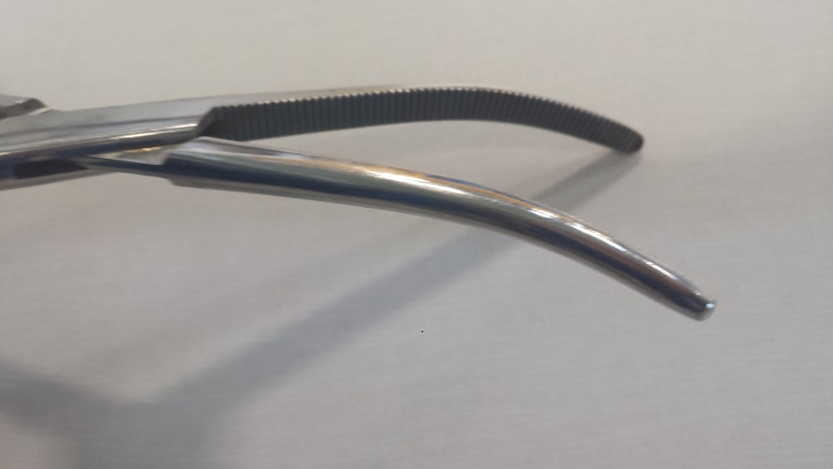
Forcep- Crile

Slide 78
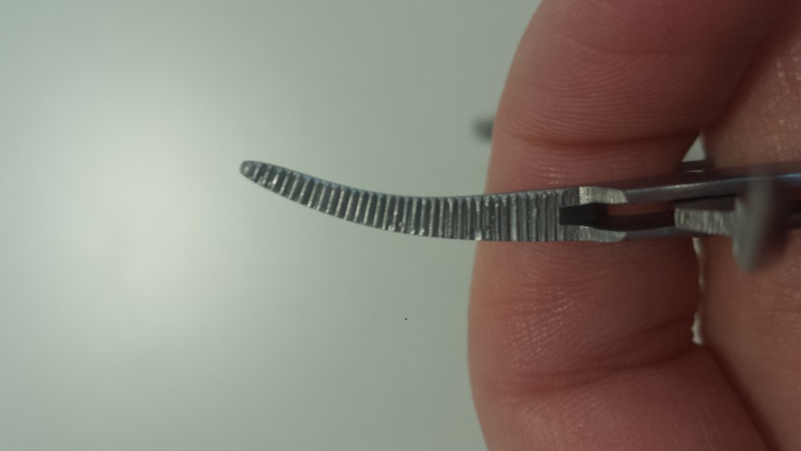
Forceps- Halstead Mosquito Hemostatic
(very small)

Slide 79
Forceps- Kelly Hemostat
Ridges half way

Slide 80
Backhaus Towel Clamp

Slide 81
Snook Hook

Slide 82
Scalpel Handle

Slide 83
Chemical Indicator Strip

Slide 84
radiology personal protective equipment

Slide 85
Stethoscope

Slide 86
Muzzle- Nylon

Slide 87
Cat Bag

Slide 88
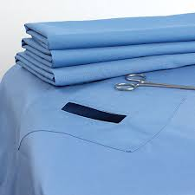
Surgical Drapes

