Slide 1
Hound Group

Slide 2
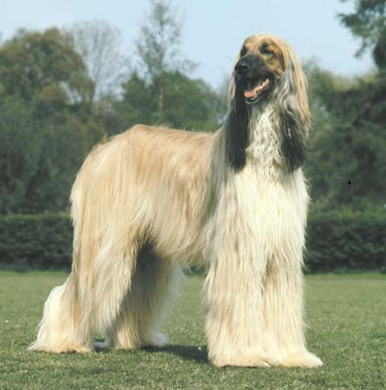
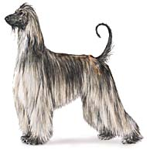
1. Greyhound
2. Afgan
3. Borzoi

Slide 3
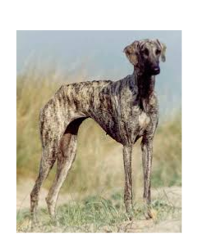
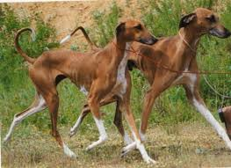
1. Saluki
2. Sloughi
3. Treeing Walker Coonhound

Slide 4
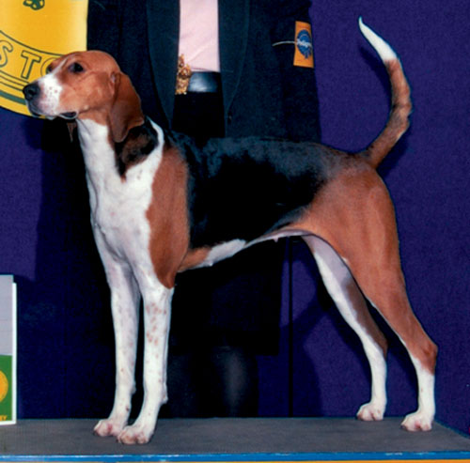
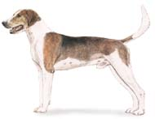
1. American Fox Hound
2. Beagle
3. Bloodhound

Slide 5
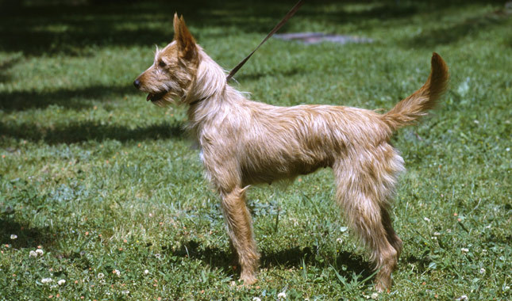
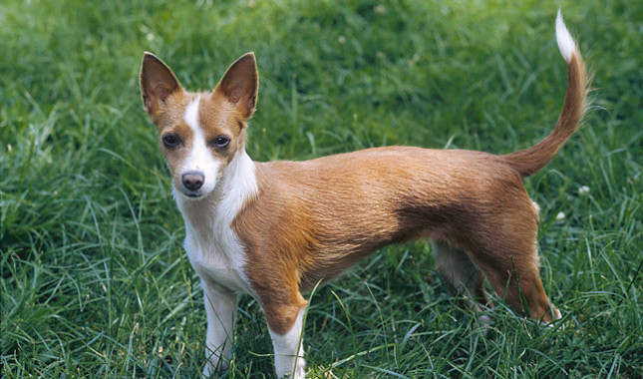
1. Briard
2. Miniature Coonhound
3. Portuguese Podengo Pequeno

Slide 6
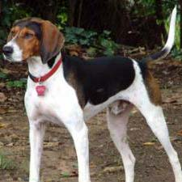
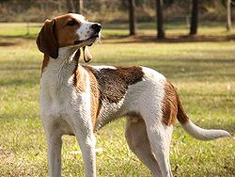
1. Treeing Walker Coonhound
2. Bluetick Coonhound
3. Redbone Coonhound

Slide 7
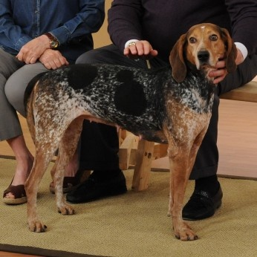
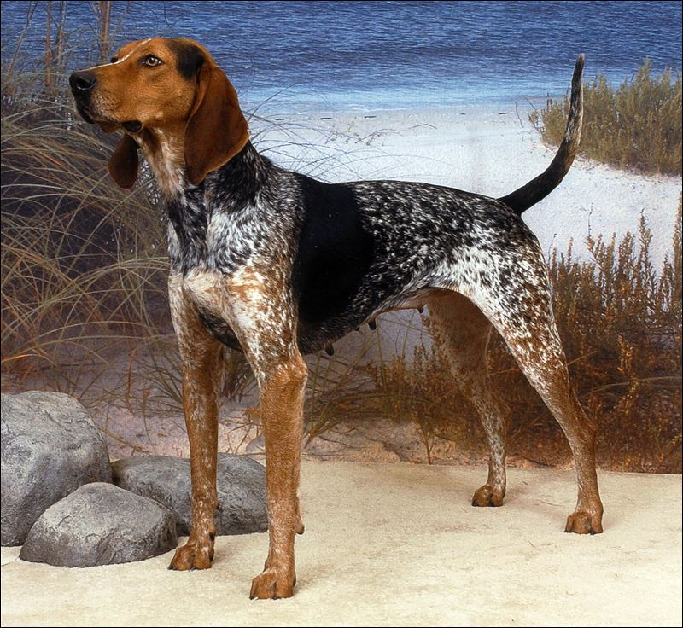
1. Beagle
2. Bloodhound
3. American English Coonhound

Slide 8
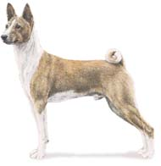
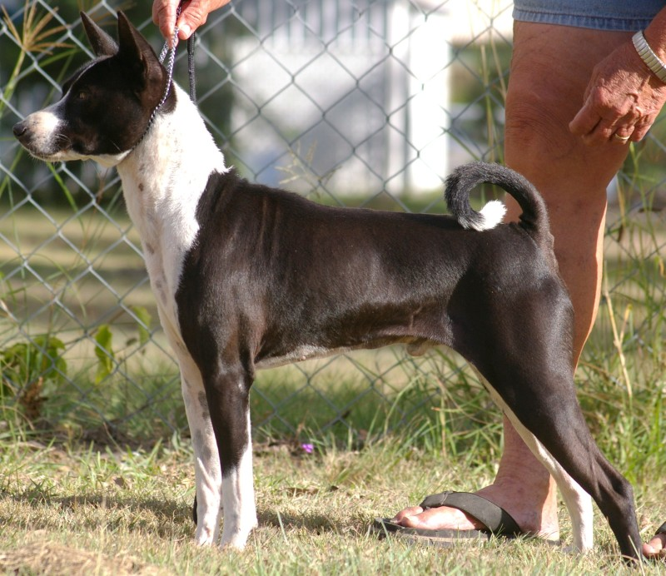
1. Pharoah Hound
2. Finnish Spitz
3. Basenji

Slide 9
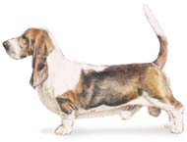
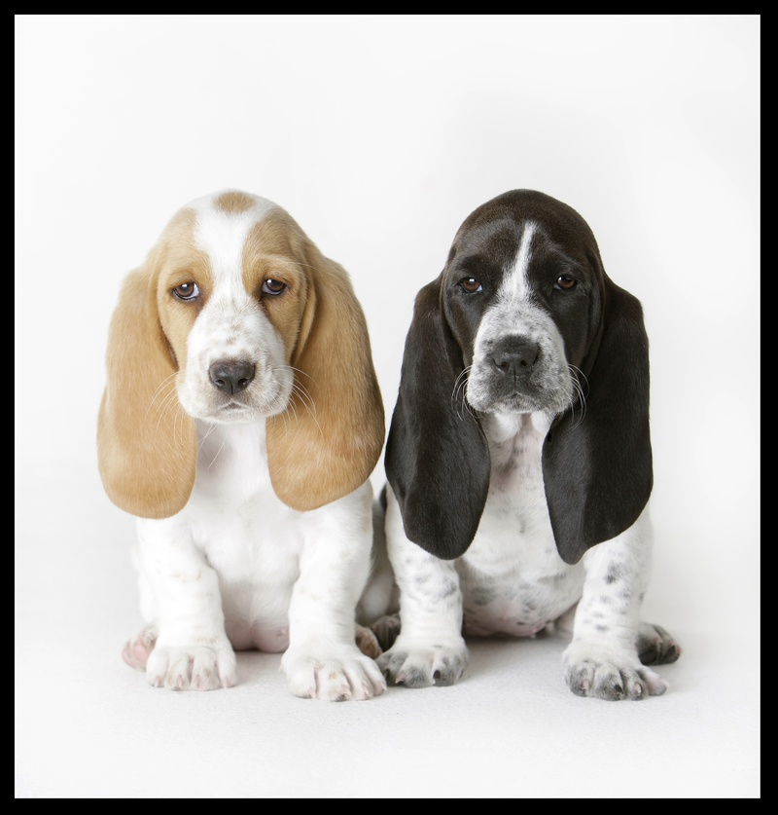
1. Basset Hound
2. Clumber Spaniel
3. Beagle

Slide 10
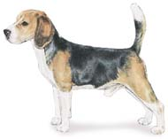
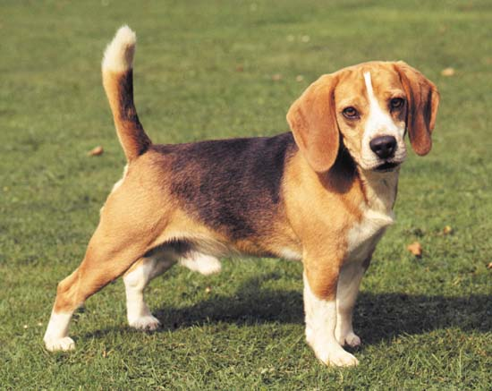
1. Petit Basset Griffon Vendeen
2. Beagle
3. English Fox Hound

Slide 11
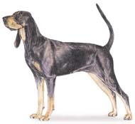
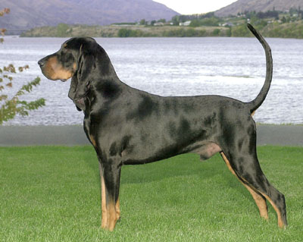
1. Gordon Setter
2. Black and Tan Coonhound
3. Redboned Coonhound

Slide 12
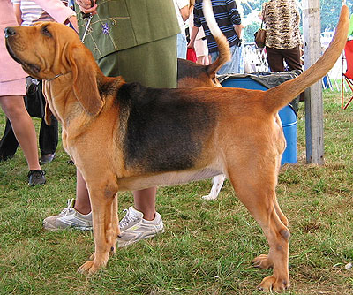
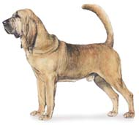
1. American Fox Hound
2. Pharoah Hound
3. Bloodhound

Slide 13
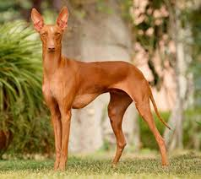
1. Bloodhound
2. Greyhound
3. Cirneco dell Etna

Slide 14
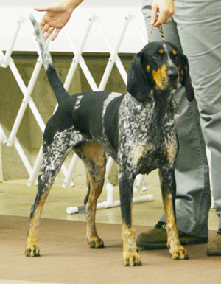
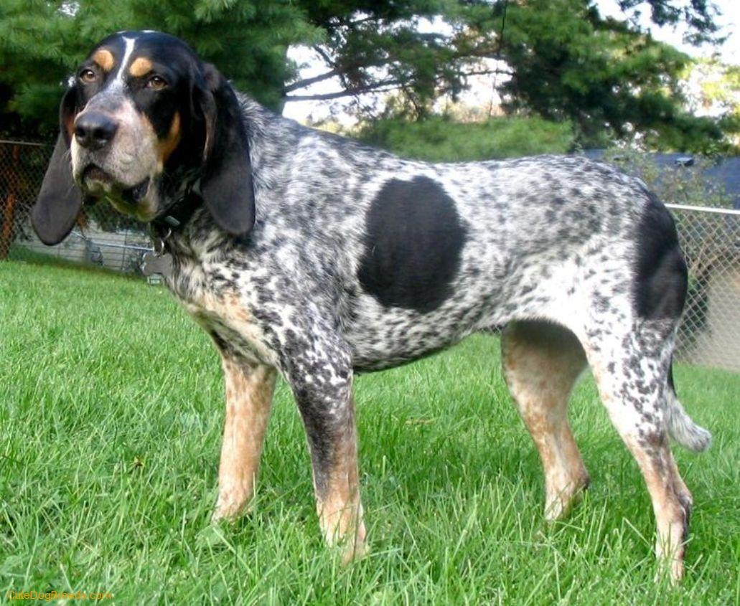
American Coonhound
Redboned Coonhound
Bluetick Coonhound

Slide 15
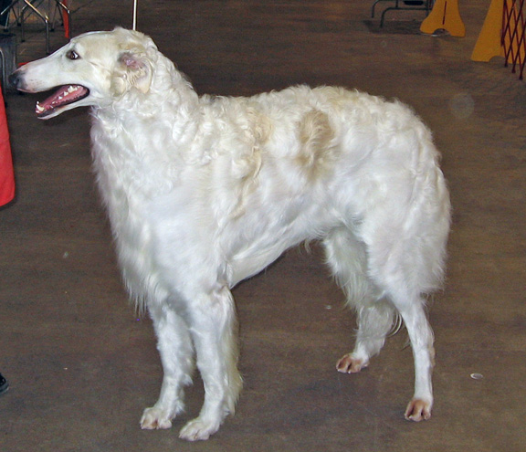
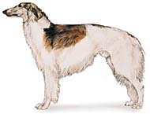
Greyhound
Borzoi
Afgan

Slide 16
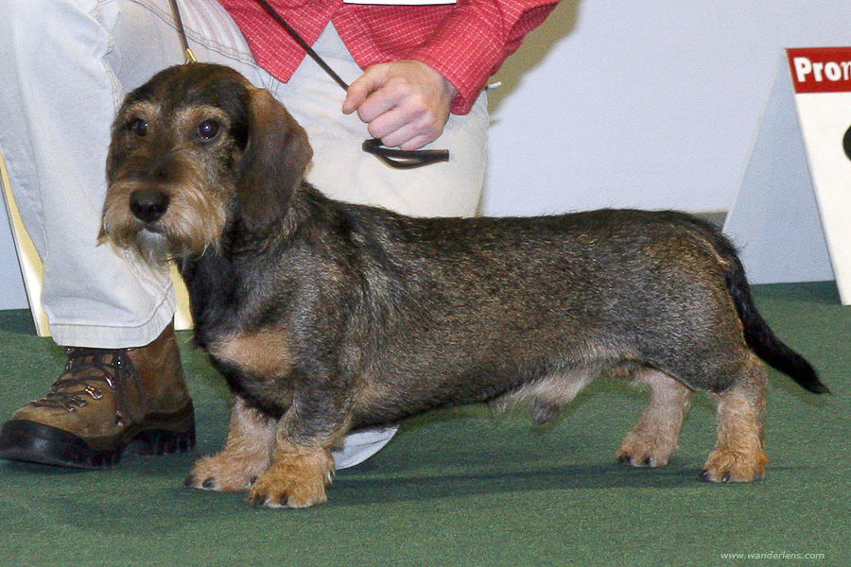
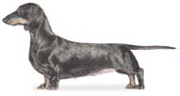
Dachshund
Otter hound
Corgi

Slide 17
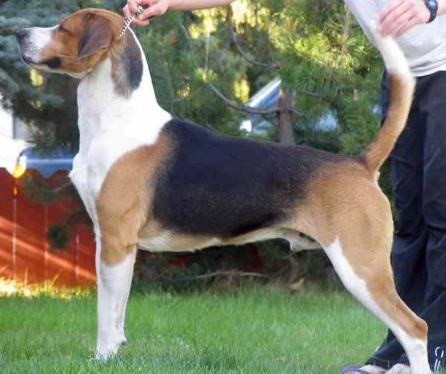
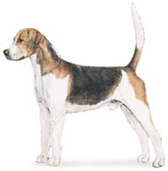
Harrier
English Fox Hound
Plott Hound

Slide 18
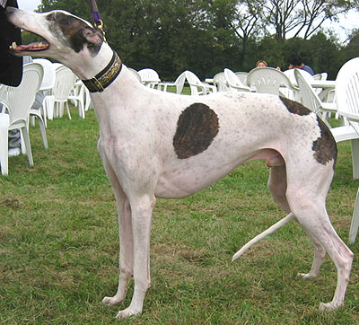
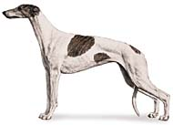
Greyhound
Borzoi
Bluehound

Slide 19
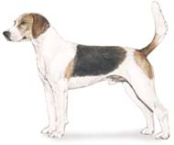
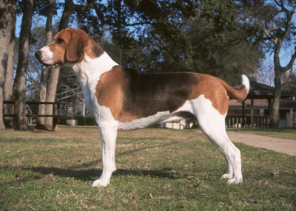
American Fox hound
Harrier
Bluetick Coon Hound

Slide 20
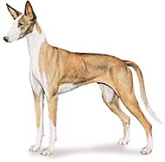
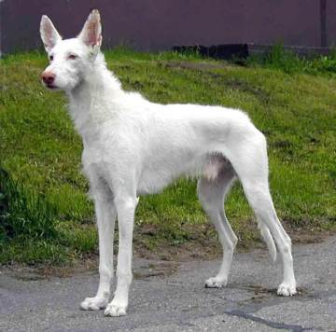
Greyhound
Ibizan Hound
Whippet

Slide 21
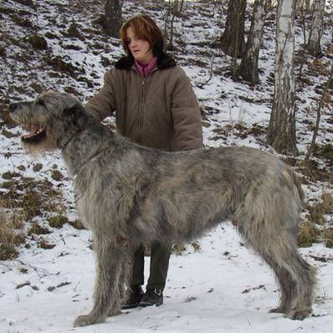
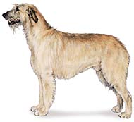
Otterhound
Irish Wolfhound
Elkhound

Slide 22
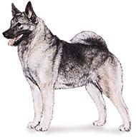
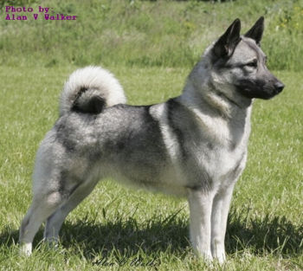
Norwegian Elkhound
Afghan Hound
Husky

Slide 23
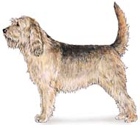
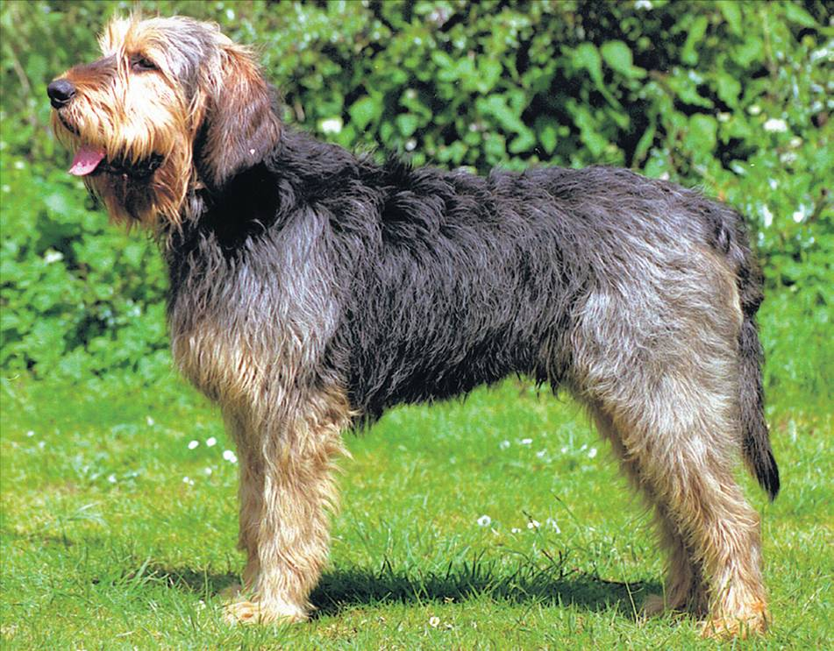
Otterhound
Black and Tan Coonhound
Petit Basset Griffon Vendeen

Slide 24
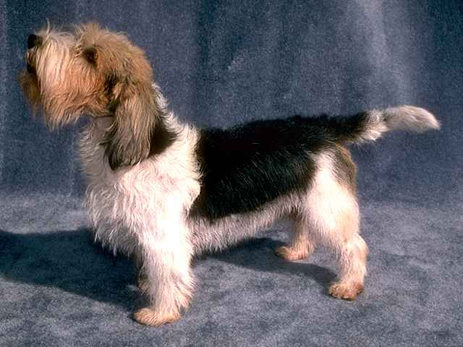
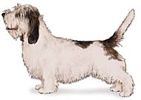
Ibizan hound
Petit Basset Griffon Vendeen
Long haired pointing spaniel

Slide 25
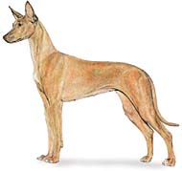
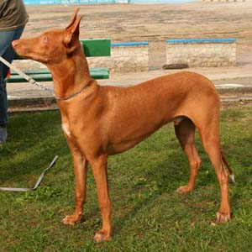
Pharaoh Hound
Redboned Coonhound
Vizsla

Slide 26
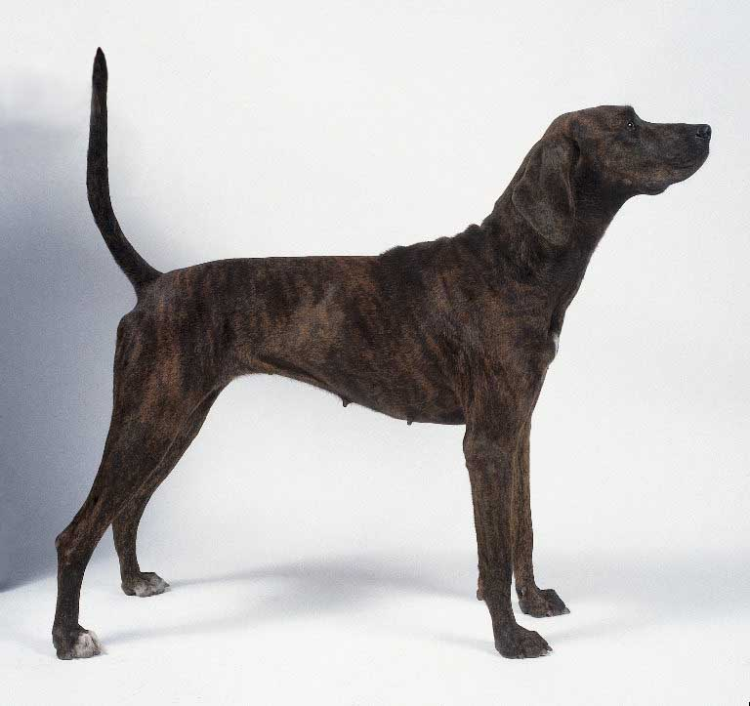
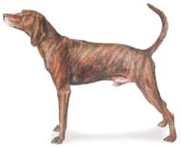
Plott
Pharoah Hound
Bloodhound

Slide 27
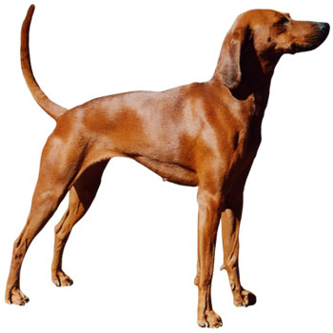
Plott
Redboned Coonhound
Blueticked Coonhound

Slide 28
Redbone Coonhound
Rhodesian Ridgeback
Plott hound

Slide 29
Whippet
Saluki
Borzoi

Slide 30
Otterhound
Scottish Deerhound
Elkhound

Slide 31
Whippet
Rhodesian Ridgeback
Saluki

Slide 32
Borzoi
Grand Basset Griffon Vendeen
Afghan

Slide 33
Citations
Kramer, Eva Maria. Portuguese Podengo. Digital image. Www.vetstreet.com, n.d. Web. 16 Dec. 2014.
Treeing Walker Coonhound. Digital image. Www.wikipedia.com. N.p., n.d. Web. 16 Dec. 2014.

