Slide 1
Laws and Ethics
Veterinary Assistant Program, Level 2

Slide 2
Ethics
Definition:
the system of moral principals that determines appropriate behavior and actions within a specific group (Sirois, Margi. "1." Elsevier's Veterinary Assisting Textbook. St. Louis, MO: Elsevier/Mosby, 2013. 15-19. Print. )
https://www.youtube.com/watch?v=K9-Qz5smw8U

Slide 3
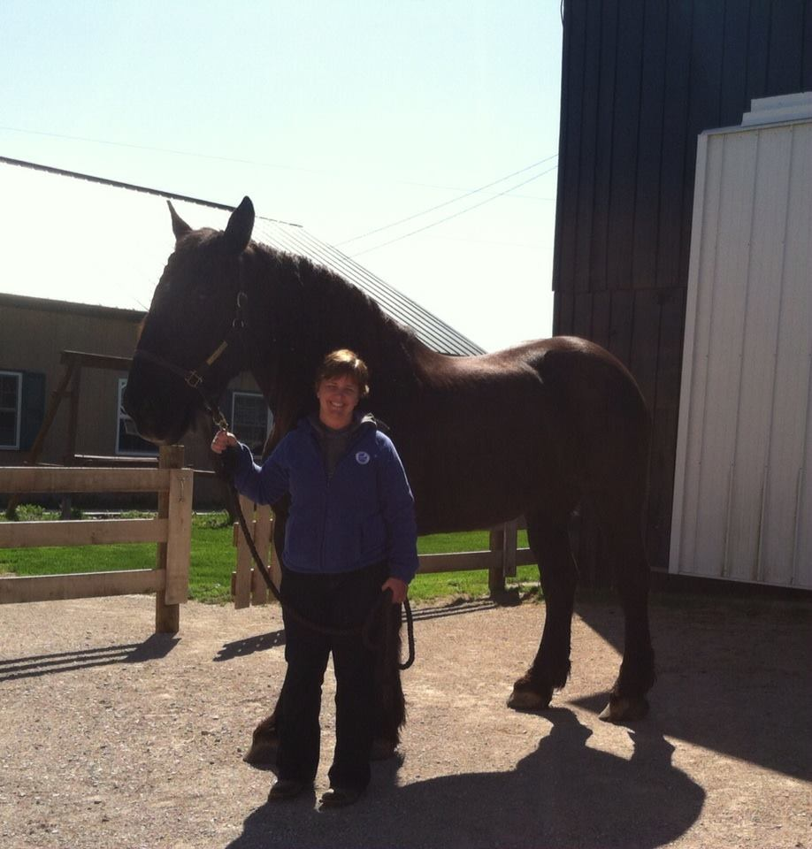
Before

Slide 4
Ethics Cont.
How does this apply to the care of animals?
Treating animals with care, we are their guardians
Human-animal bond
Animal Rights vs Animal Welfare

Slide 5
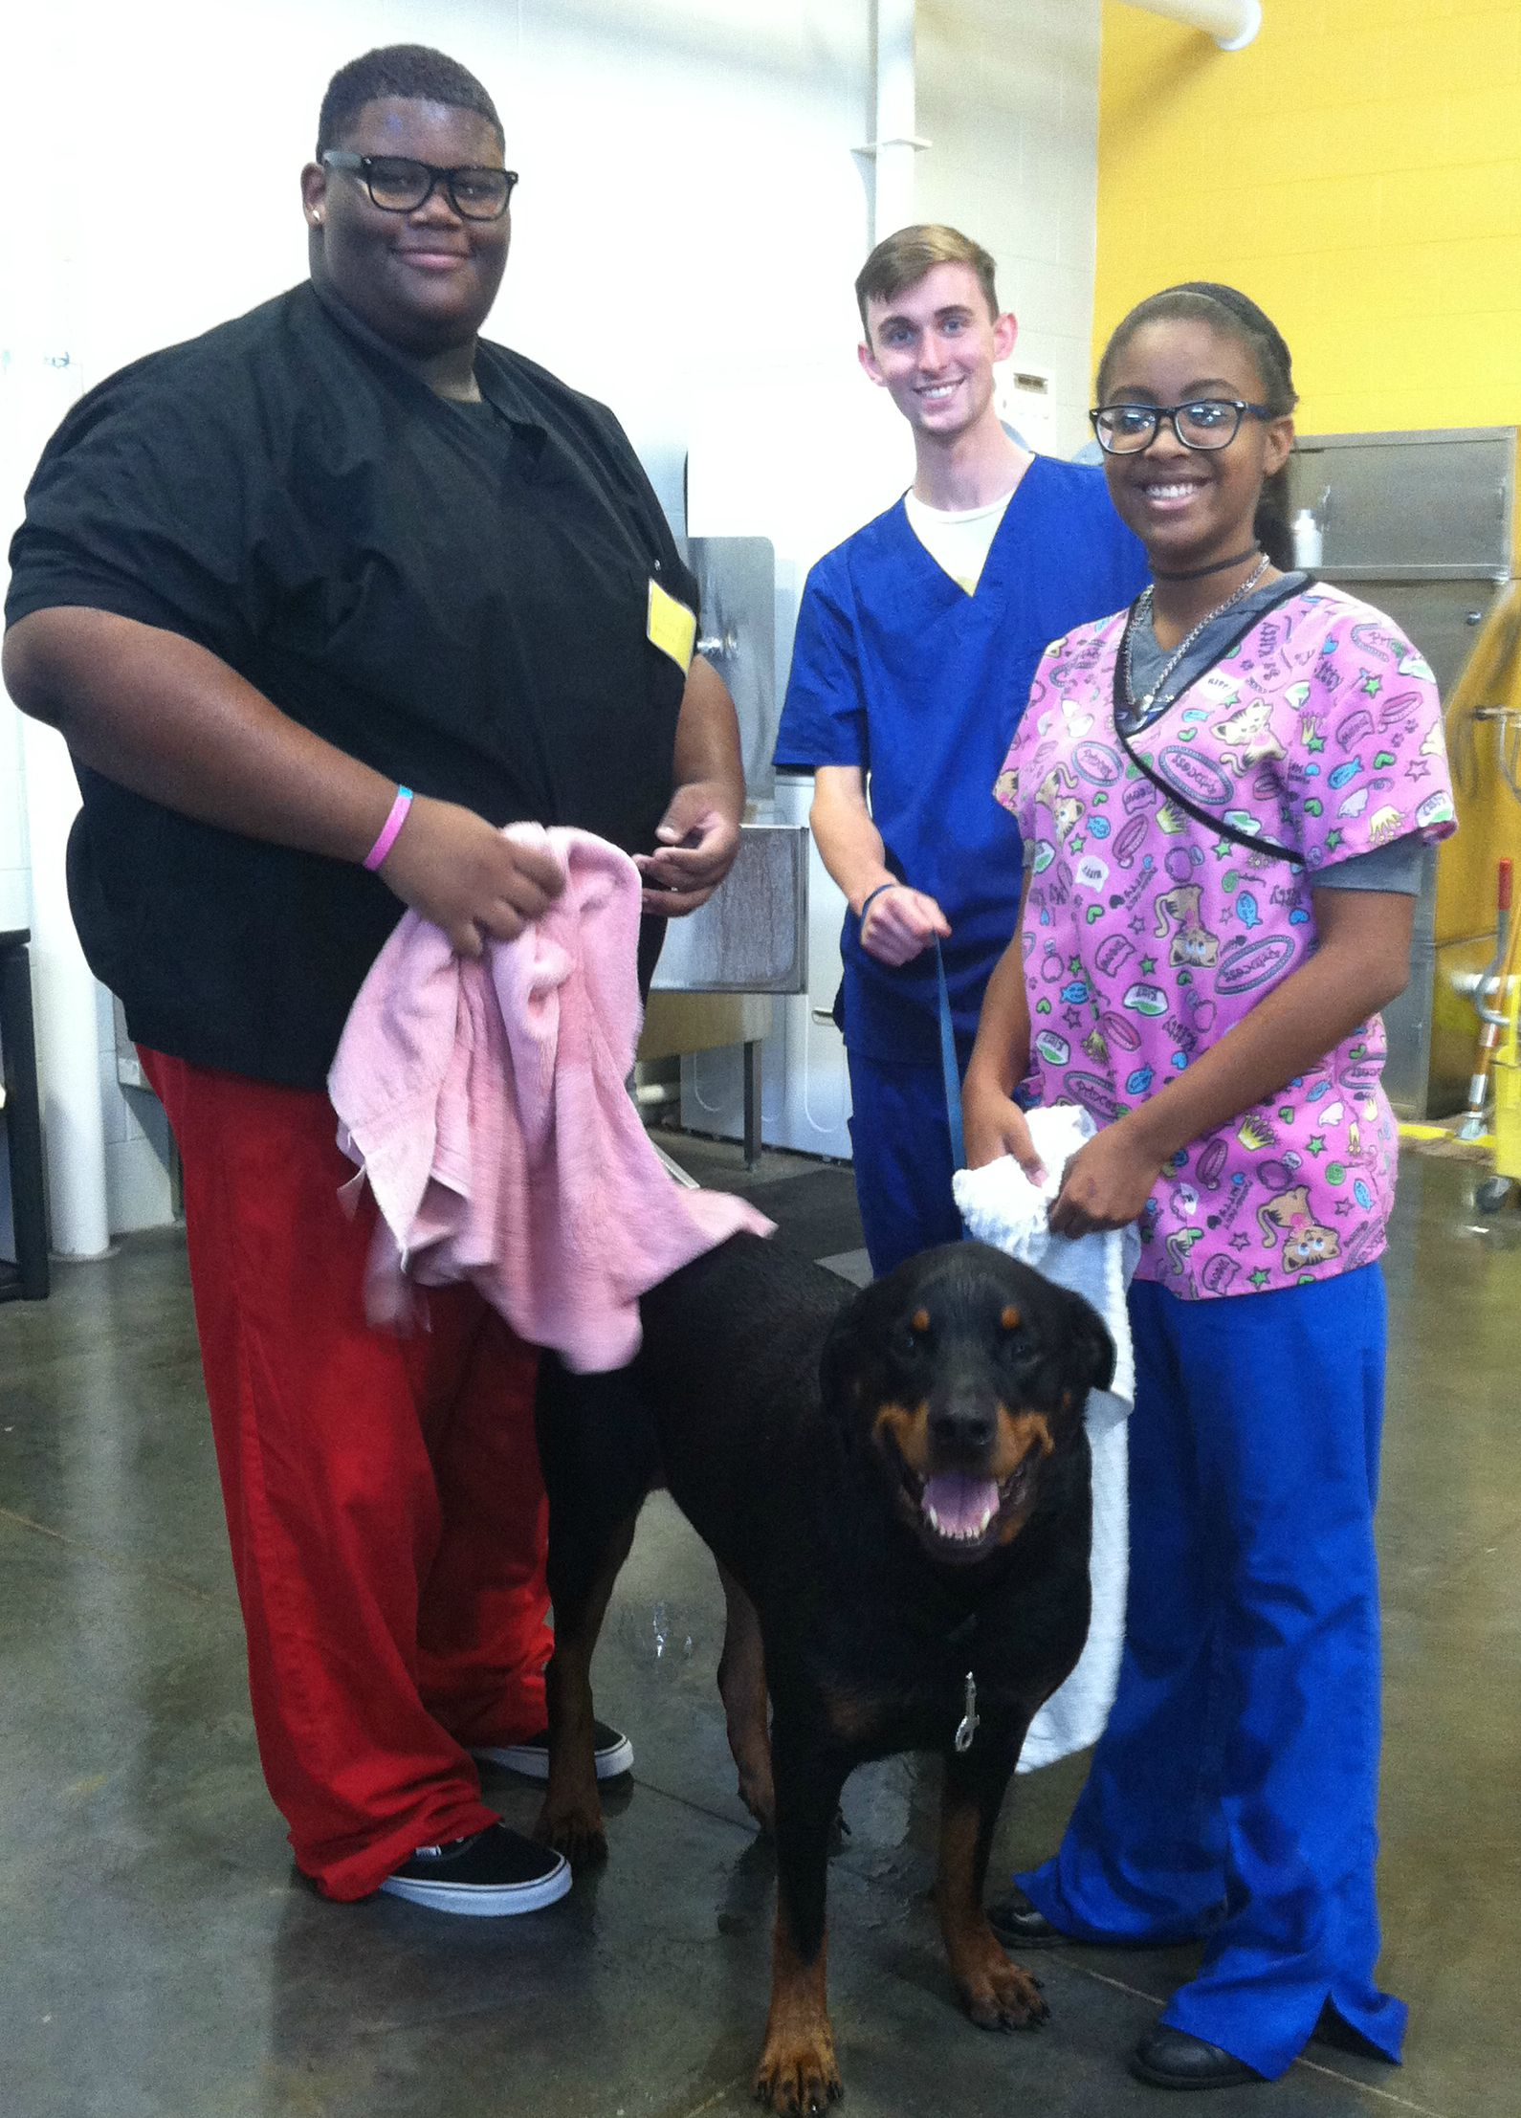
Ethics in the Veterinary Workplace
Professional Judgement
Acting as professionals
Honest, communicate well
Negatives
Slander
Malpractice/negligence

Slide 6
Ethics and Law Enforcement in Veterinary Medicine
Veterinary Practice Act
State Laws that apply to veterinary professionals- all staff
Enforced by the Board of Veterinary Examiners – each state has one
Certify veterinarians and veterinary technicians
Fines, retraining, suspension
http://www.bve.ky.gov/Pages/default.aspx

Slide 7
Laws
4 categories
Federal Law, State, Local/municipal law- Legislative or written laws
Enforced by governmental authorities/agencies – which ones?
Common law
Legal interpretation, enforced by the citizens filing lawsuits

Slide 8
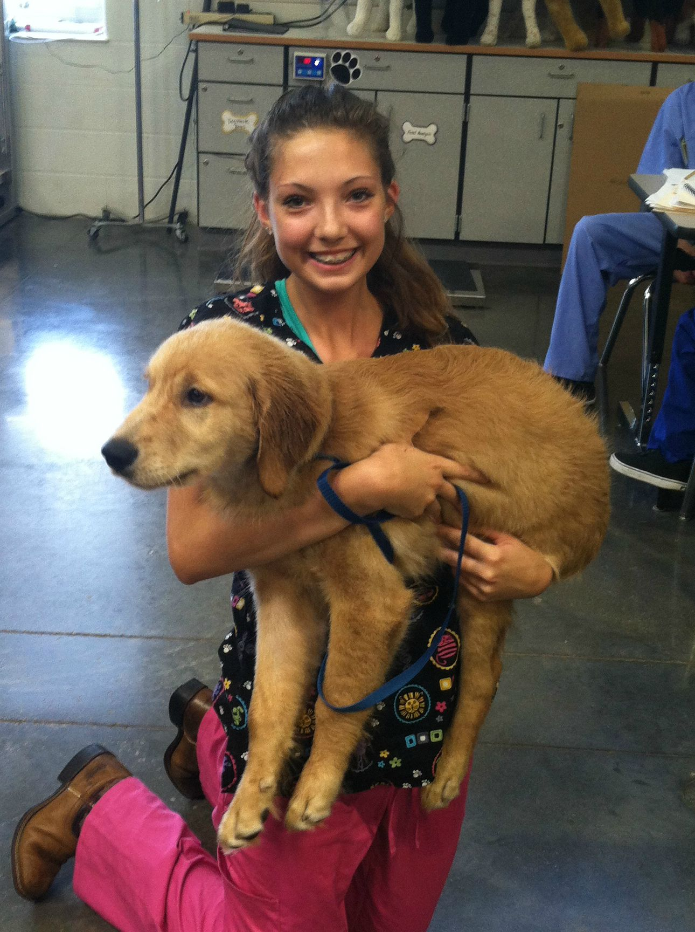
2 Categories of Laws
Laws that ensure every patient receives quality service
Laws that provide a non-hostile and safe environment
for employees, clients and the public

Slide 9
Quality Service for Patients
State Practice Act
Licensing qualifications and certification
Definitions of professional roles:
Limits or definitions of procedures and who can perform them
Practice Act Terms:
Immediate Supervision- doctor is within eyesight of the staff member
Direct Supervision- doctor is in the building- available for directions/ help
Indirect Supervision- doctor is available by phone- not in the building

Slide 10
Common Law Malpractice
Negligence or Malpractice- doctor did not follow standard practice (set by AVMA)
For a client to sue a doctor:
The vet agreed to treat the patient
The vet failed to follow the established techniques when treating the patient
The negligence caused harm to the patient
** Also applies to Licensed Vet Techs and other veterinary professionals

Slide 11
Employee and Public Safety
Occupational Safety and Health Act (OSHA)- Safety of employees
MSDS
Equal Employment Opportunity
Sue for wrongful termination
Fair Labor Standards Act (FLSA)
Overtime, minimum wage, youth employment

Slide 12
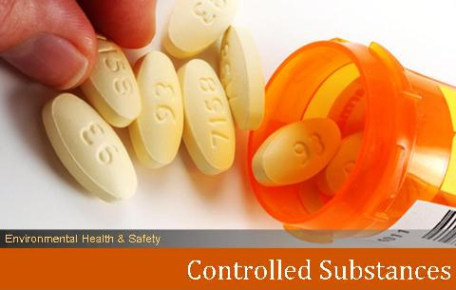
Veterinary Hospital Specific Regulations
Medical Waste Disposal
State and county regulation
Drug Enforcement Agency (DEA)
Regulation of Controlled Drugs

Slide 13
Review
State Veterinary Standards set by whom?
Practice Act
The term ethics means what?
The system of morals and acceptable behavior in a culture
Who enforces the Practice Act?
Veterinary Medical Board of Examiners
What is the difference between a regular drug and a controlled drug?
A controlled drug can cause addiction

