Slide 1
Veterinary Radiology
Safety and Procedures

Slide 2
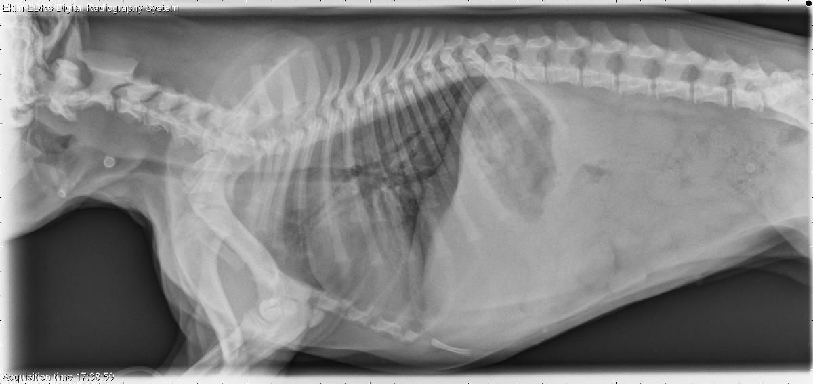
What is a radiograph?
When an xray beam (a form of electromagnetic radiation) penetrates tissue to form a picture

Slide 3
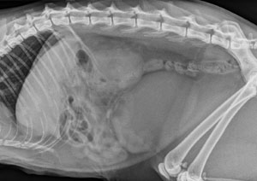
Our Goal….
Safety for animals and personnel
Less radiation because of preparation and training
Diagnostic films the first time

Slide 4
Safety First
Lead: blocks xray beams
Aprons
Glasses
Thyroid shields
Gloves
Placed ON HANDS- not laying over hands

Slide 5
Safety First
Dosimeter
Measures radiation exposure
Should be worn by anyone with increased risk of occupational exposure

Slide 6
Hardware…
Cassettes: hold the film and have an intensifying screen built in, different for different views
Xray machine: needs to be warmed up
Caliper: measures patient for correct settings
Processor: develops radiographs
Labeler: labels radiographs before developed

Slide 7
Hardware
Intensifying Screens:
Smooth, shiny, white inner layer of the film cassette that improves radiographic detail
The screen allow for a lower mAs setting, which decreases the chance of blurriness due to movement, decreases patient radiation exposure, and prolongs the life of the x-ray tube
Cleaning: at least once a month. Use the manufacturer recommended product. If unavailable, use 70% alcohol

Slide 8
Radiology Terminology
Radiopaque
Appearing white to light gray in color
May indicate hard tissue or that exposure was too low
Radiolucent
Appearing black to dark gray
May indicate soft tissue or that exposure was too high

Slide 9
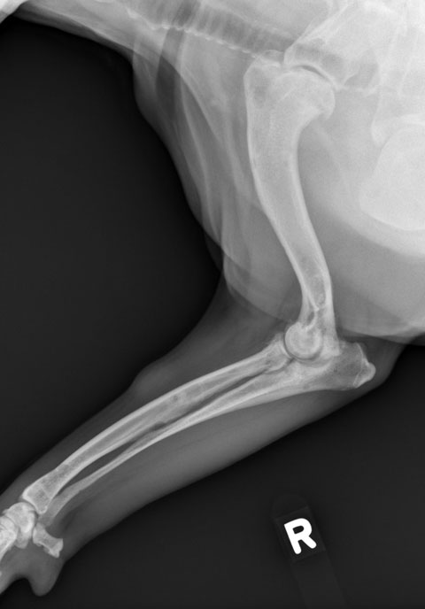
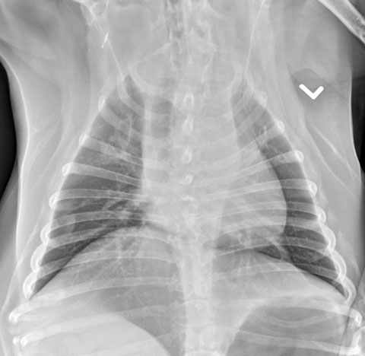
Mechanisms of Xrays…
Xrays pass completely through some things and therefore the film is black
■ air, gas
Other things absorb the xrays creating an image that is variances of white
Metal, bone appear white
Everything else is gray-shades in between
Soft tissue
Organs
Tumors/masses
Food material in digestive tract

Slide 10
3 Factors That Produce a Radiograph
kVP= kilovoltage peak
- the energy (power) or strength of the beam
mA= milliamperage
- quantity of xray beams used
S= seconds
- exposure time: shorter time will reduce blurriness

Slide 11
Radiology Logs
Legally required document
Comparison on techniques for patient follow-up films
Recording quality of film taken
State practice acts outline required information for the log

Slide 12
Technique Chart
List of settings on the machine based upon thickness of area to be exposed
Grid technique
Film not in contact with patient
Radiation source is lower
Tabletop technique
Cassette is in contact with patient

Slide 13
Film Identification
Hospital name, address, and phone number
Veterinarian’s name
X-ray number
Client’s name
Patient’s name
Date
Directional label

Slide 14
Stretch and Reflect
What is kVp?
What is a technique chart?
What material is our PPE made of?

Slide 15
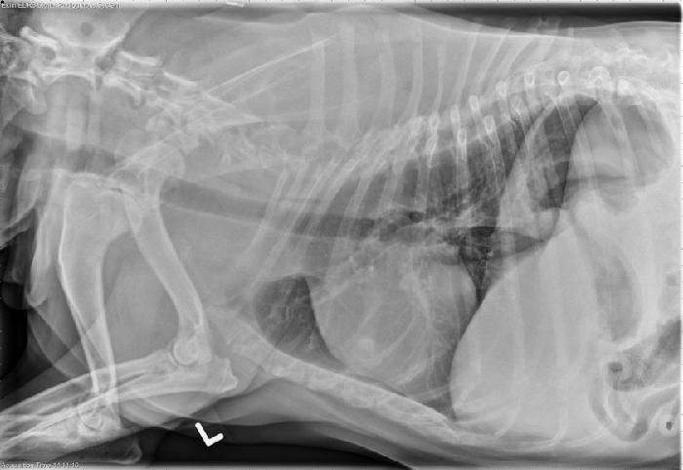
Standard VS. Digital Radiography

Slide 16
Developing Film
Manual
Done by hand
Takes longer
Is less expensive
Automatic
Done by machine
More expensive
Quicker
Better quality

Slide 17
Manual and Automatic
Developing tanks
Developer solution
Left side
Develops the film
Fixer solution
Right side
Fixes film and maintains life of film
Wash tank
Far right
Rids film of chemicals

Slide 18
Digital Processing
Image is transferred to a computer
Image is read on a computer screen
Image quality tends to be better

Slide 19
Radiation Sickness
Radiation will cause:
Birth defects
Aplastic anemia (damage to bone marrow and stem cells)
Degenerative changes in the extremities (necrosis)
Cancer

Slide 20
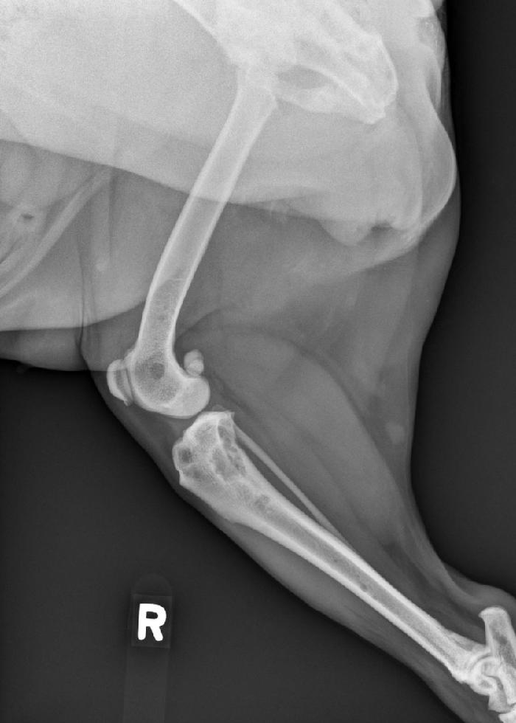
NEVER----
Assist or take a radiograph if you are not wearing protective gear or do not have a badge
Put your hands or other body parts in
a radiograph beam
Forget to prepare before getting your
animal on the table
Leave animal on table alone
Be near radiation if you are pregnant
or nursing

Slide 21
Never…Never….NEVER
Let a client help with taking a radiograph!!!

