Slide 1
Tool ID Part 2

Slide 2
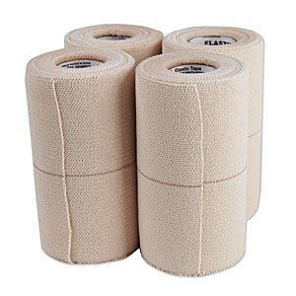
Elasticon

Slide 3
Roll Gauze

Slide 4
Vetwrap

Slide 5
Butterfly catheter

Slide 6
IV Catheter

Slide 7
Cold Sterile Tray

Slide 8
Drench Gun

Slide 9
Endoscope

Slide 10
Fecal Loop

Slide 11
Fetal extractor- calf

Slide 12
Alligator Forceps

Slide 13
Babcock Tissue Forceps

Slide 14
Laparoscope

Slide 15
Rectal Prolapse Ring-swine

Slide 16
Suture wire cutting scissors

Slide 17
Bandage Scissors

Slide 18
Lister Bandage scissors

Slide 19
Littauer suture removal scissors

Slide 20
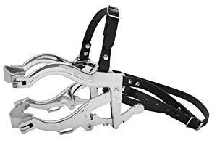
Large Animal Oral Speculum

Slide 21
Small Animal Oral Speculum

Slide 22
Vaginal Speculum

Slide 23
Suture needle- cutting

Slide 24
Suture needle- taper

Slide 25
Tonometer

Slide 26
Tourinquet

Slide 27
Trocar and cannula

