Slide 1
Vet Science CDE
Equipment ID

Slide 2
Basket Muzzle

Slide 3
Urinary Catheter

Slide 4
Centrifuge

Slide 5
Endotracheal tube

Slide 6
Feeding Tube

Slide 7
Gravity Feeder and tube

Slide 8
Hoof Rasp

Slide 9
Humane Twitch

Slide 10
OB Chains and handles

Slide 11
Rumen Magnet

Slide 12
Silver Nitrate Sticks

Slide 13
Squeeze Chute

Slide 14
Balling Gun

Slide 15
Hog Snare

Slide 16
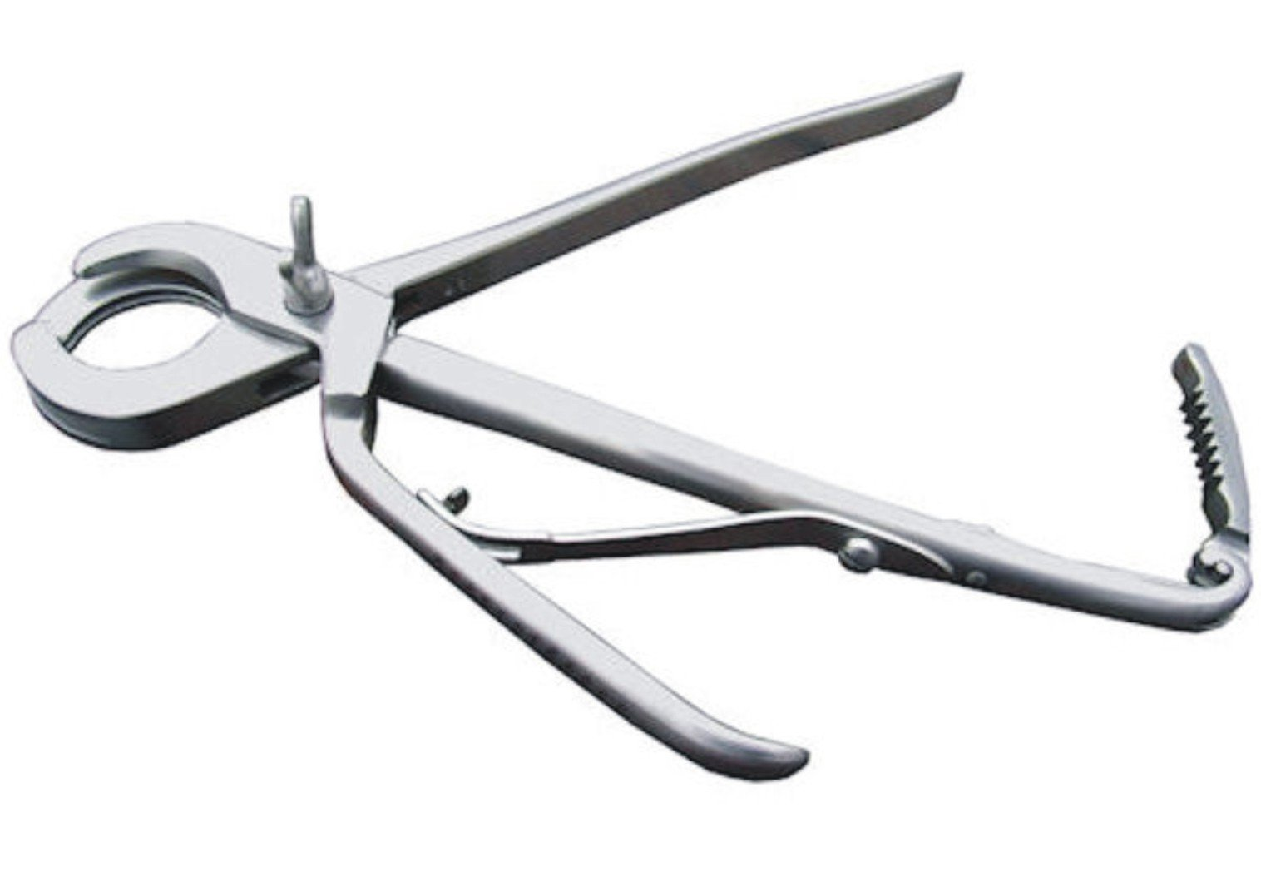
Emasculator

Slide 17
Barnes Dehorner

Slide 18
Elastrator

Slide 19
Hoof Knife

Slide 20
Equine Tooth Float

Slide 21
Chain Twitch

Slide 22
Laryngoscope

Slide 23
Pig Tooth Nippers

Slide 24
Staple Remover

Slide 25
Ambubag

Slide 26
Electric Calf Dehorner

Slide 27
Dental Scaler

Slide 28
Ear Notcher

Slide 29
Fecal Loop

Slide 30
Autoclave

Slide 31
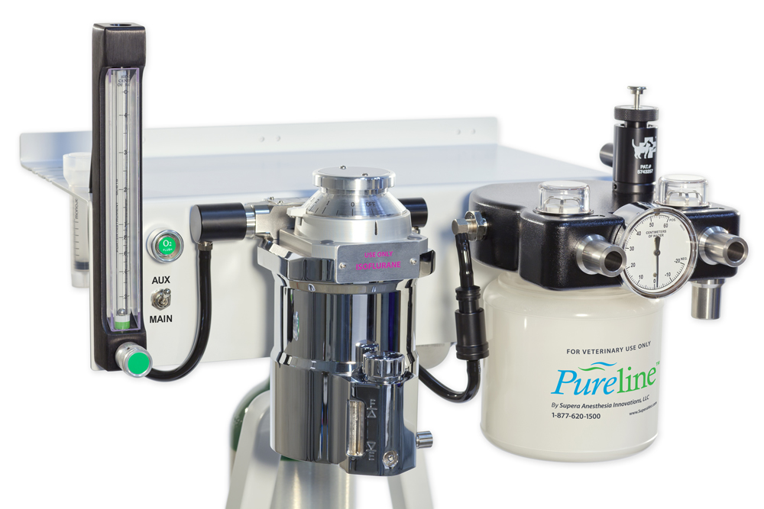
Anesthesia Machine

Slide 32
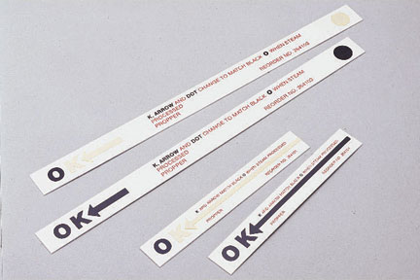
Autoclave Indicator Strip & Tape

Slide 33
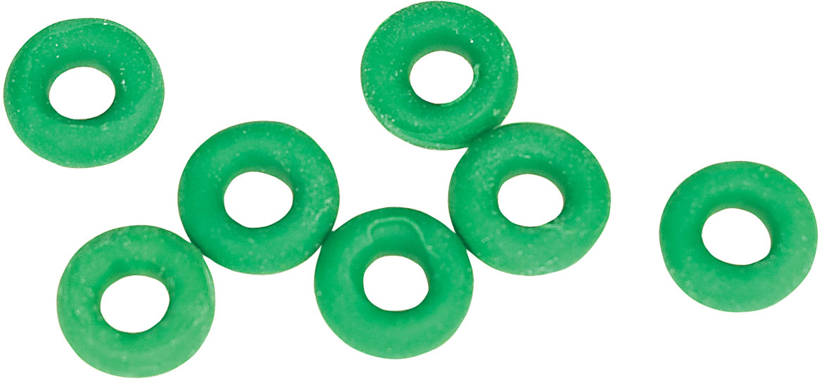
Castration Bands

Slide 34
Catch Pole

Slide 35
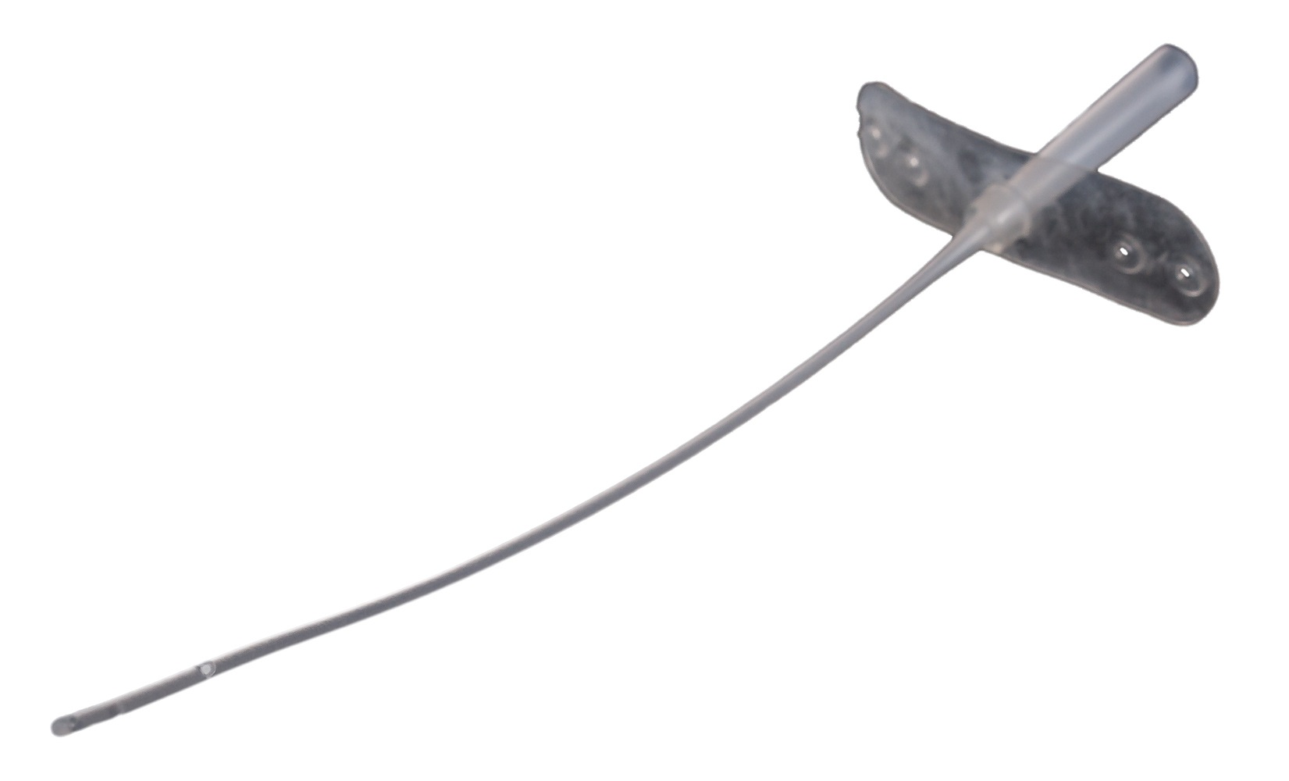
Tomcat catheter

Slide 36
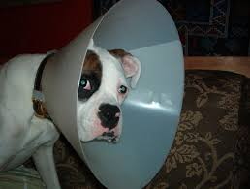
Elizabethan Collar

Slide 37
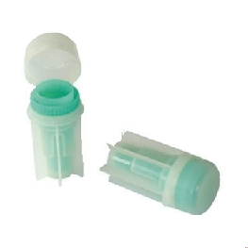
Fecalyzer

Slide 38
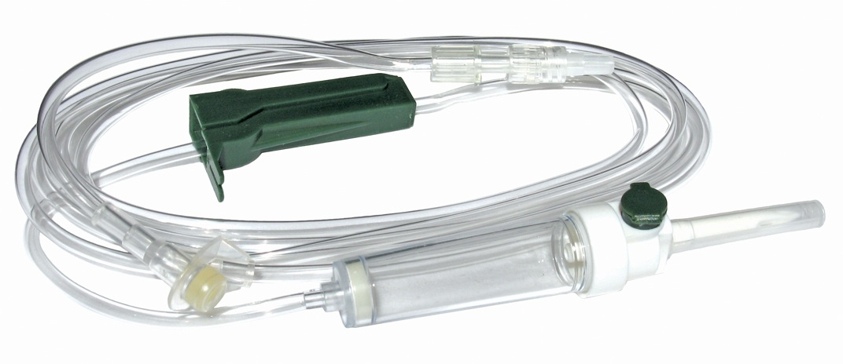
IV administration set

Slide 39
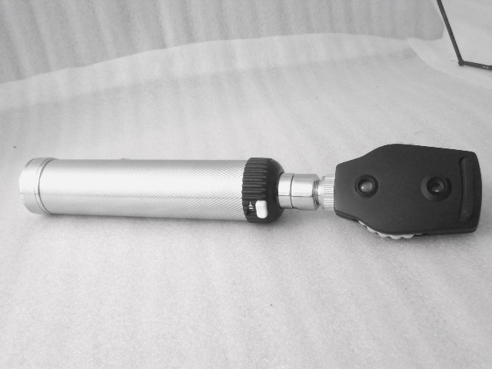
Opthalmascope

Slide 40
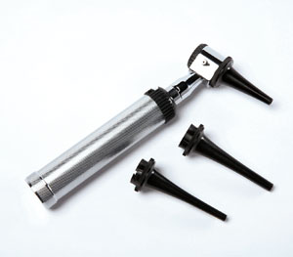
Otoscope

Slide 41
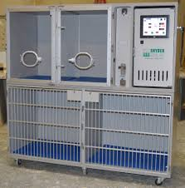
Oxygen Cage

Slide 42
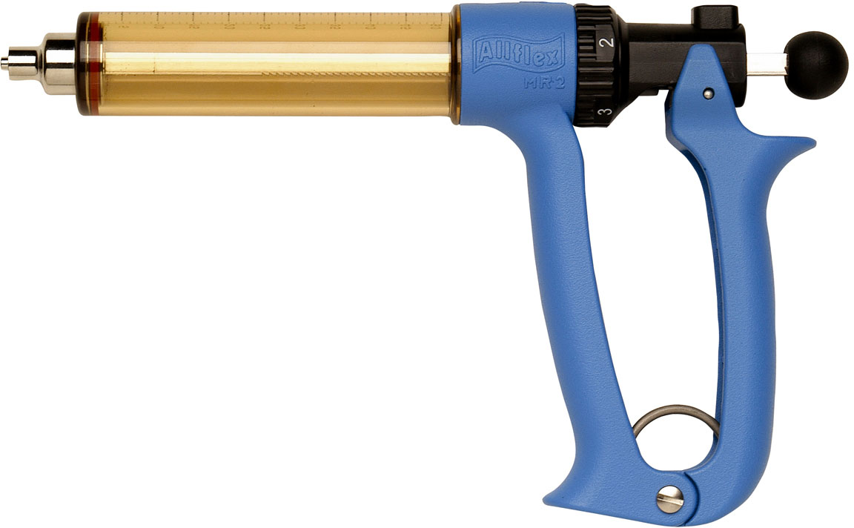
Automatic Multidose Syringe

Slide 43
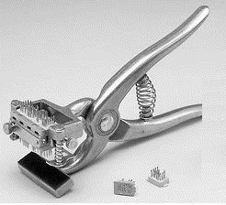
Tattoo Gun- small animal

Slide 44
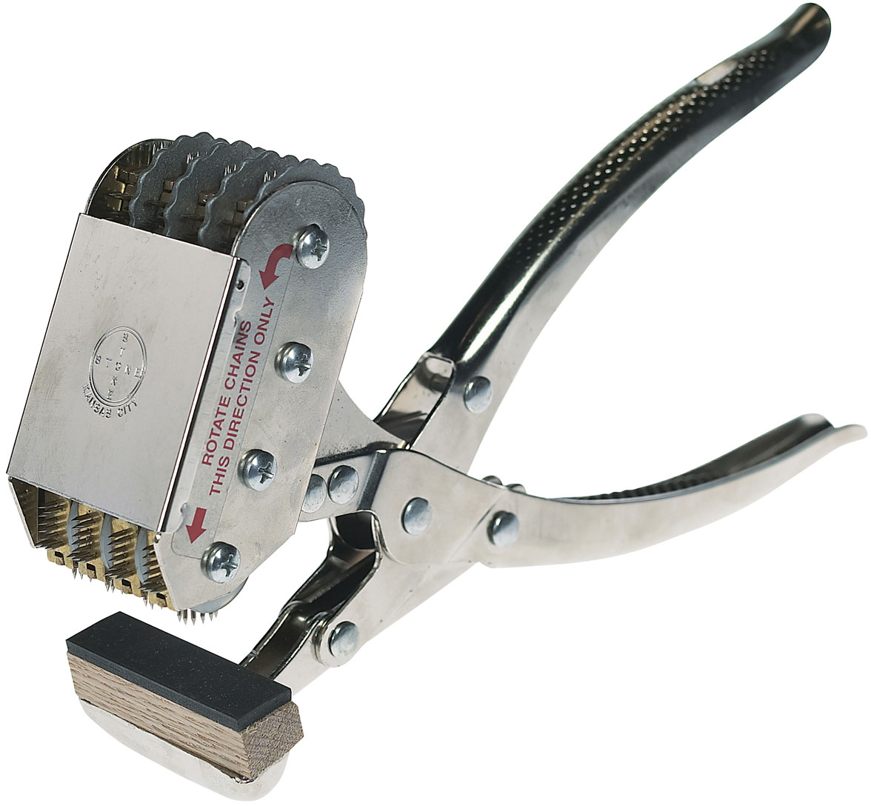
Large Animal Tattoo Gun

Slide 45
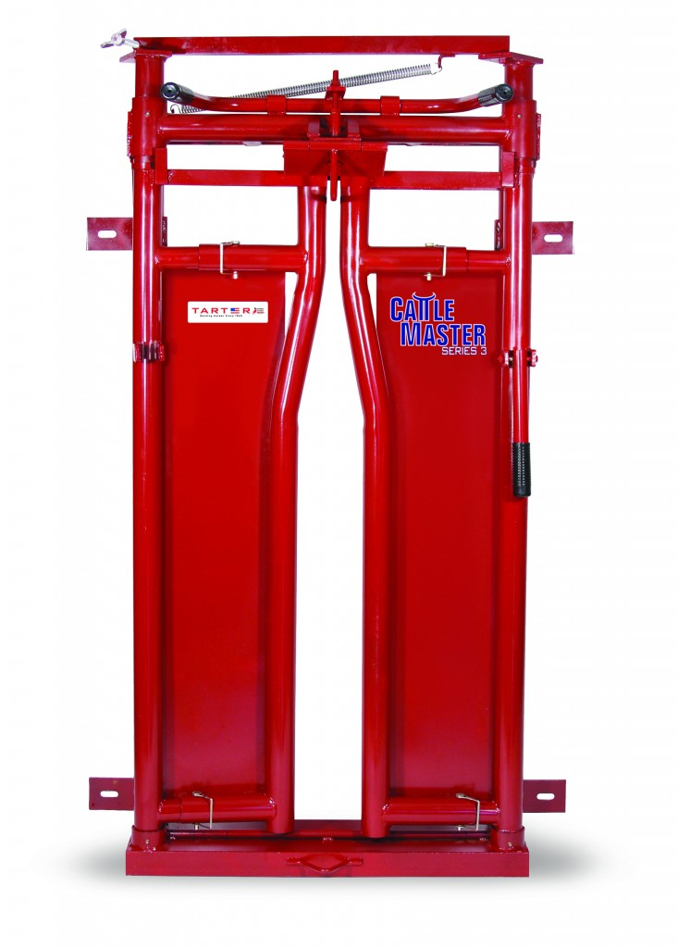
Headgate

