Slide 1
Working Dogs

Slide 2
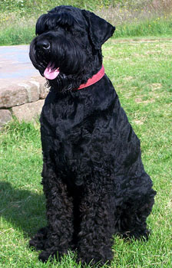
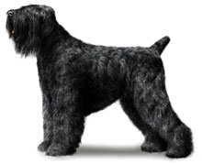
What Working Dog is this?
1. Standard Schnauzer
2. Black Russian Terrier
3. Briard

Slide 3
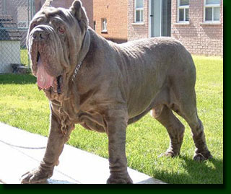
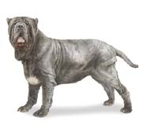
Name this Breed
1. Cane Corso
2. Neopolitan Mastiff
3. Tibetan Mastiff

Slide 4
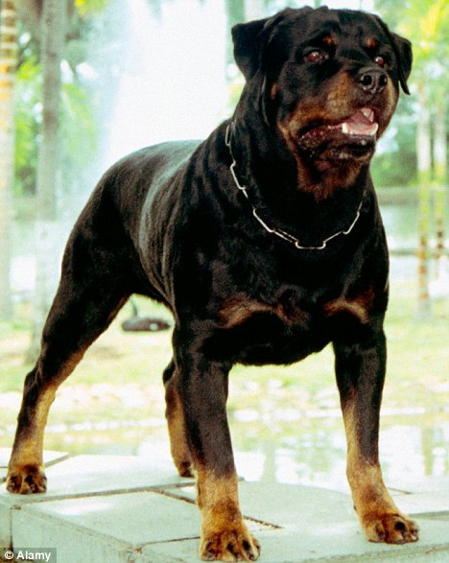
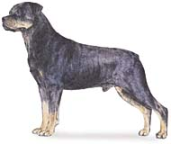
What Working Dog is this?
1. Rottweiler
2. Doberman Pinscher

Slide 5
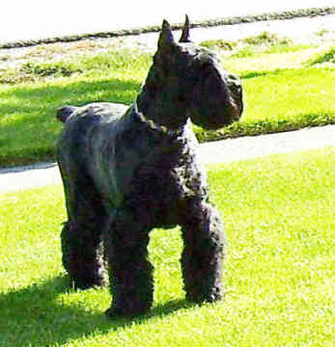
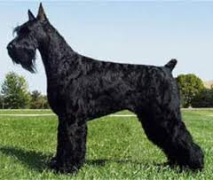
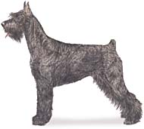
Name this Working Dog
1. Russian Terrier
2. Bouvier de Flandres
3. Giant Schnauzer

Slide 6
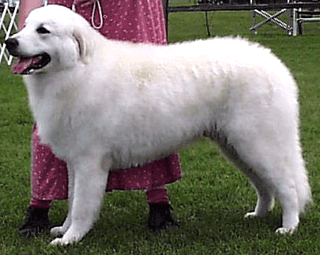
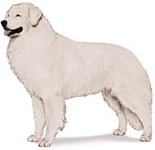
Name this Breed
1. Komondor
2. Kuvasz
3. American Eskimo

Slide 7
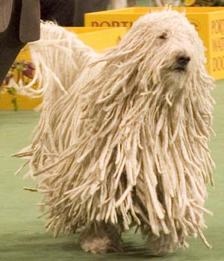
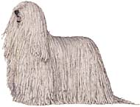
What is this breed?
1. Puli
2. Kuvasz
3. Komondor

Slide 8
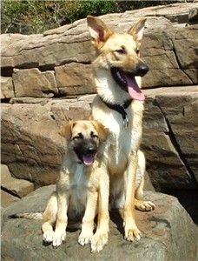
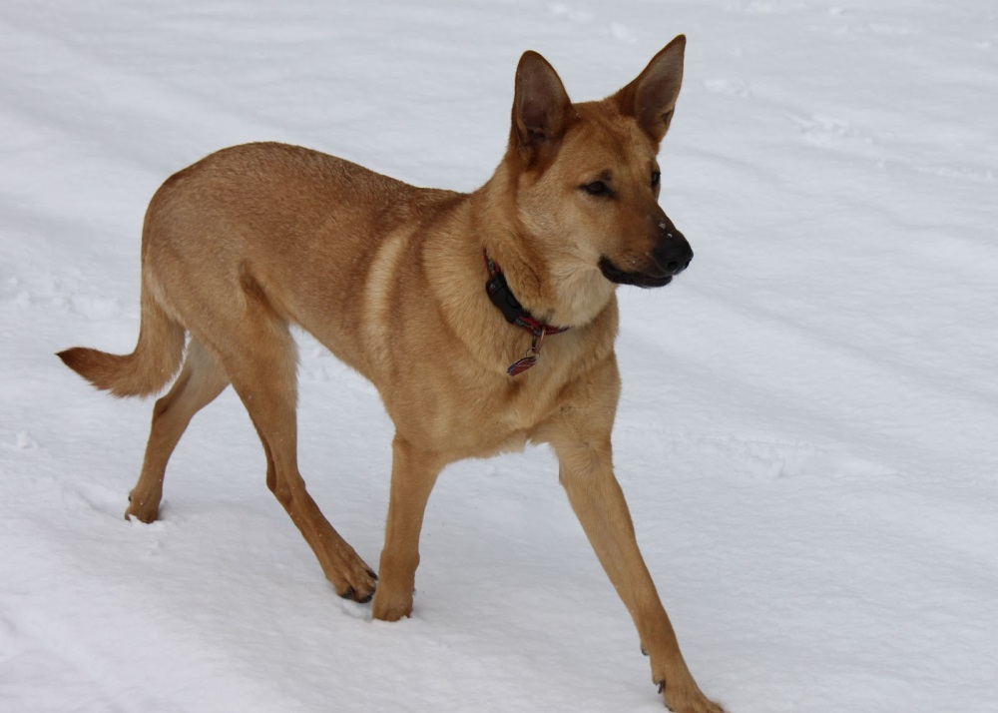
Name this Breed
1. Chinook
2. Australian Herding Dog
3. Tan Shepherd

Slide 9
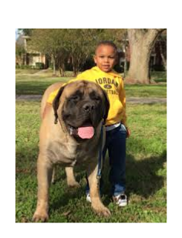
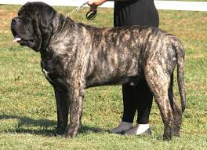
1. Rottweiler
2. Neopolitan Mastiff
3. Mastiff

Slide 10
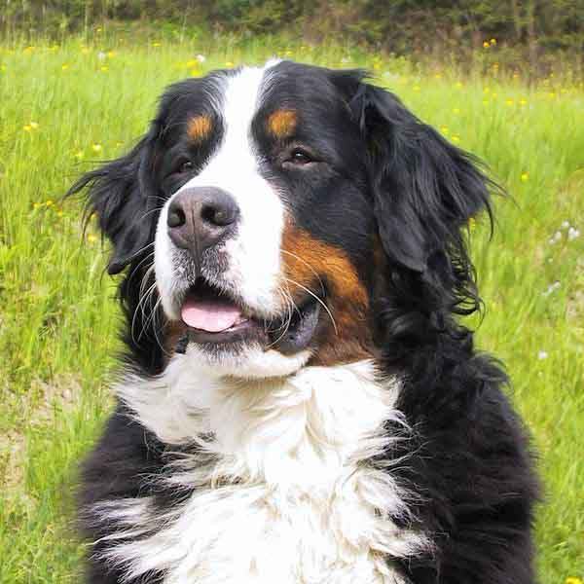
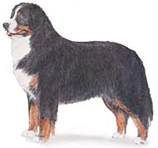
Name This Working Dog
1. Greater Swiss Mountain Dog
2. Bernese Mountain Dog
3. Belgian Mountain Dog

Slide 11
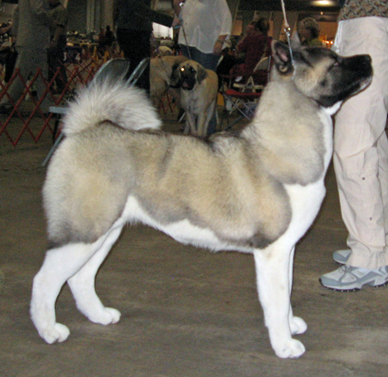
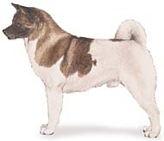
Name this Breed
1. Alaskan Malamute
2. Akita
3. Basenji

Slide 12
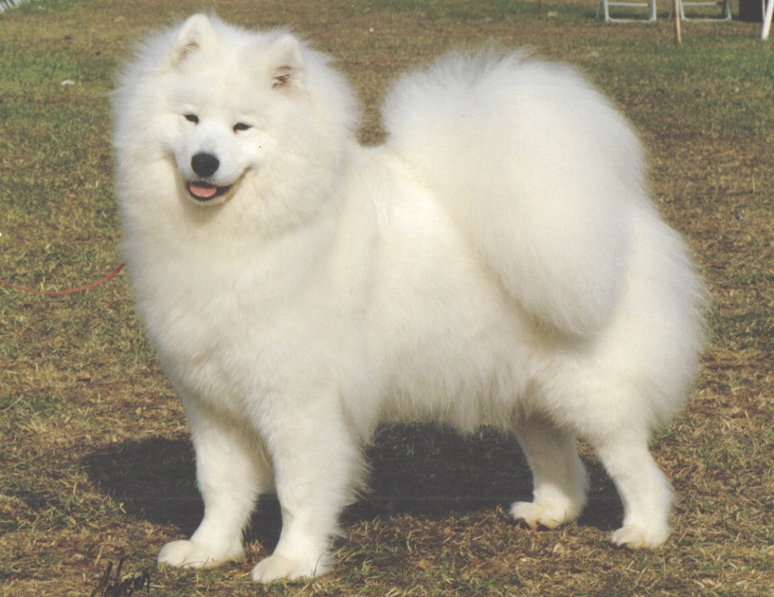
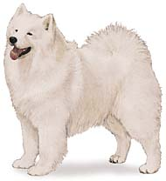
What is this Working Dog?
1. Alaskan Malamute
2. Powderpuff Malamute
3. Samoyed

Slide 13
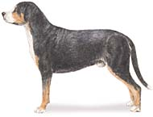
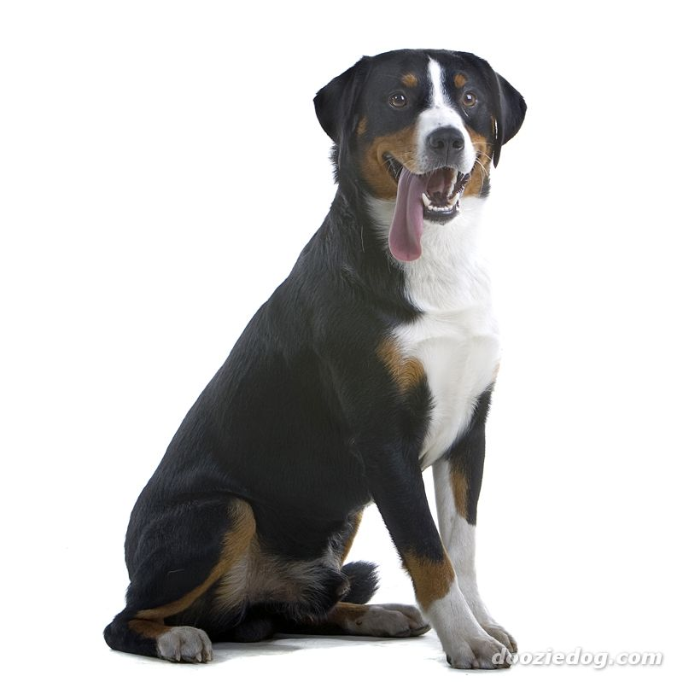
Name this Working Dog
1. Greater Swiss Mountain Dog
2. Bernese Mountain Dog
3. Burmese Mountain Dog

Slide 14
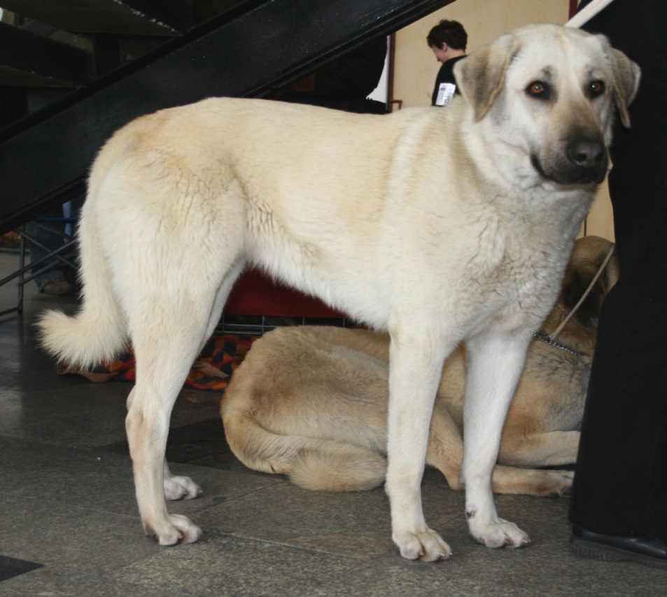
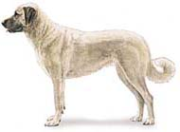
Which breed is it?
1. Cane Corso
2. Anatolian Shepherd
3. Norweigan Buhund

Slide 15
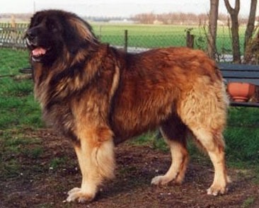
Which Working Dog is it?
1. Dogue de Bordeaux
2. Leonberger
3. Tibetan Mastiff

Slide 16
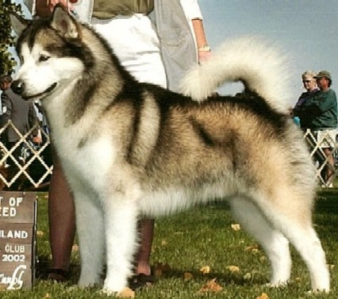
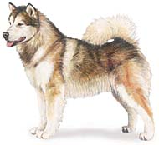
Name this Breed
1. Samoyed
2. Great Pyrenees
3. Alaskan Malamute

Slide 17
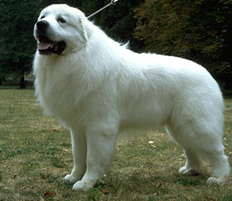
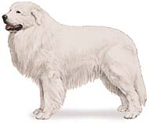
Name this Breed
1. Great Pyrenees
2. Siberian Husky
3. American Eskimo

Slide 18
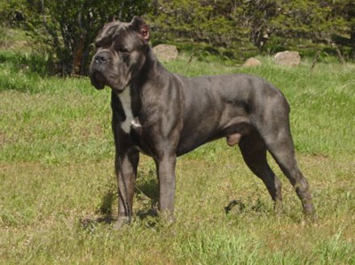
Which Working Dog is it?
1. Cane Corso
2. Bullmastiff
3. Neopolitan Mastiff

Slide 19
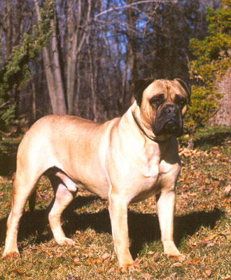
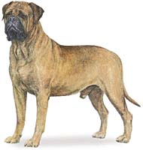
Name the breed
1. Boxer
2. Bullmastiff
3. English Boxer

Slide 20
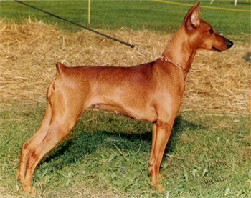
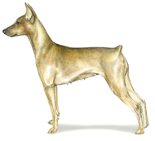
Name the breed
1. Great Dane
2. German Pinscher
3. Manchester Terrier

Slide 21
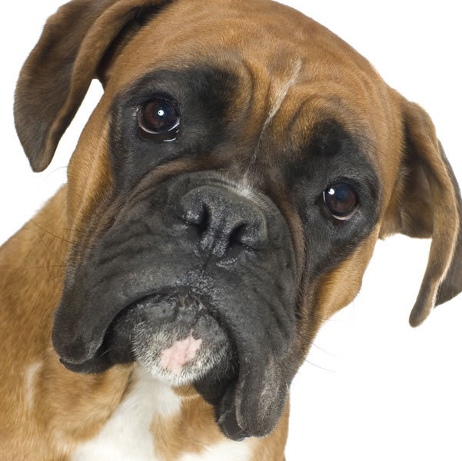
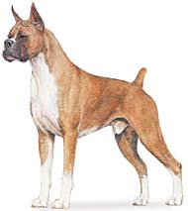
What is the name of this dog?
1. Boxer
2. Doberman Pinscher

Slide 22
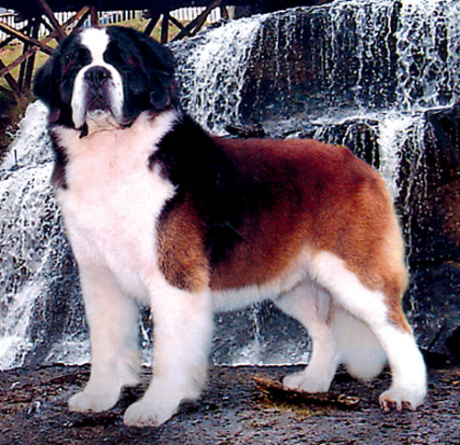
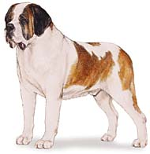
Name the breed
1. Saint Bernard
2. Mastiff

Slide 23
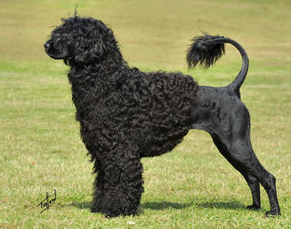
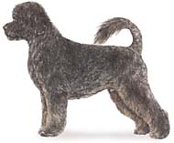
What Working Dog is this?
1. Poodle
2. Tibetan Mastiff
3. Portuguese Water Dog

Slide 24
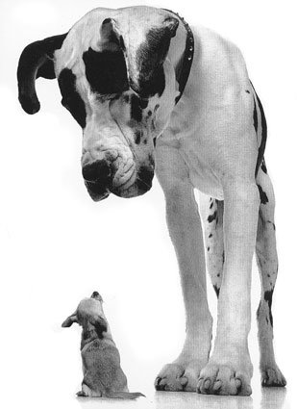
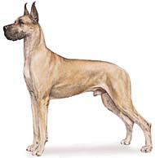
Name this breed…almost done!
1. Great Dane
2. Newfoundland

Slide 25
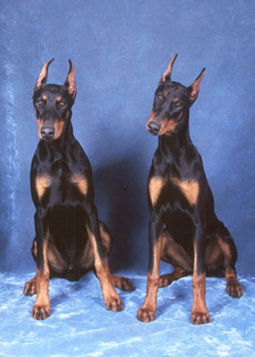
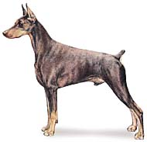
Name this breed
1. German Pinscher
2. Doberman Pinscher

Slide 26
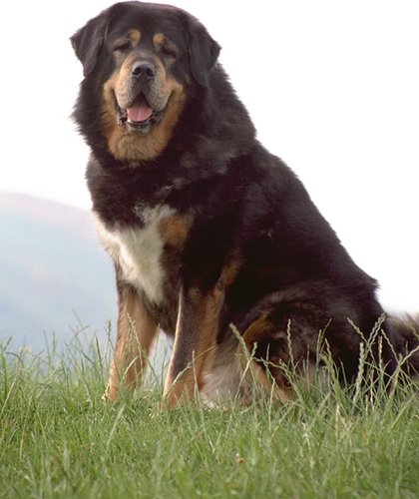
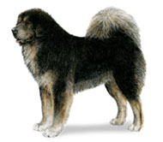
What breed is this?
1. Tibetan Mastiff
2. Leonberger
3. Bermese Mountain Dog

Slide 27
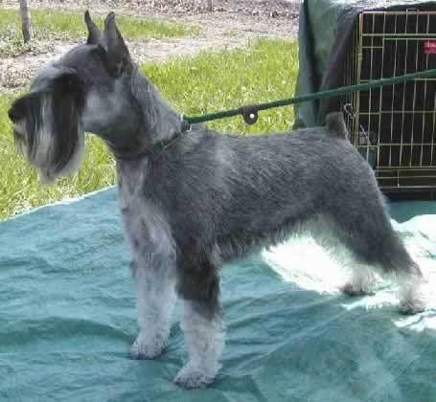
Still a few left…what is this one?
1. Standard Schnauzer
2. Tibetan Mastiff
3. German Terrier

Slide 28
Name this Breed
1. Newfoundland
2. Great Pyrenees
3. Boerboel

Slide 29
What dog?
1. Dogue de Bordeaux
2. Neapolitan Mastiff
3. Bullmastiff

Slide 30
Second to last slide! Which dog..
1. Akita
2. Siberian Husky
3. Alaskan Mastiff

Slide 31
Last one- Working Dogs! Which one?
1. Leonberger
2. Newfoundland

Slide 32
Citations
Chinooks. Digital image. Greatmountainchinooks.com. Www.pinterest.com, n.d. Web. 18 Dec. 2014.

