Slide 1
CDE Animal Breeds
By: Aracely & Shawndulynn
2015-2016

Slide 2
Cat Breeds

Slide 3
Russian Blue

Slide 4
Sphynx

Slide 5
Burmese

Slide 6
Abyssinian

Slide 7
Persian

Slide 8
Ragdoll

Slide 9
Siamese

Slide 10
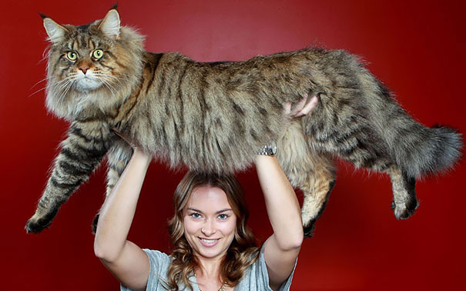
Maine Coon

Slide 11
American Shorthair

Slide 12
Manx

Slide 13
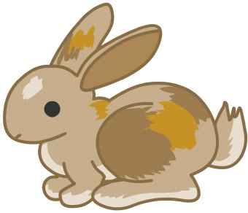
Rabbit Breeds

Slide 14
Netherland Dwarf

Slide 15
Angora

Slide 16
Dutch

Slide 17
Mini-Rex

Slide 18
Californian

Slide 19
Holland Lop

Slide 20
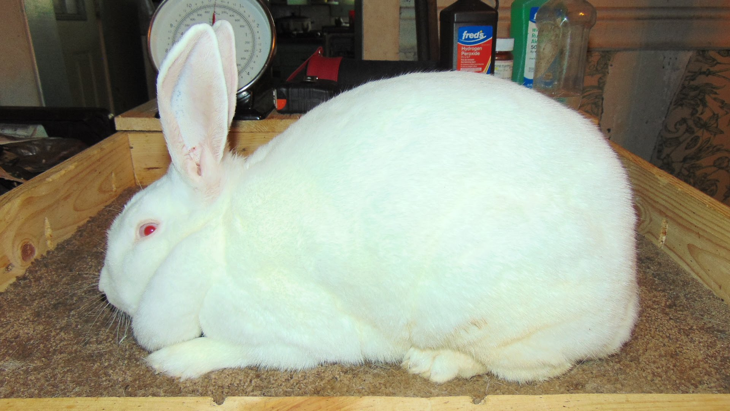
New Zealand

Slide 21
English Spot

Slide 22
Bird Breeds

Slide 23
Zebra Finch

Slide 24
Parakeet

Slide 25
Canary

Slide 26
Cockatoos

Slide 27
Love Birds

Slide 28
Sun Conure

Slide 29
Macaw

Slide 30
Cockatiel

Slide 31
African Gray Parrot

Slide 32
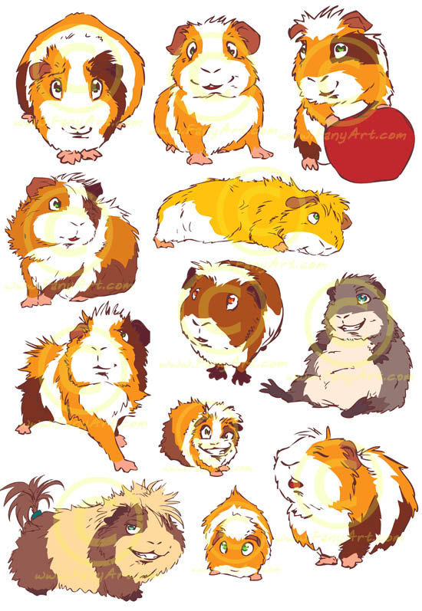
Small Mammals

Slide 33
Sugar Glider

Slide 34
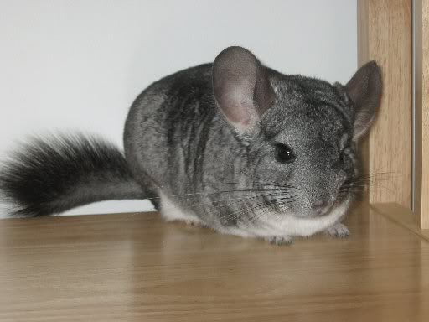
Chinchilla

Slide 35
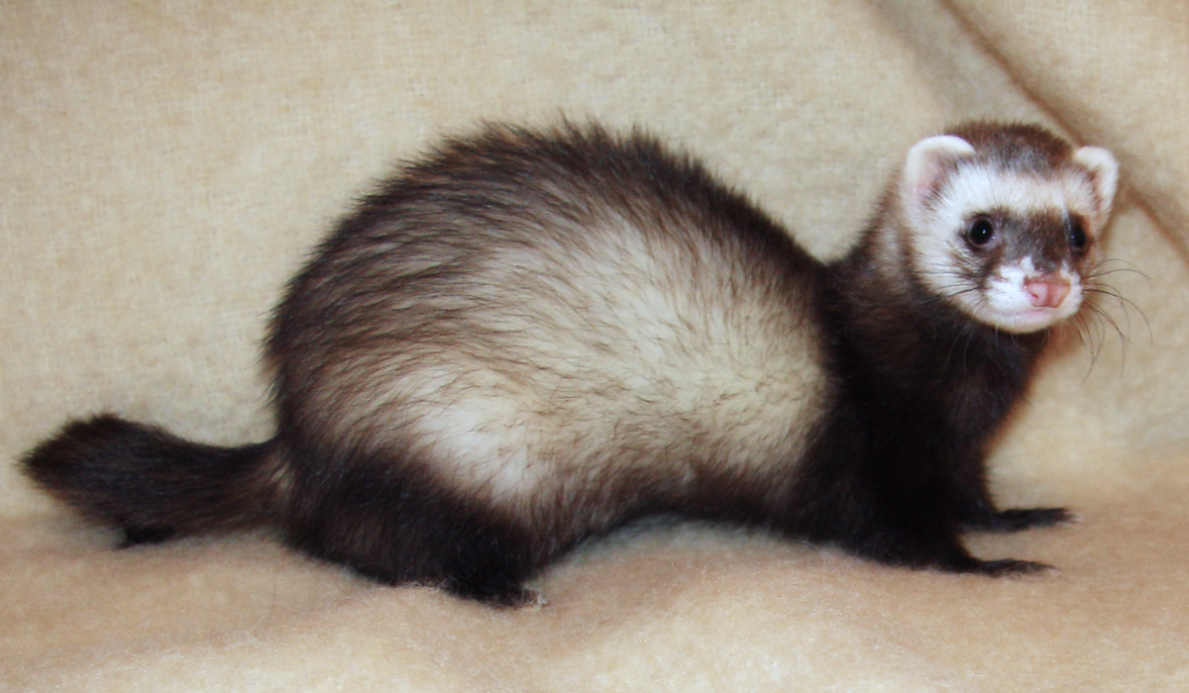
Ferret

Slide 36
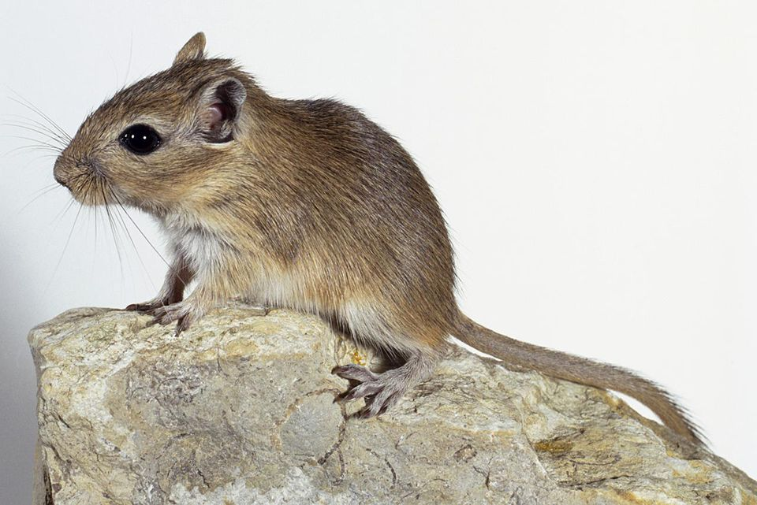
Gerbil

Slide 37
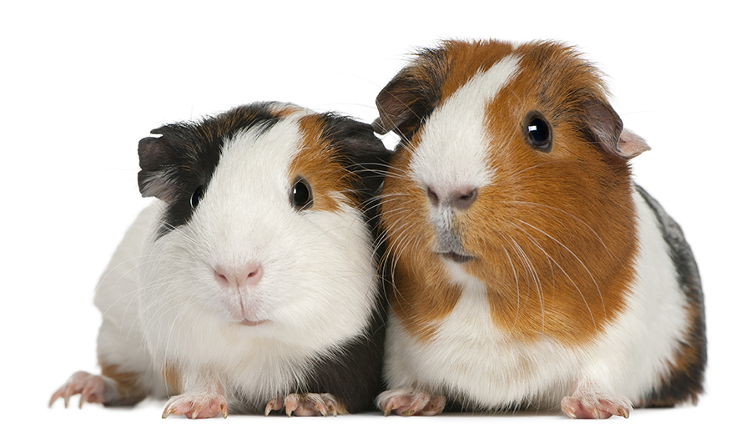
Guinea Pig

Slide 38
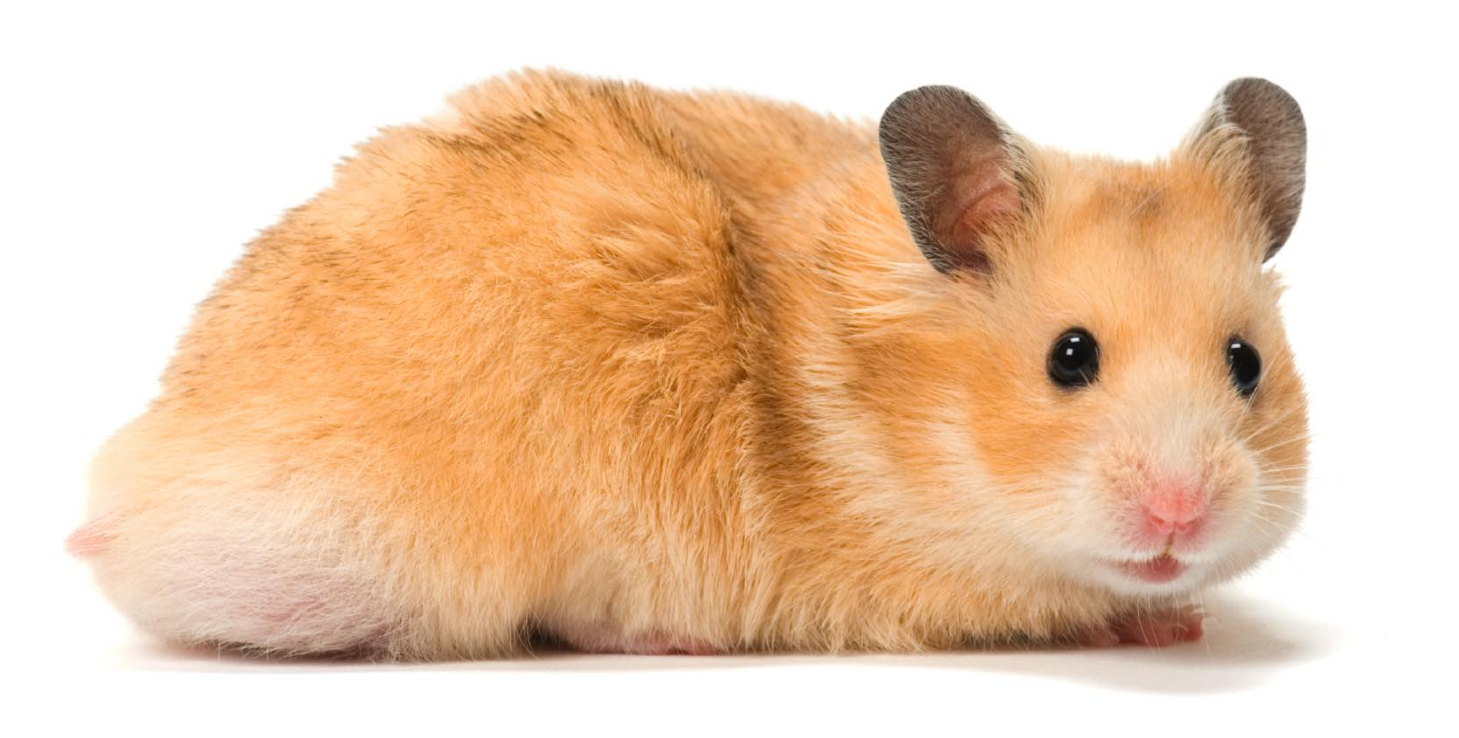
Hamster

Slide 39
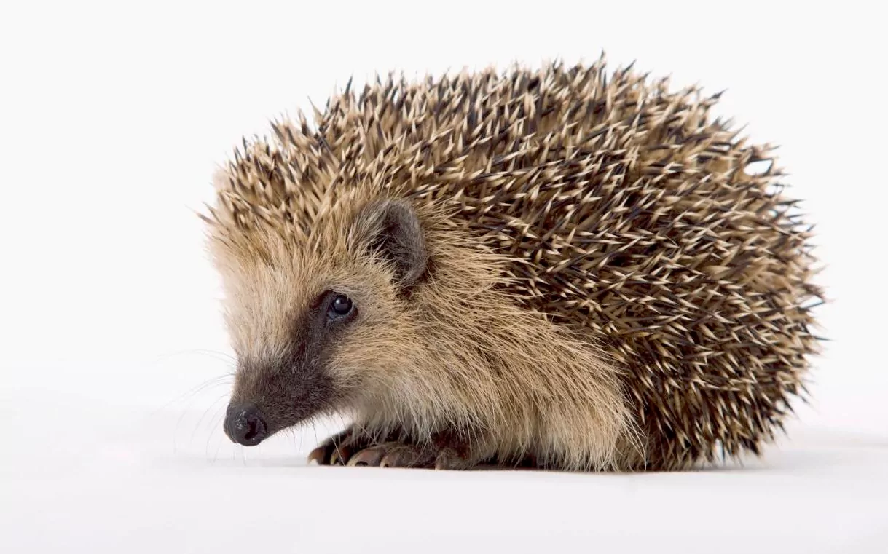
Hedgehog

Slide 40
Poultry Breeds

Slide 41
Quail

Slide 42
Plymouth Rock

Slide 43
Leghorns

Slide 44
Rhode Island Red

Slide 45
Cornish

Slide 46
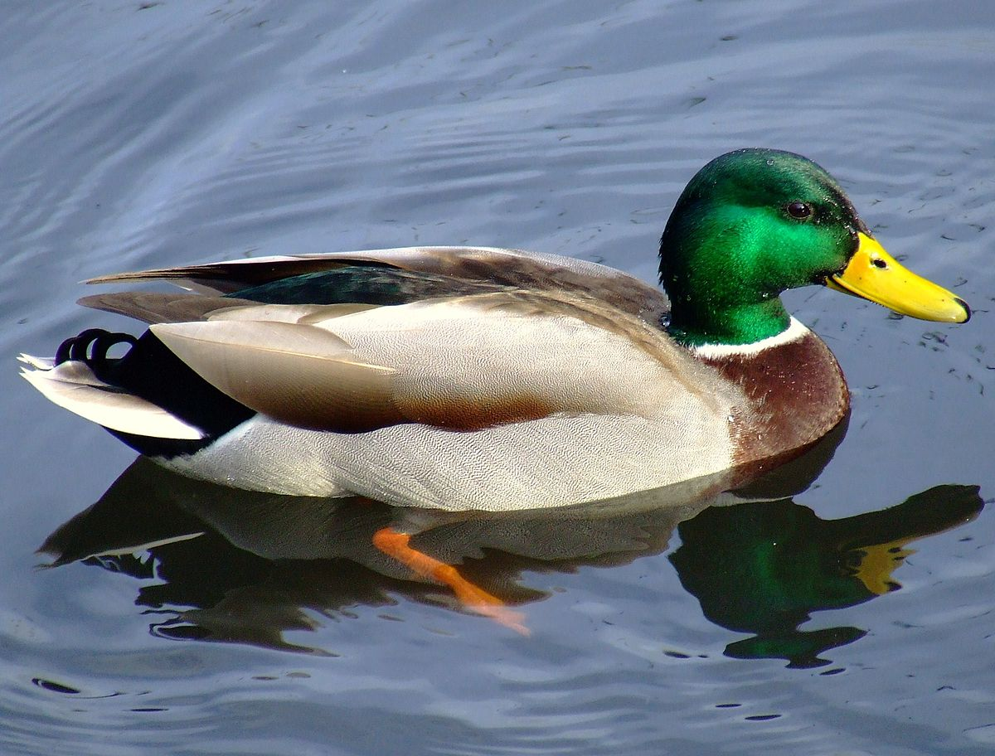
Duck

Slide 47
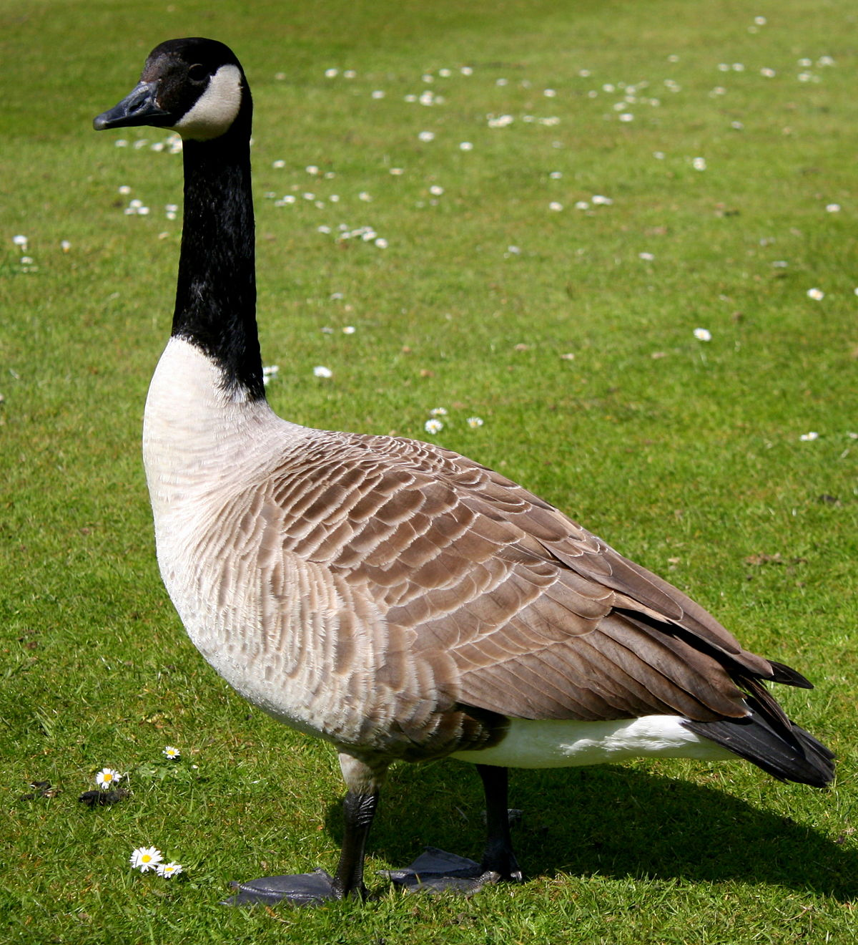
Geese

Slide 48
Turkey

Slide 49
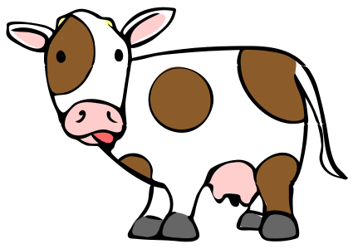
Dairy Cattle Breeds

Slide 50
Holstein

Slide 51
Jersey

Slide 52
Brown Swiss

Slide 53
Guernsey

Slide 54
Ayshire

Slide 55
Beef Cattle

Slide 56
Shorthorn

Slide 57
Hereford

Slide 58
Angus

Slide 59
Brahman

Slide 60
Charolais

Slide 61
Simmental

Slide 62
Swine

Slide 63
Hampshire

Slide 64
Chester White

Slide 65
American Landrace

Slide 66
Berkshire

Slide 67
Yorkshire

Slide 68
Duroc

Slide 69
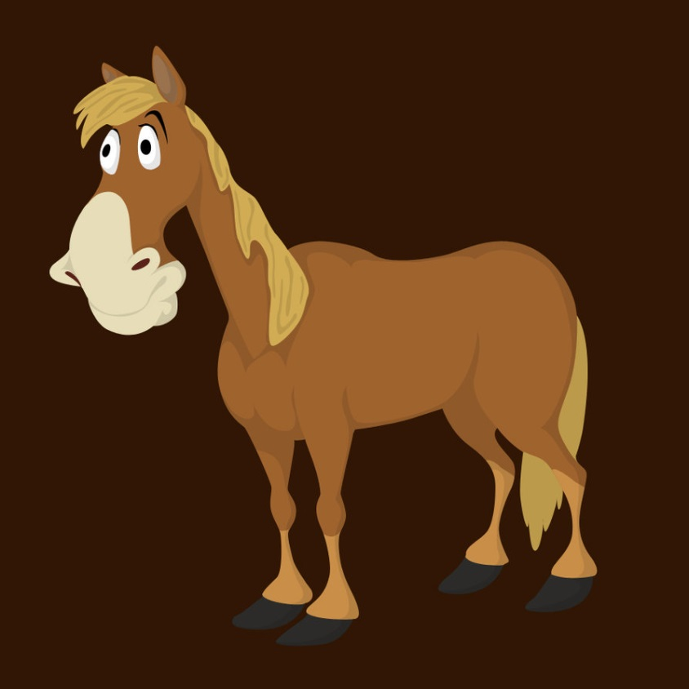
Horse Breeds

Slide 70
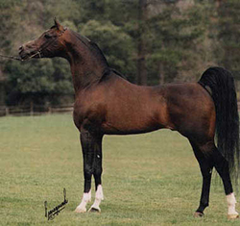
Arabian

Slide 71
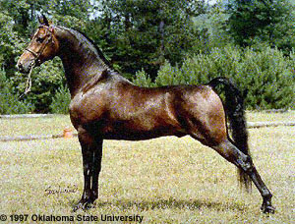
Morgan

Slide 72
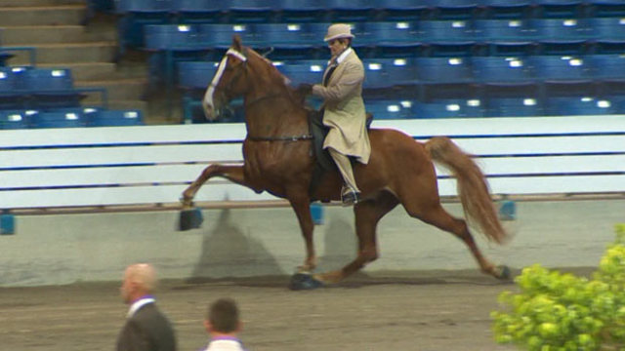
Tennessee Walking Horse

Slide 73
Paint

Slide 74
Clydesdale

Slide 75
Belgian

Slide 76
Appaloosa

Slide 77
Percheron

Slide 78
Quarter Horse

Slide 79
Thoroughbred

Slide 80
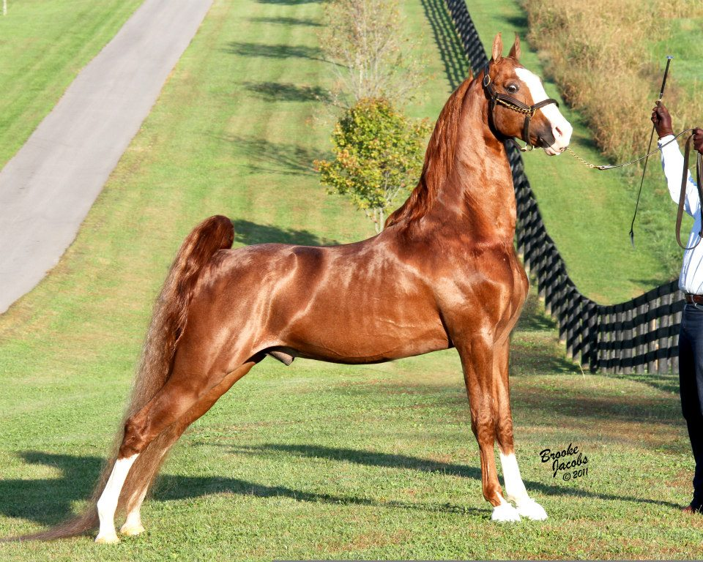
Saddlebred

Slide 81
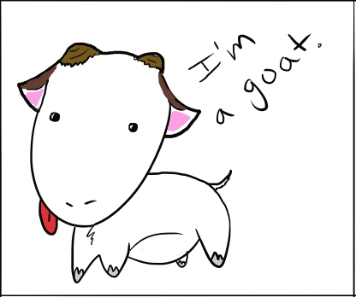
Goat

Slide 82
Saanen

Slide 83
Alpine

Slide 84
Nubian

Slide 85
Toggenburg

Slide 86
Angora

Slide 87
LaMancha

Slide 88
Boer

Slide 89
Sheep

Slide 90
Suffolk

Slide 91
Southdown

Slide 92
Columbia

Slide 93
Merino

Slide 94
Dorset

Slide 95
Rambouillet

Slide 96
Hampshire

Slide 97
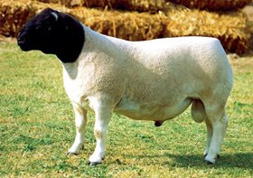
Dorper

Slide 98
Reptiles

Slide 99
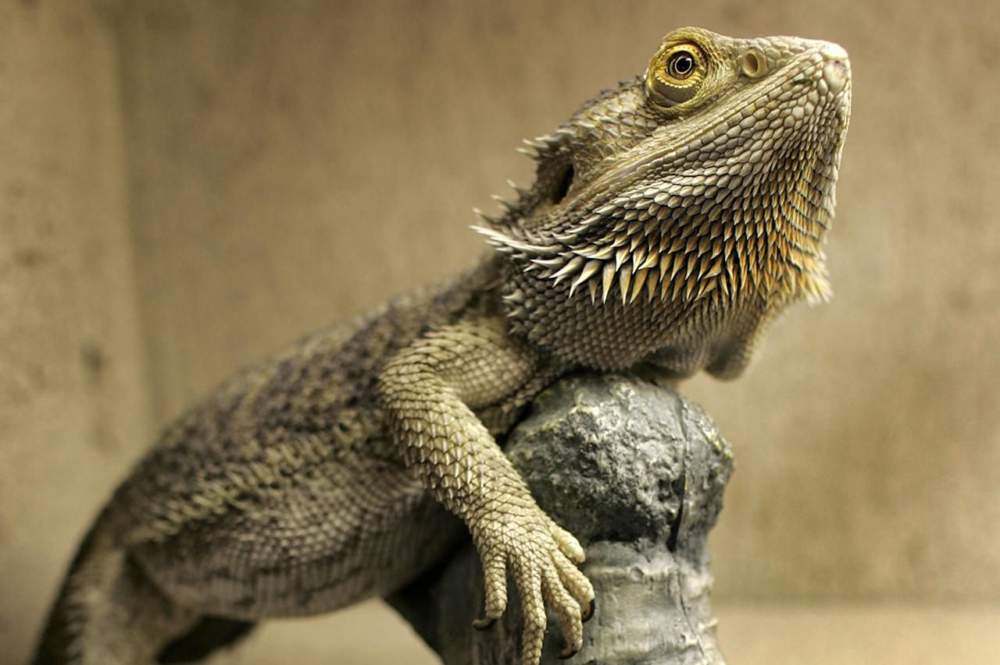
Bearded Dragon

Slide 100
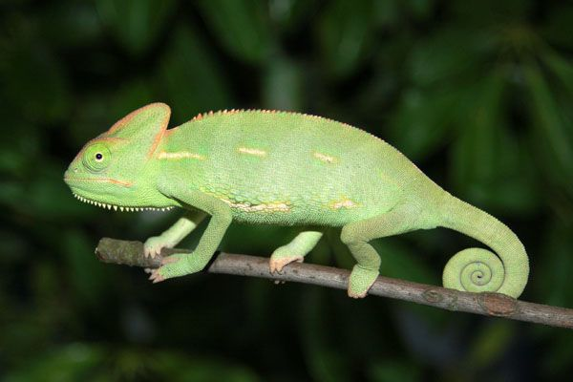
Chameleon

Slide 101
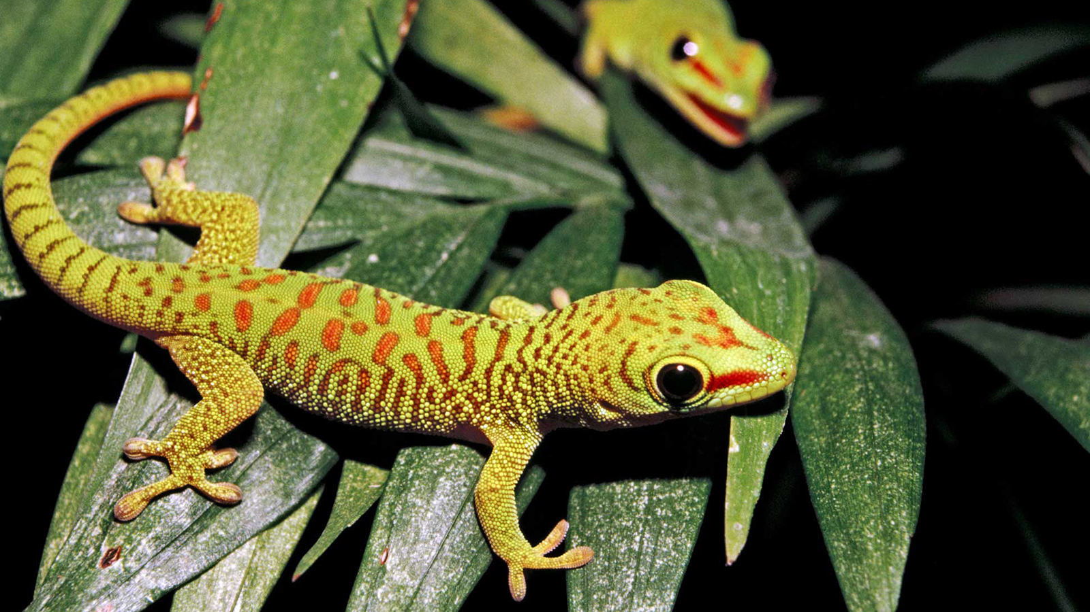
Gecko

Slide 102
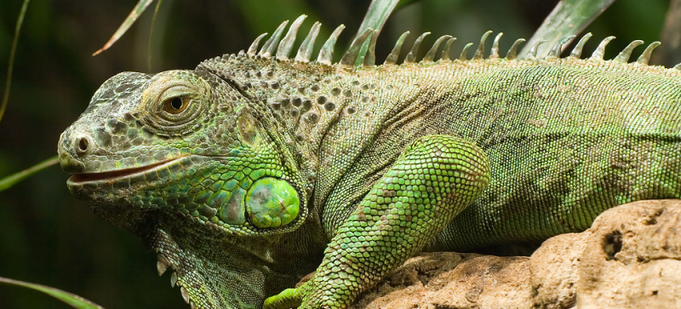
Iguana

