Slide 1
Chapter 23
Goat Breed Identification and Production Management

Slide 2
Veterinary Terminology
Caprine
veterinary term for goats
Doe or Nanny
female goat
Buck or Billy
male goat

Slide 3
Veterinary Terminology
Kid
young goat under one year of age
Kidding
labor process of goats
Herd
a group of goats

Slide 4
Biology
Ruminants
Range in size from 20 to 150 lbs.
Range in height from 1.5 to 4 feet
Average lifespan: 8-10 years
Male goats have strong odor

Slide 5
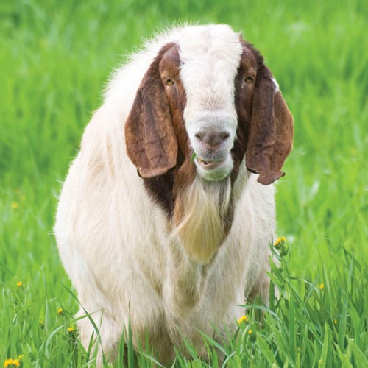
Breeds
Over 300 domestic goat breeds
Wild goats are still found all over the U.S.
5 goat groups:
Angora goats
Dairy goats
Meat goats
Cashmere goats
Pygmy goats

Slide 6
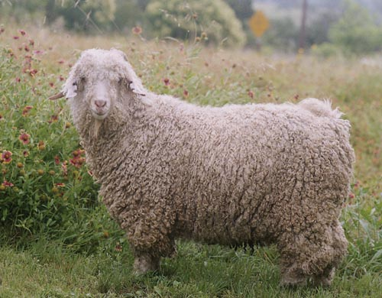
Angora
Produced for their hair
Used to make clothing and fiber products
Fiber produced is called mohair
Also used for meat

Slide 7
Dairy
Products from dairy goats are desirable for people with digestive sensitivities to dairy products
Goat milk is easier to digest, has more Vitamin A, and less fat
than other animals

Slide 8
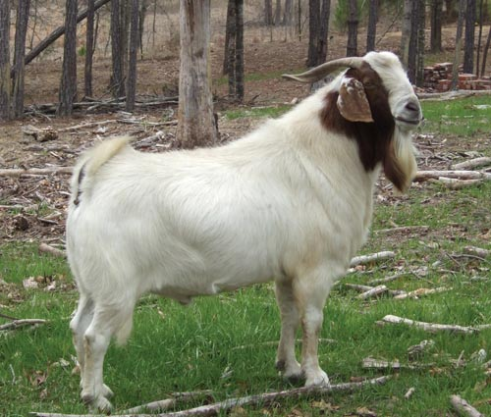
Meat
Raised for meat sources
Bred for quality muscles
Most are Spanish breeds- Boer Goat

Slide 9
Cashmere
Soft down or undercoat produced by most breeds
Angoras do not produce cashmere

Slide 10
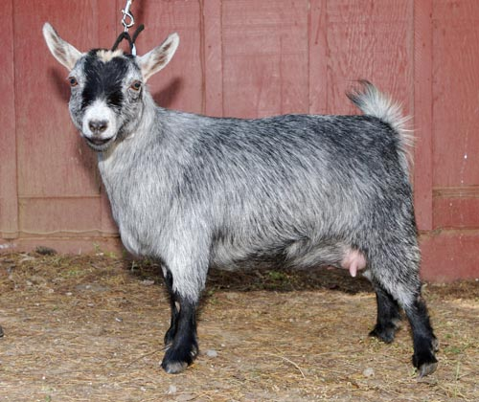
Pygmy
Miniature goats
Used as pets and in research
Enjoyable and entertaining to watch
Very playful
Any color or pattern
Popular in zoos

Slide 11
Breed Selection
Based on type of production or purpose
Hair and coat characteristics in fiber goats
Milk production in dairy goats

Slide 12
Goat Nutrition
Will eat anything, especially weeds and browse (woody type of plant)
Ruminant digestive system
Should be fed based on use and purpose
Hay, grass, and browse needs between 3.5-4.5 lbs. per day
Kids nurse for 60 days

Slide 13
Behavior
Tend to scatter when herded
In a herd, there will be a lead goat
Normally docile and friendly
Playful nature; commonly kept as pets
Will mark their scents over objects
Signs of anger and aggression include:
Hair raising over back, holding tail close to back, sneezing, stomping, and snorting

Slide 14
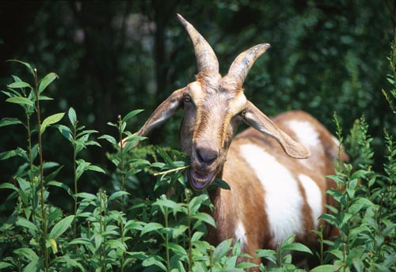
Basic Training
May be trained to halter and lead
When shown, must be able to lead in hand and walk with trainer
Can be brushed and groomed
Regular brushing, bathing, and hoof trimming

Slide 15
Equipment and Housing Needs
Indoor or outdoor facilities
Stalls should be well bedded and dry
Proper ventilation necessary
Running water, electricity, food and water in troughs
Dehorned
Fences at least 60 inches in height
Blankets, hoof trimmers, shearing tables

Slide 16
Restraint and Handling
Minimum amount of restraint the better
Best method of catching – grasp one leg and lift
Lateral
recumbency
for restraining
Venipuncture
restraint

Slide 17
Grooming
Wash with water and mild soap
Brush with stiff brush to remove dirt and shedding hair
Can be sheared
Hooves require routine trimming and maintenance

Slide 18
Basic Health Care and Maintenance
Healthy goats will:
Graze on pasture and plants throughout day
Chew on cud
Have a shiny and healthy hair coat
Strong legs and hoofs
Appear social
Have bright, clear eyes
Body temp between 103-103.6 degrees F

Slide 19
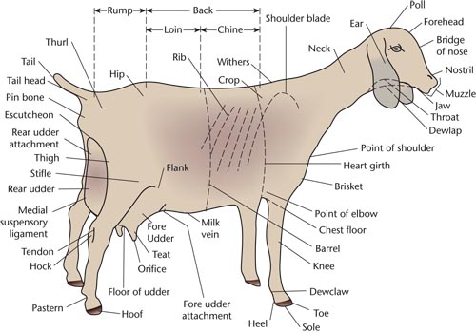

Slide 20
Vaccinations
Should begin between 6-8 weeks
Follow similar recommendations to that of sheep and veterinarian
Routinely vaccinated for:
Overeating disease
Tetanus
Soremouth
Goat pox
Deworming program 4-8 weeks after beginning to graze

Slide 21
Reproduction and Breeding
Ideal number of young produced each year: 2-3 per breeding season
Gestation length: 148-151 days
Does typically breed around 2 years
Estrus cycle: every 16-17 days
Kids usually average 5 lbs. at birth

Slide 22
Common Diseases
Relatively healthy, but can acquire many of the same diseases as sheep (Ch. 22)
Signs of unhealthy goat include:
Poor or rough hair coat, hair loss, abnormal temperature, swelling on joints and body, pale mucous membranes of mouth and eye mucosa, and thickened nasal and ocular discharge

Slide 23
Joint Ill
May affect young kids
Bacterial condition where umbilical cord site becomes contaminated
Inflammation and pain in growing joints
Breeding goats should be tested for brucellosis prior to reproduction

Slide 24
Bloat
Occurs when goats ingest foreign objects
Causes severe stomach pains and digestive upset
May be a common issue in goats without access to proper nutrition

Slide 25
Goat Pox
Viral disease
Affects mostly young or immune compromised goats
Flu-like symptoms
Lesions develop over head and face
Spreads rapidly
Infected goats should be isolated

Slide 26
Hypocalcemia
“Milk fever”
Occurs in lactating does
Calcium supplements necessary
Signs include:
Inability to stand, decreased respiratory rate, gasping for breath, coma, and possible death

Slide 27
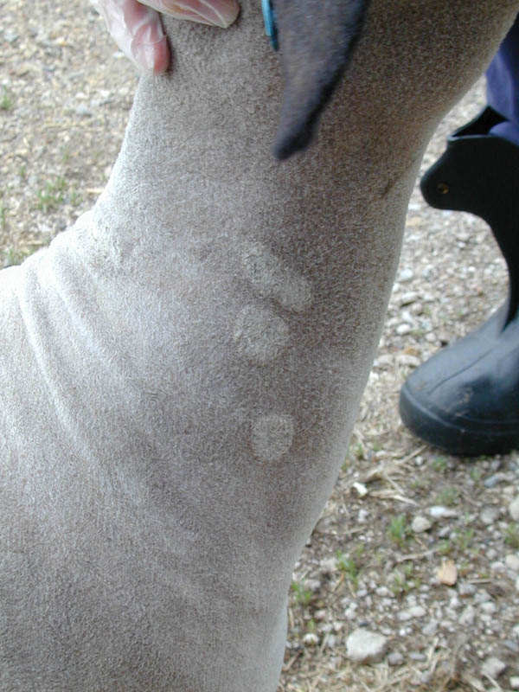
Common Parasites
Same as those that affect sheep
Most common: Ringworm
Causes hair loss in patches on coat
Highly contagious condition

