Slide 1
Chapter 2
Medical Records

Slide 2
The Veterinary Medical Record
Legal document that
Monitors patient progress
Makes information retrieval easy and quick
Keeps all staff appraised of current status of patient
Client consent must be given to release information

Slide 3
The Veterinary Medical Record
Should include the following:
Patient (animal) information
Client (owner) information
Master Problem List
Progress Notes
Lab, Radiology, and Pharmacy records
Surgical and Anesthesia Records

Slide 4
The Veterinary Medical Record
Establishes Veterinary-Client-Patient Relationship
Maintained yearly
Veterinarian assumes responsibility to assess patient health and recommendations for treatment
Owner agrees to follow instructions given by veterinarian
Veterinarian can terminate if patient isn’t undergoing current treatment

Slide 5
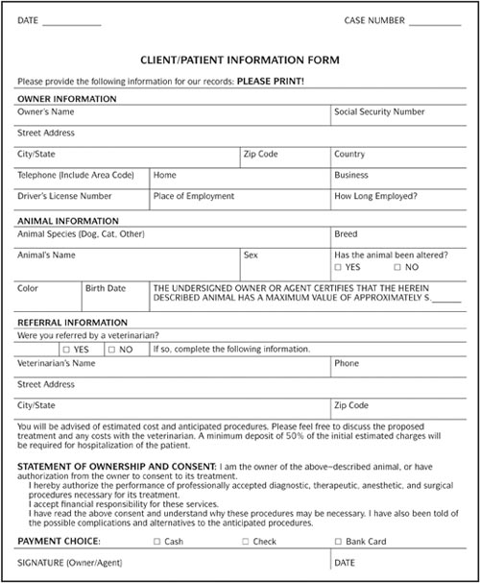

Slide 6
Master Problem List
Summary of most important medical issues for patient
Vaccines
Client and patient info
Big medical issues

Slide 7
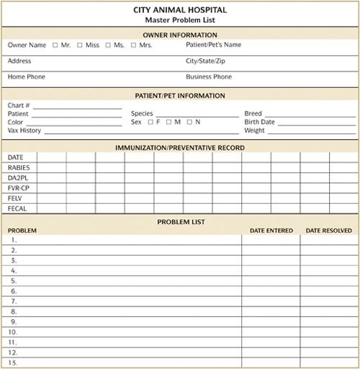

Slide 8
Progress Notes
Chronologic entries of patient examination and treatment
SOAP format
S = subjective, opinions, and descriptions
O = objective, facts, or measurable data
A = assessment; what’s wrong
P = plan or procedure

Slide 9
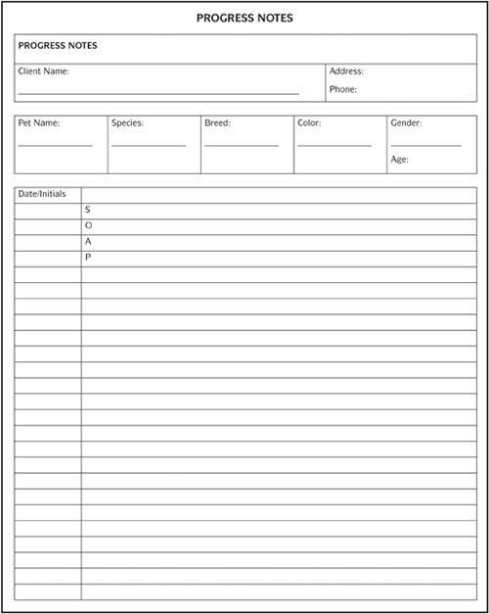

Slide 10
Progress Notes
Also known as the patient history
Record everything that happens with the patient, including:
Phone calls
Medications
Defecation and urination
Treatments
*** Always write down the date, time and your initials for every entry!

Slide 11
Laboratory Reports
Record all
testing procedures
results of tests
dates
vet that should review results
blood work, fecal exams, urinalysis, biopsy

Slide 12
Radiology Reports
Commonly called x-ray notes
Record
date of x-ray
x-ray patient number
anatomy and reason for x-ray
x-ray settings on machine
developing procedures

Slide 13
Pharmacy Records
Record all medicines the patient has been given or is currently prescribed
medicine name
date
vet prescribing med
dosage and how to be given
refills

Slide 14
Surgical and Anesthesia Reports
Records surgical procedures
Notes for surgical reports
Anesthesia log and medicines used
Lists dates of surgeries
Lists any complications from surgery

Slide 15
Other Paperwork Included in the Medical Record:
Estimates- approximate costs
Waivers- release of liability
Intake and discharges (usually done by vet tech or vet assistant)

Slide 16
Recording Information in the Medical Record
Do not
use pencil
erase
white out
scratch out info
Never give out original record

Slide 17
Certificates
Rabies- proof of rabies vaccine
Vaccine manufacturer, 1 year or 3 year vaccine, date given and due date, doctor, vaccine serial number
Health status- health history in last year
Vaccine record, test results, date of exam, doctor, good for 1 month
Neuter/spay- proof of surgical altering
date and doctor

Slide 18
Filing Medical Records
Filing Methods:
Alphabetical (last name)
Numerical (by patient or by client)
Color codes
Computerized

Slide 19
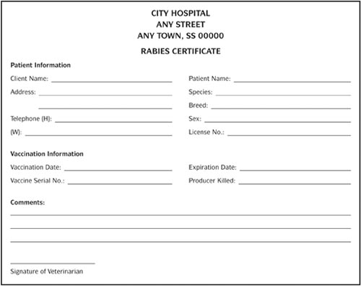

Slide 20
Ownership of the Med Rec
Record is owned by the clinic
All information is confidential- same as human health care
Clients may ask for a copy of a copy but they must sign a waiver and the records should be sent to another veterinarian
Med recs should be kept for 3-7 years depending on state regulations. This applies whether the animal is alive or not.

Slide 21
