Slide 1
Herding Group
They need a job….

Slide 2
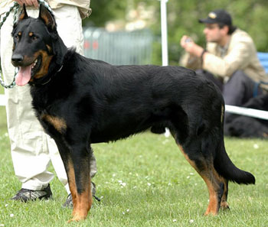
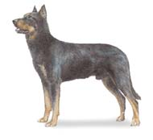
1. Doberman
2. Rottweiler
3. Beauceron

Slide 3
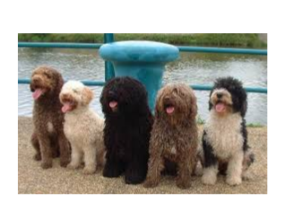
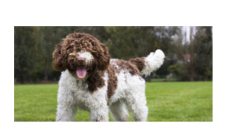
1. Swedish Vallhund
2. Pumi
3. Spanish Water Dog

Slide 4
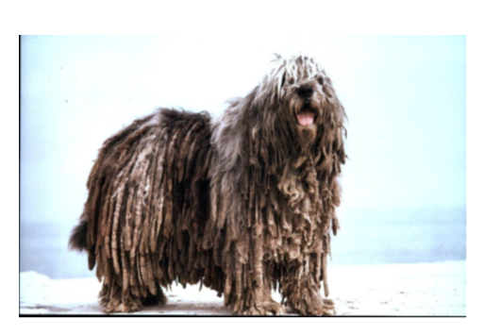
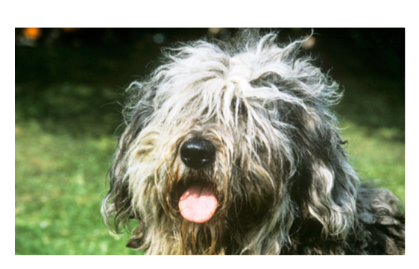
1. Italian Shepherd
2. Bergamasco
3. Cardigan Welsh Corgi

Slide 5
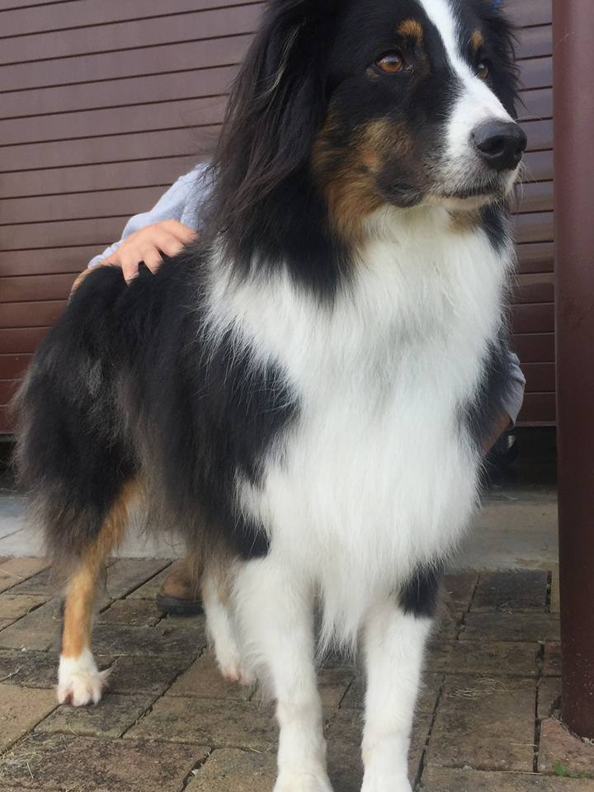
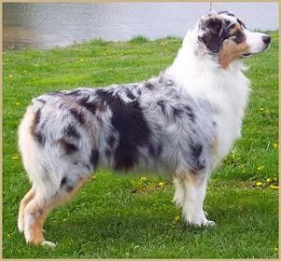
1. Australian Cattle Dog
2. Australian Shepherd
3. Pyrenean Shepherd

Slide 6
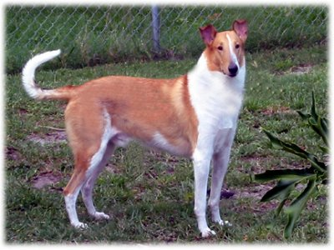
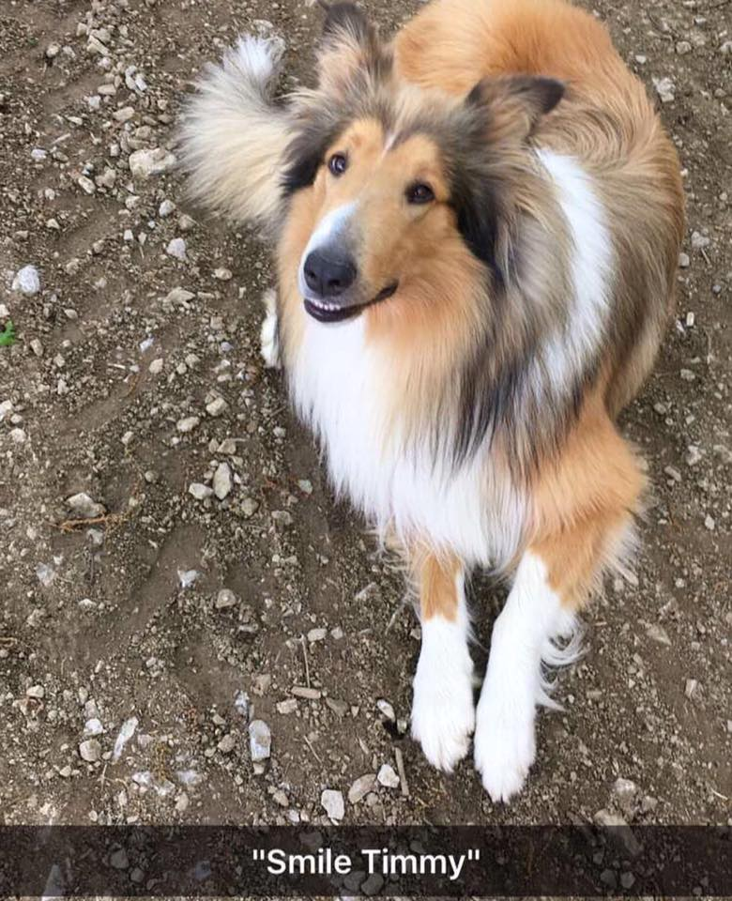
1. Australian Cattle Dog
2. Collie
3. Borzoi

Slide 7
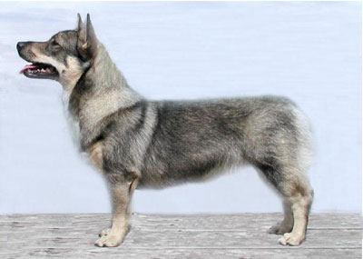
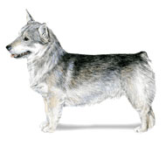
1. Pembroke Welsh Corgi
2. Cardigan Welsh Corgi
3. Swedish Vallhund

Slide 8
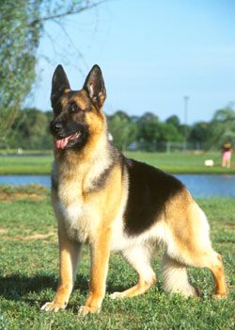
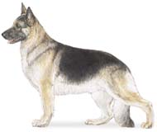
Belgian Malanois
German Shepherd
Belgian Tervuren

Slide 9
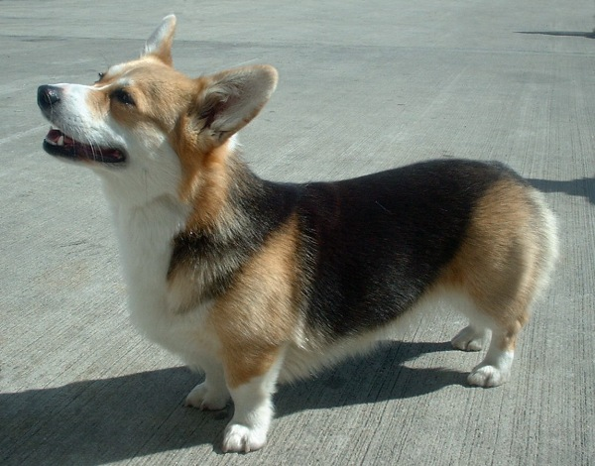
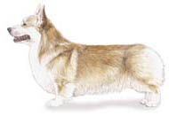
1. Cardigan Welsh Corgi
2. Swedish Vallhund
3. Pembroke Welsh Corgi

Slide 10
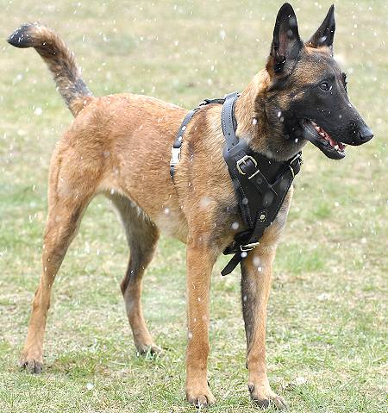
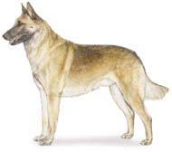
1. Belgian Malanois
2. German Shepherd
3. Belgian Tervuren

Slide 11
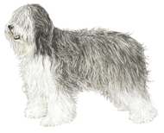
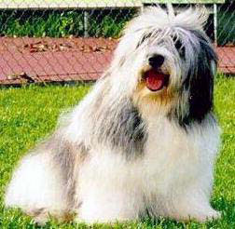
1. Bearded Collie
2. Australian Shepherd
3. Polish Lowland Sheepdog

Slide 12
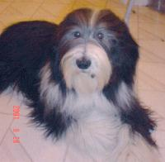
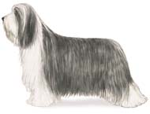
1. Belgian Malanois
2. Collie
3. Bearded Collie

Slide 13
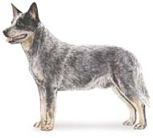
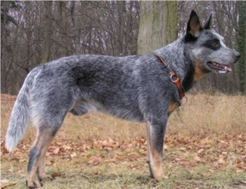
1. Australian Cattle Dog
2. Briard
3. Australian Cattle Dog

Slide 14
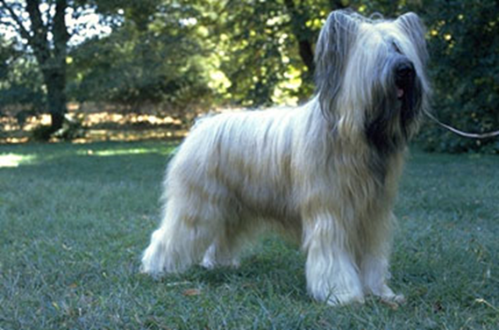
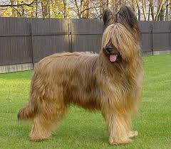
1. Belgian Sheepdog
2. Bouvier
3. Briard

Slide 15
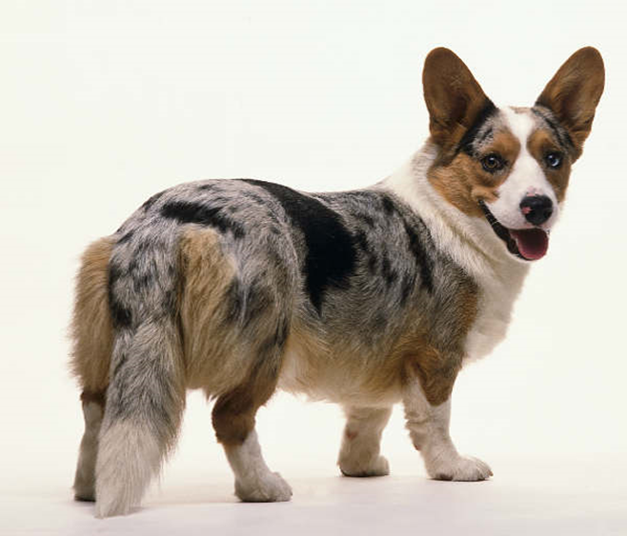
Cardigan Welsh Corgi
Pembroke Welsh Corgi
American Corgi

Slide 16
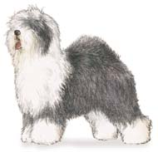
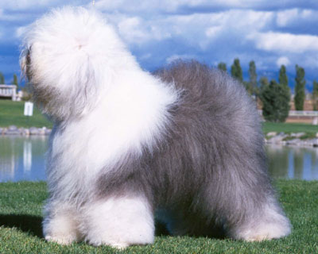
Name the Breed
1. Australian Shepherd
2. Old English Sheepdog
3. Polish Lowland Sheepdog

Slide 17
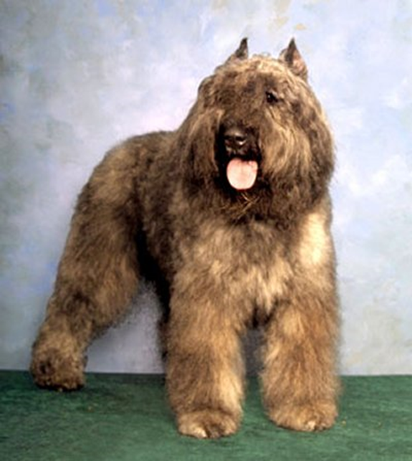
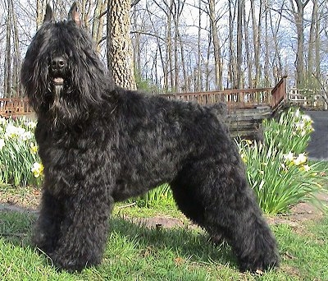
1. Briard
2. Bouvier des Flandres
3. Belgian Sheepdog

Slide 18
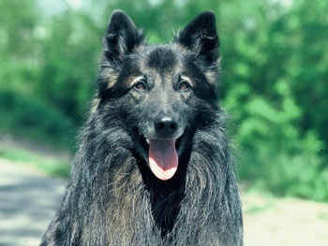
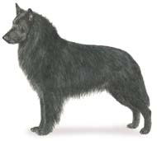
What Breed?
1. Belgian Sheepdog
2. Belgian Tervuren
3. Black Shepherd

Slide 19
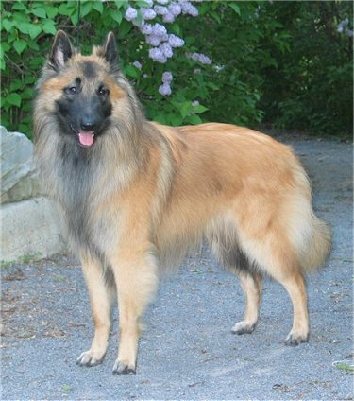
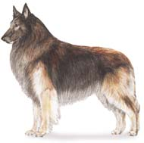
Which Herding Dog?
1. Belgian Malanois
2. Belgian Tervuren
3. Belgian Sheepdog

Slide 20
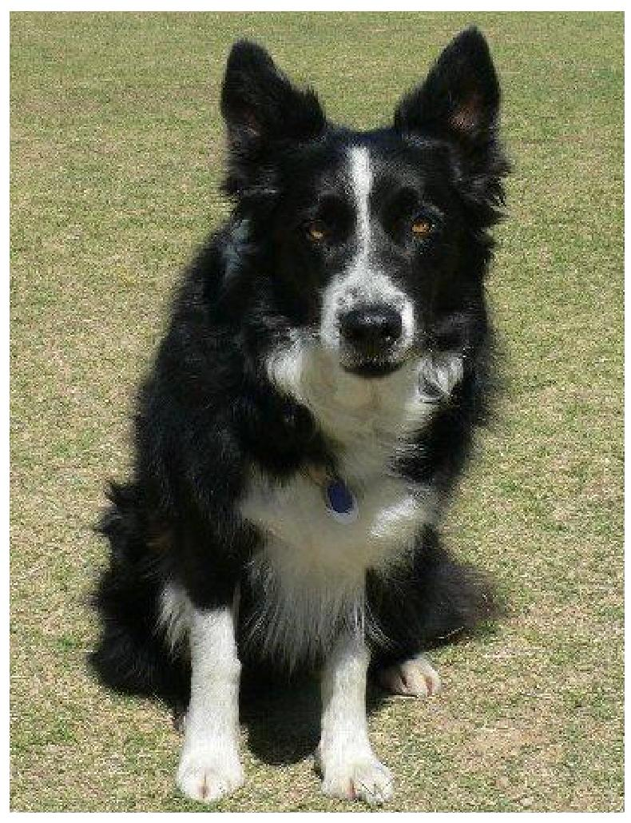
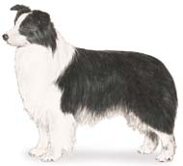
Name the Breed
1. Swiss Sheepdog
2. Shetland Sheepdog
3. Border Collie

Slide 21
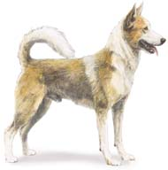
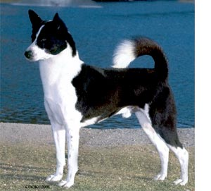
What Breed?
1. Caanan Dog
2. Norweigian Buhund
3. Akita

Slide 22
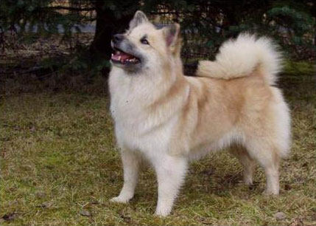
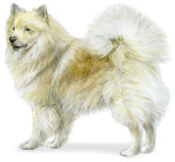
Name the Herding Dog
1. Eskimo Spitz
2. Norwegian Buhund
3. Icelandic Sheepdog

Slide 23
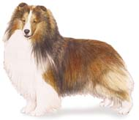
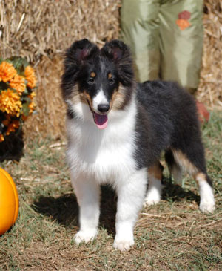
Almost Done…
1. Collie
2. Puli
3. Shetland Sheepdog

Slide 24
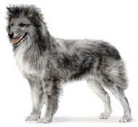
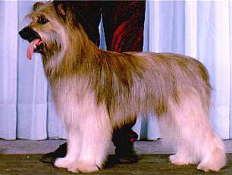
What Breed?
1. Caanan Dog
2. Norwegian Buhund
3. Pyrenean Shepherd

Slide 25
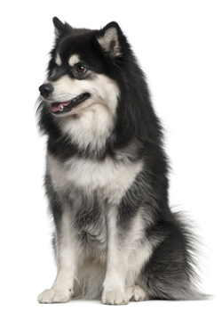
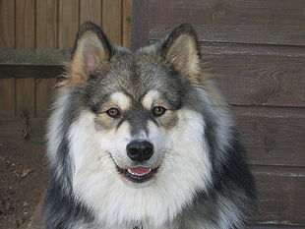
Name this breed
Caanan Dog
Finnish Lapphund
Swedish Shepherd

Slide 26
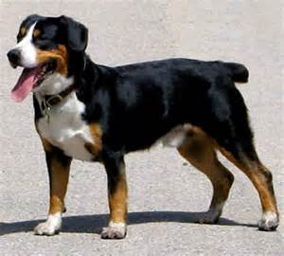
What breed?
1. Entlebucher
2. Greater Swiss Mountain Dog
3. Bernese Mountain Dog

Slide 27
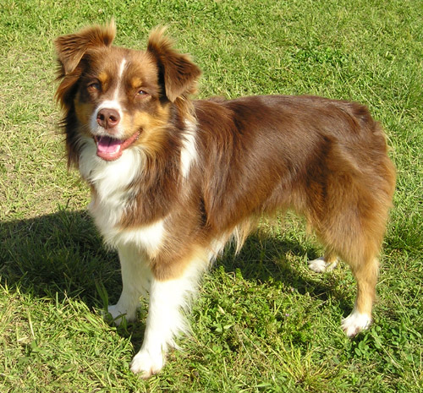
Name this breed?
Belgian Sheepdog
Miniature American Shepherd
Swedish Shepherd

Slide 28
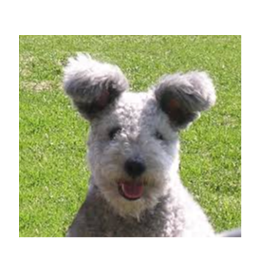
1. Pyrenean Shepherd
2. Norweigan Buhund
3. Pumi

Slide 29
Name this breed?
Berger Picard
Pyrenean Shepherd
Canaan Dog

Slide 30
1. Norwegian Buhund
2. Pyrenean Shepherd
3. Eskimo Spitz

Slide 31
1. Puli
2. Komondor
3. Bob Marley

Slide 32
1. Puli
2. Bergamasco
3. Spanish Water Dog

Slide 33
Citations
By Alphie Entlebucher on Pinterest. Digital image. Www.pinterest.com. Www.pinterest.com, n.d. Web. 16 Dec. 2014.
ile:Finnish Lapphund Elbereth Norppa 1.jpg. Digital image. Wikipedia. Wikimedia Commons, 17 Sept. 2006. Web. 16 Dec. 2014.
Finnish Lapphund Puppy. Digital image. Bing Images. Breedersonline.co.uk, n.d. Web. 16 Dec. 2014.

