Slide 1
Nonsporting Group
AKC Breeds Quiz

Slide 2
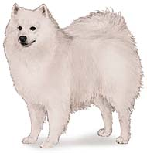
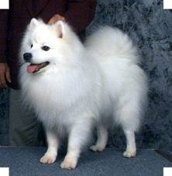
American Eskimo
Keeshond
Samoyed

Slide 3
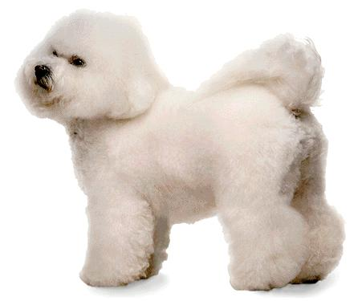
Bichon Frise
Shih Tzu
Miniature Poodle

Slide 4
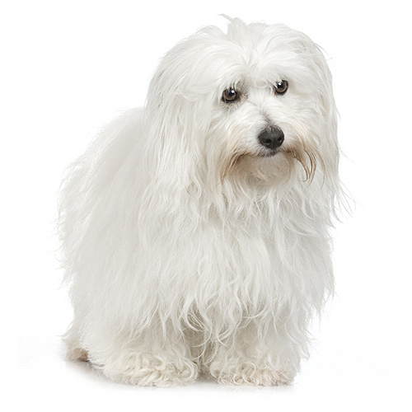
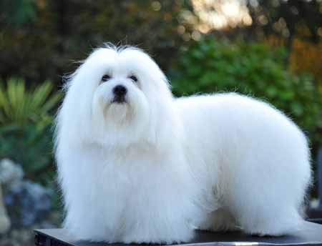
1. Coton de Tulear
2. Bichon
3. Poodle

Slide 5
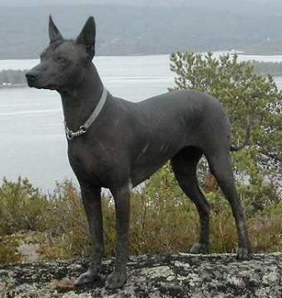
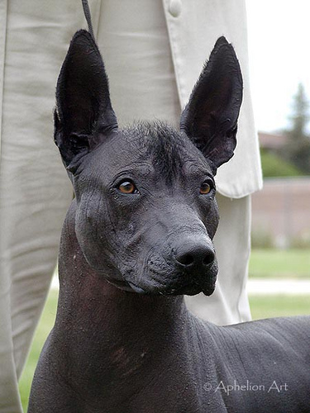
1. Chihuahua
2. Xoloitzcuintli
3. Mexican rat dog

Slide 6
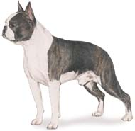
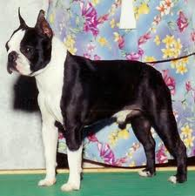
Japanese Chin
Boston Terrier
American Bull Dog

Slide 7
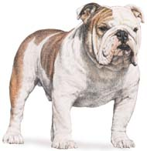
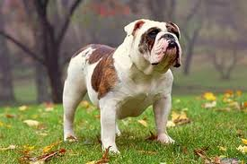
Bull Mastiff
Bull dog
Boxer

Slide 8
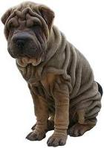
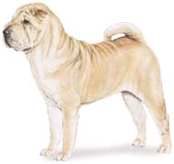
Shiba Inu
Neopolitan Mastiff
Chinese Shar pei

Slide 9
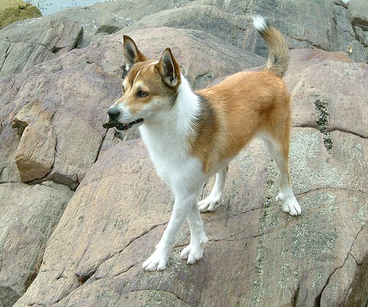
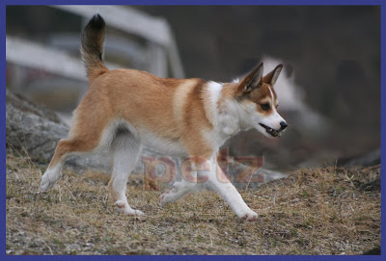
1. Chow Chow
2. Finnish Spitz
3. Norwegian Lundehund

Slide 10
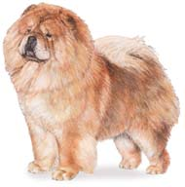
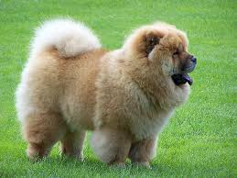
1. Akita
2. Tibetian Mastiff
3. Chow Chow

Slide 11
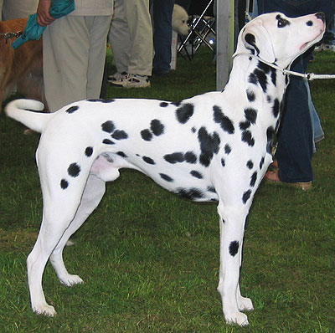
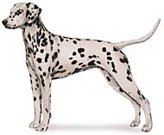
Labrador Retriever
Dalmatian
Great Dane

Slide 12
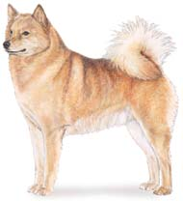
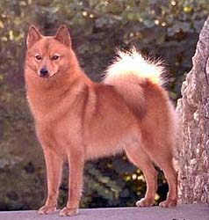
Finnish Spitz
Shiba Inu
Akita

Slide 13
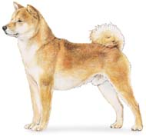
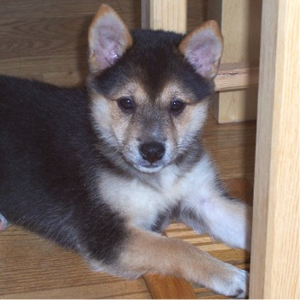
Enter question text...
1. Shiba Inu
2. Eskimo Dog
3. Malamute

Slide 14
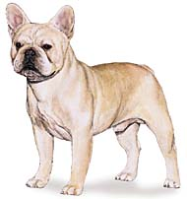
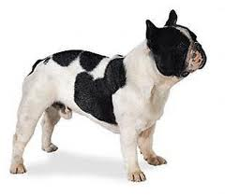
Bull Dog
French Bull Dog
Boston Terrier

Slide 15
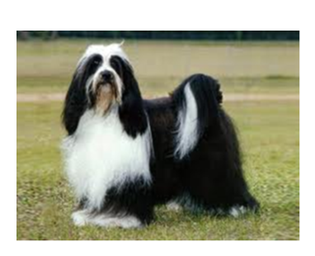
1. Tibetan Spaniel
2. Tibetan Mastiff
3. Tibetan Terrier

Slide 16
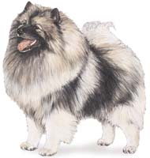
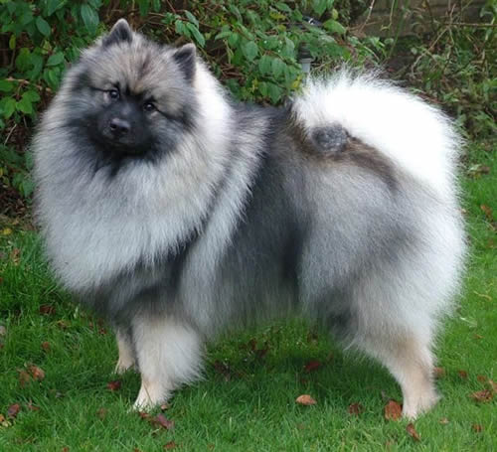
Husky
Keeshond
Afghan Hound

Slide 17
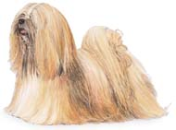
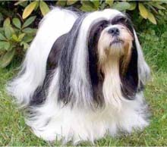
Papillion
Lhasa Apso
Shih Tzu

Slide 18
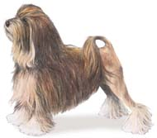
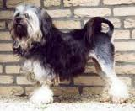
Chinese Crested-powder puff
Shih Tzu
Lowchen

Slide 19
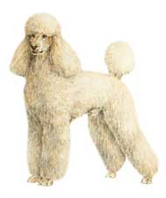
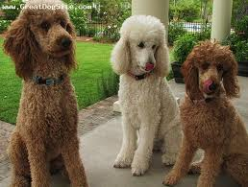
Portugese Water Dog
Old English Sheep Dog
Poodle

Slide 20
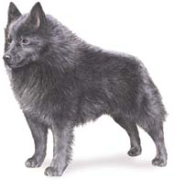
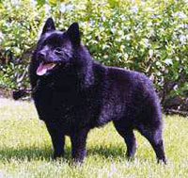
Chow Chow
Schipperke
Brussels Griffon

Slide 21
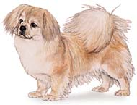
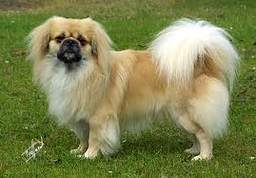
Tibetan Mastiff
Tibetan Spaniel
Tibetan Terrier

Slide 22
Citations
Coton De Tulear. Digital image. Www.bing.com. Www.dogbreedslist.com, n.d. Web. 16 Dec. 2014.
Chupacabras Vivo Xoloitzcuintli. Digital image. Www.bing.com. Www.aeromental.com, n.d. Web.
The Petz.com. Digital image. Pets-norsklundehund.blogspot.com. Www.bing.com, n.d. Web. 18 Dec. 2014.

