Slide 1
Sporting Group

Slide 2
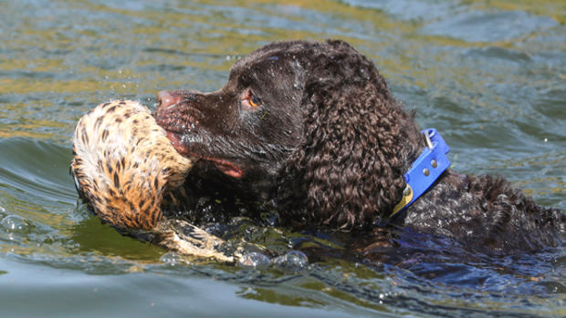
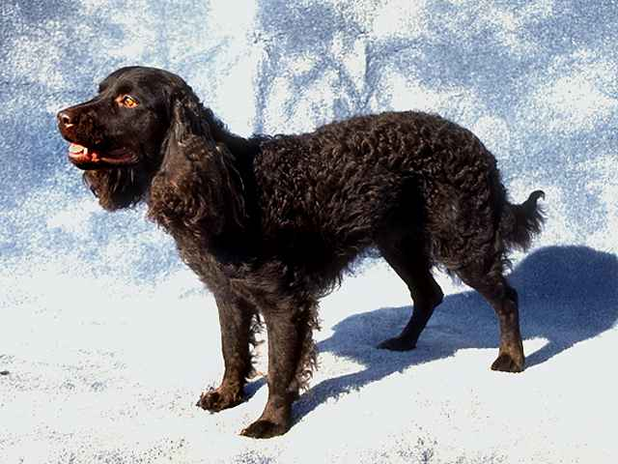
American Water Spaniel
Brittany
Springer Spaniel

Slide 3
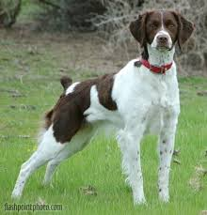
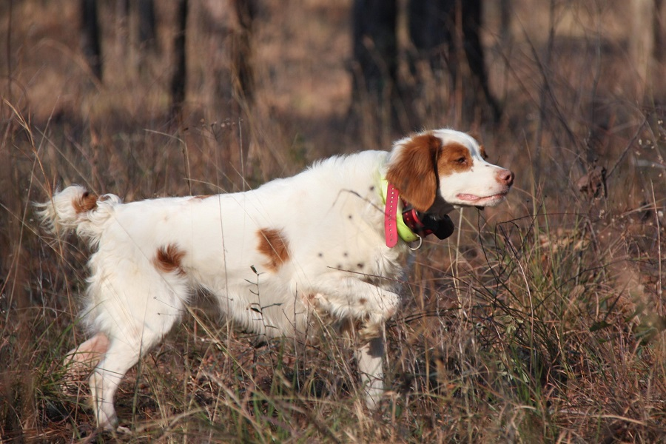
Brittany
Springer spaniel
English Setter

Slide 4
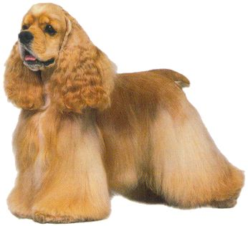
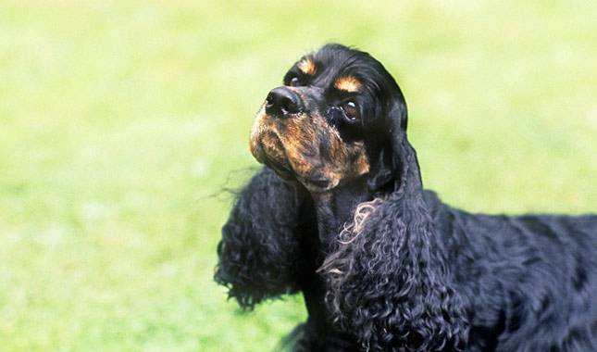
Cocker spaniel
Cavalier King Charles Spaniel
Brittany

Slide 5
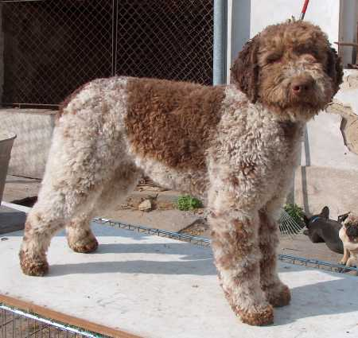
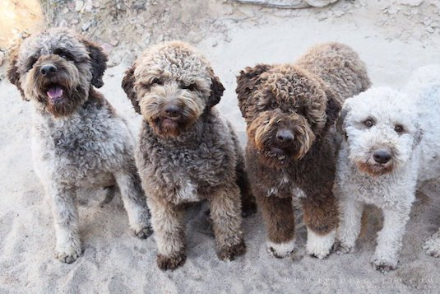
German Wirehair Pointer
Lagotto Romagnolo
Spinone Italiano

Slide 6
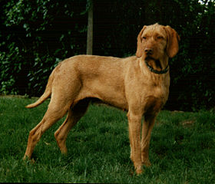
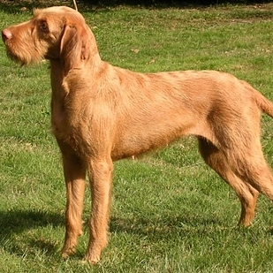
1. Weimaraner
2. Wirehaired Vizsla
3. German Wirehaired Pointer

Slide 7
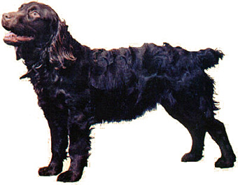
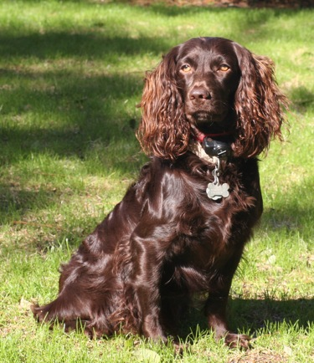
Boykin spaniel
Cocker Spaniel
English Setter

Slide 8
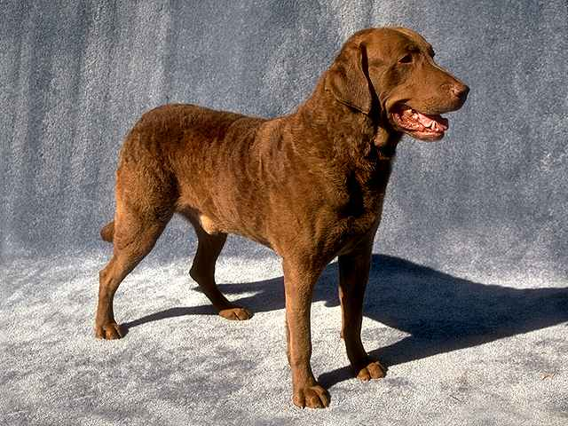
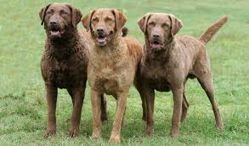
Chesapeake Bay Retriever
Labrador retriever
Flat Coated Retriever

Slide 9
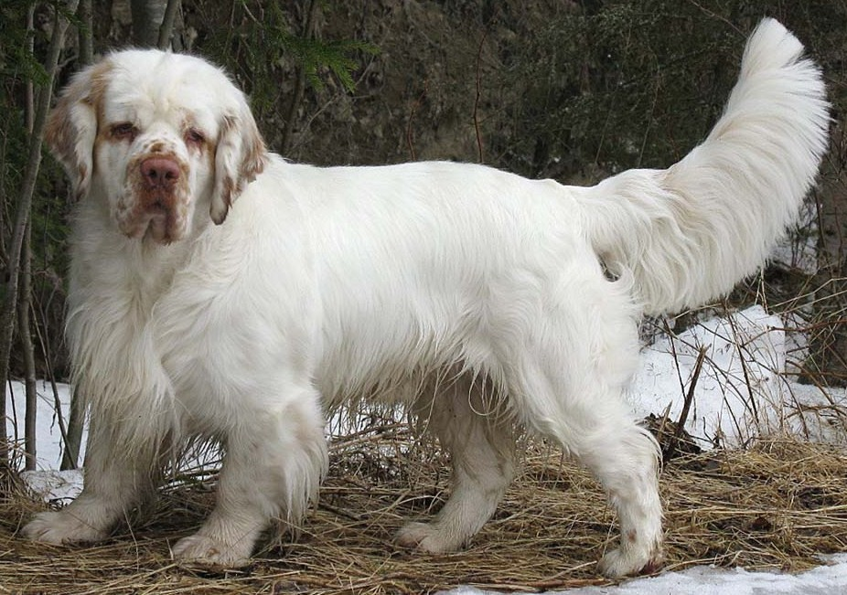
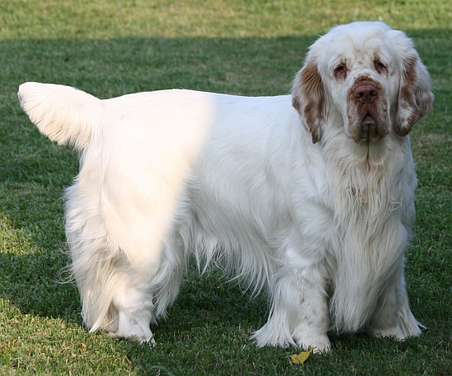
Springer Spaniel
Clumber Spaniel
English Spaniel

Slide 10
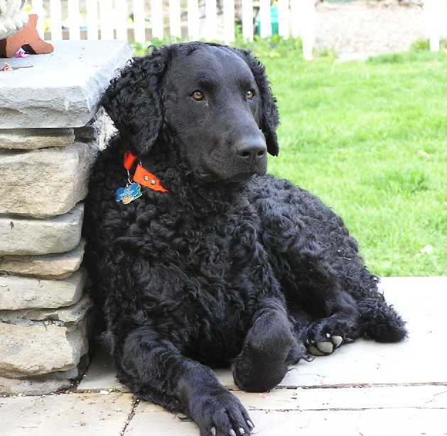
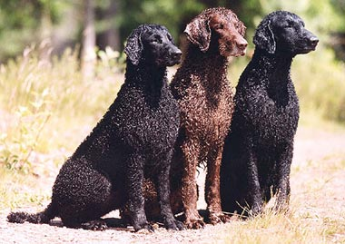
Chesapeake Bay Retriever
Curly Coated Retriever
Labrador Retriever

Slide 11
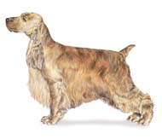
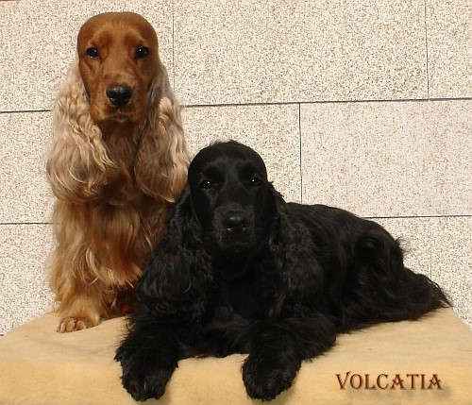
English Cocker Spaniel
Cocker Spaniel
Red Setter

Slide 12
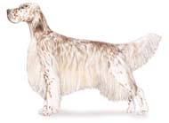
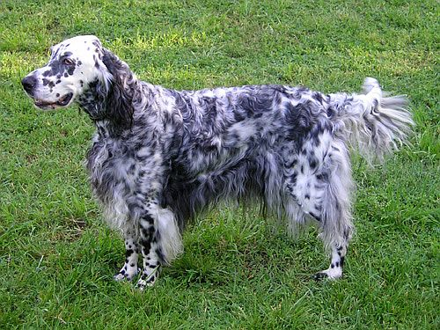
English Setter
English Pointer
Gordon Setter

Slide 13
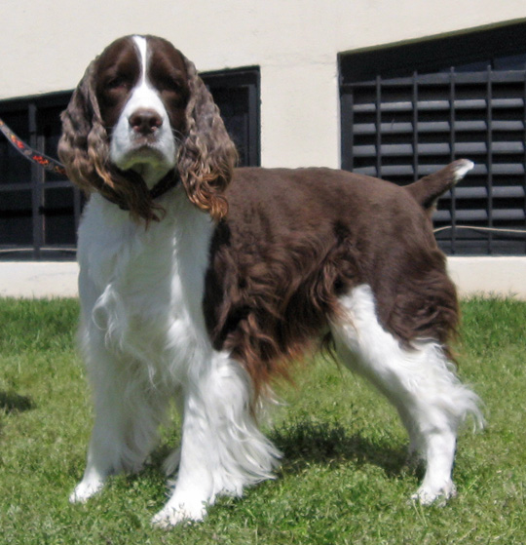
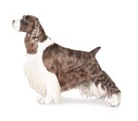
English Springer Spaniel
Brittany Spaniel
English Setter

Slide 14
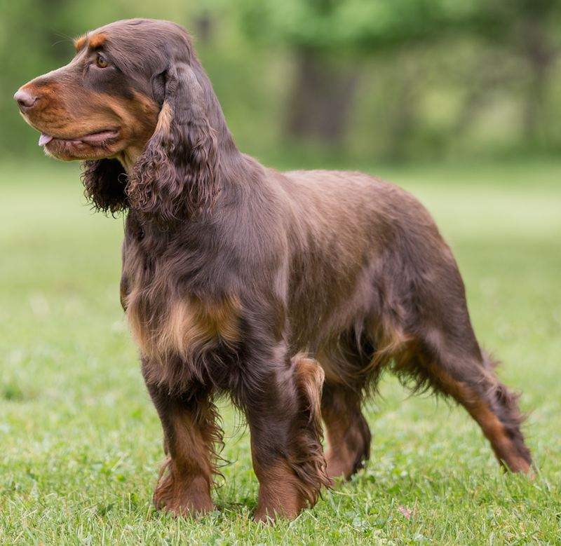
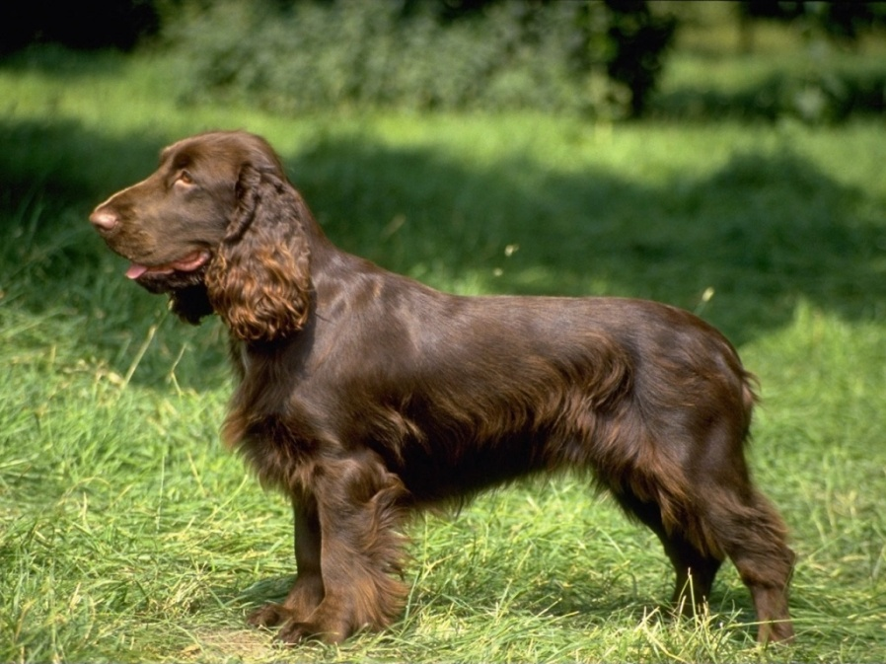
Field Spaniel
Clumber Spaniel
English Springer Spaniel

Slide 15
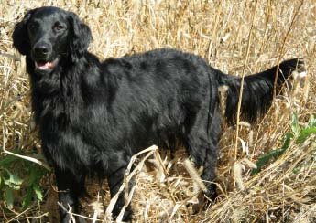
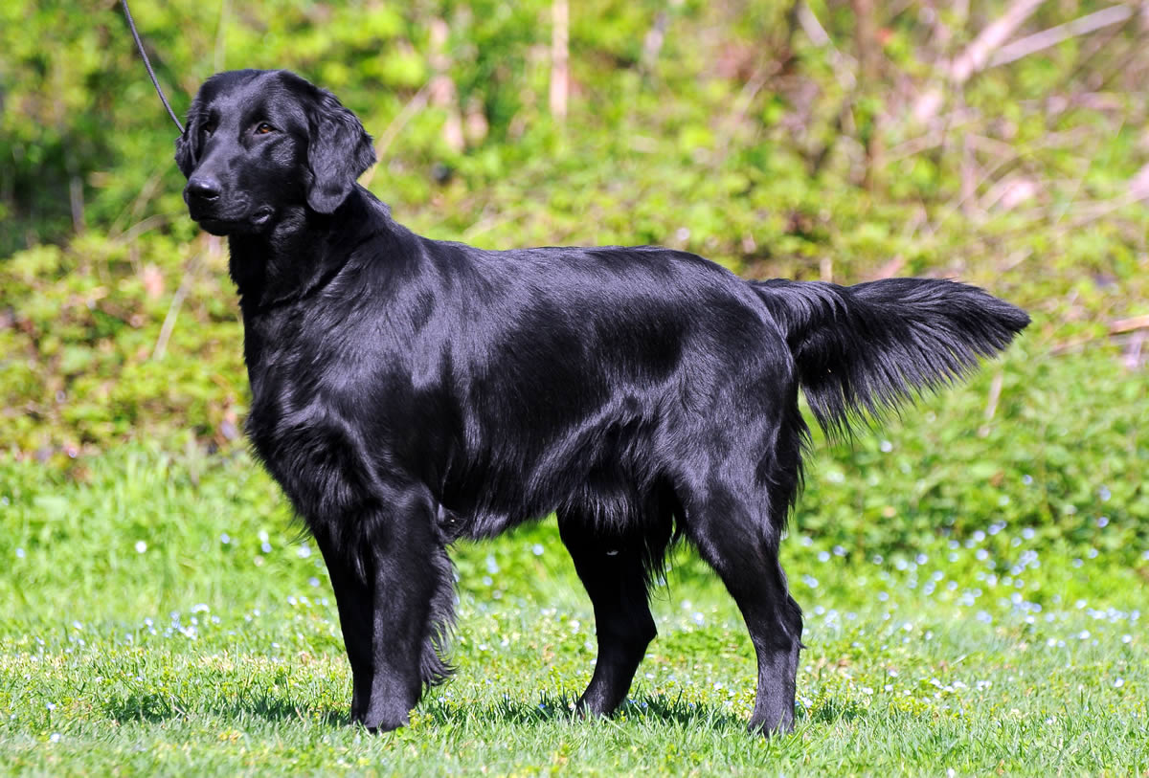
Flat coated Retriever
Golden Retriever
English Retriever

Slide 16
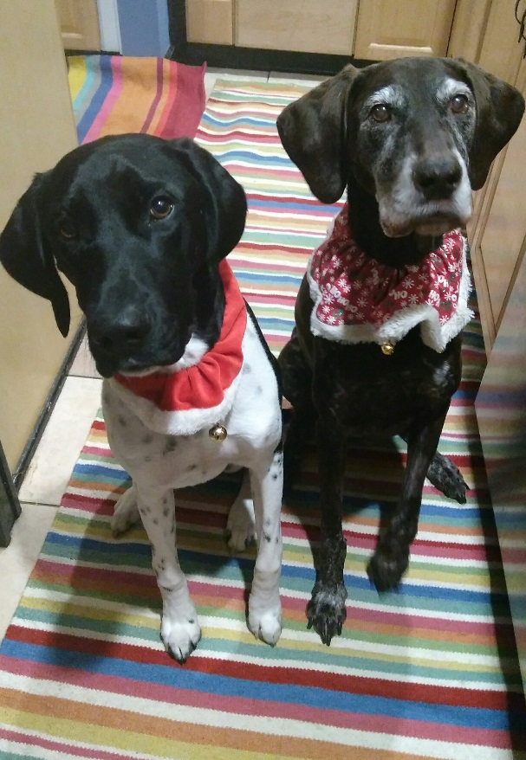
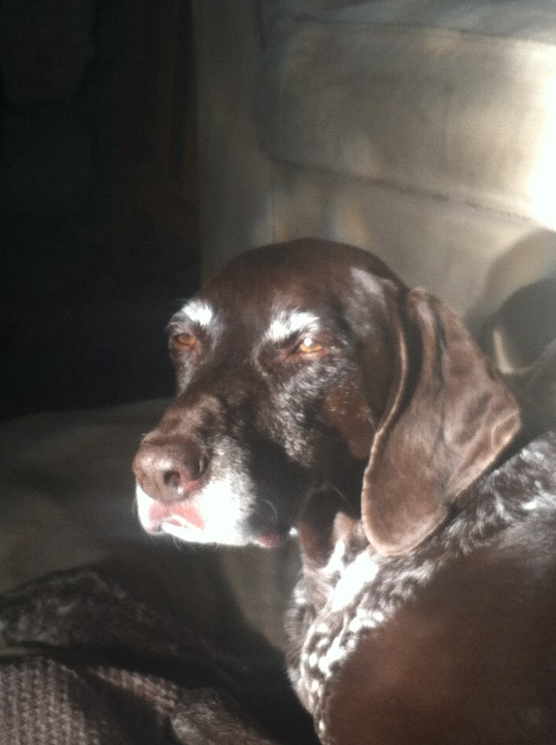
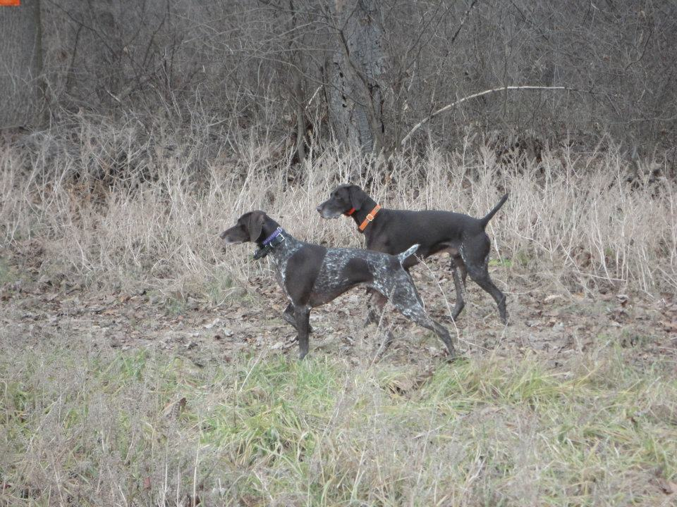
German Wirehaired Pointer
German Shorthaired Pointer
English Pointer

Slide 17
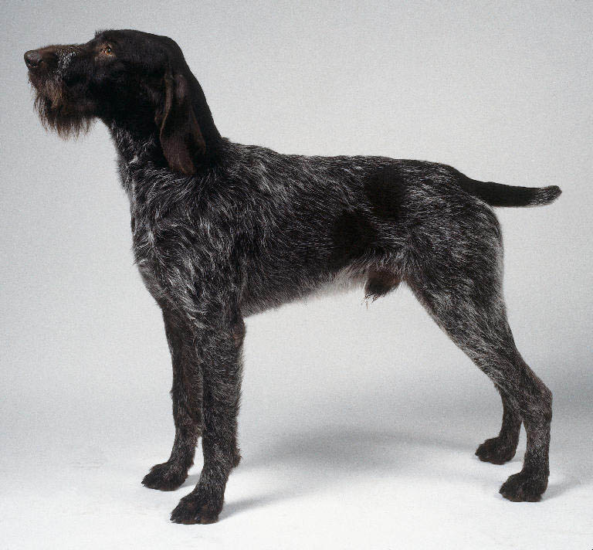
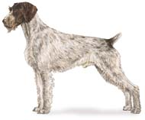
German Wirehaired Pointer
Gordon Setter
Pudelpointer

Slide 18
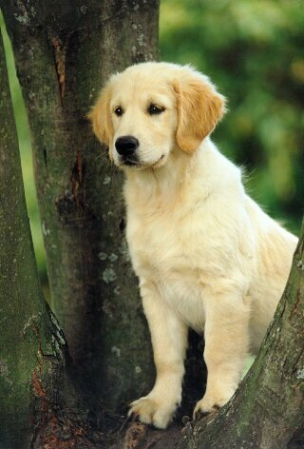
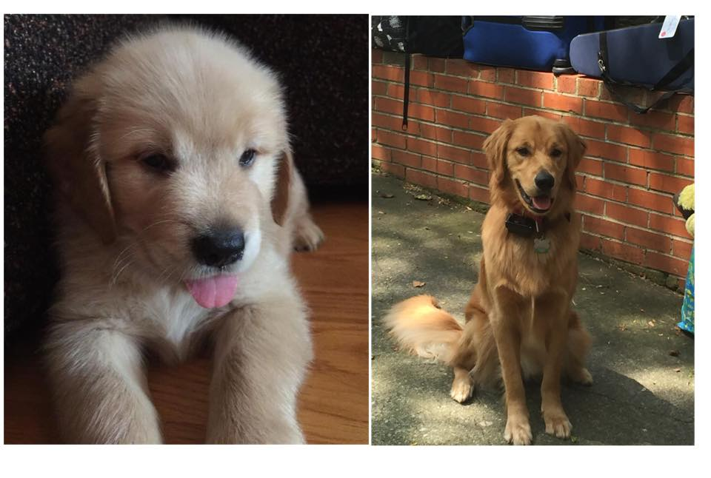
Flat Coated Retriever
Golden Retriever
Labrador Retriever

Slide 19
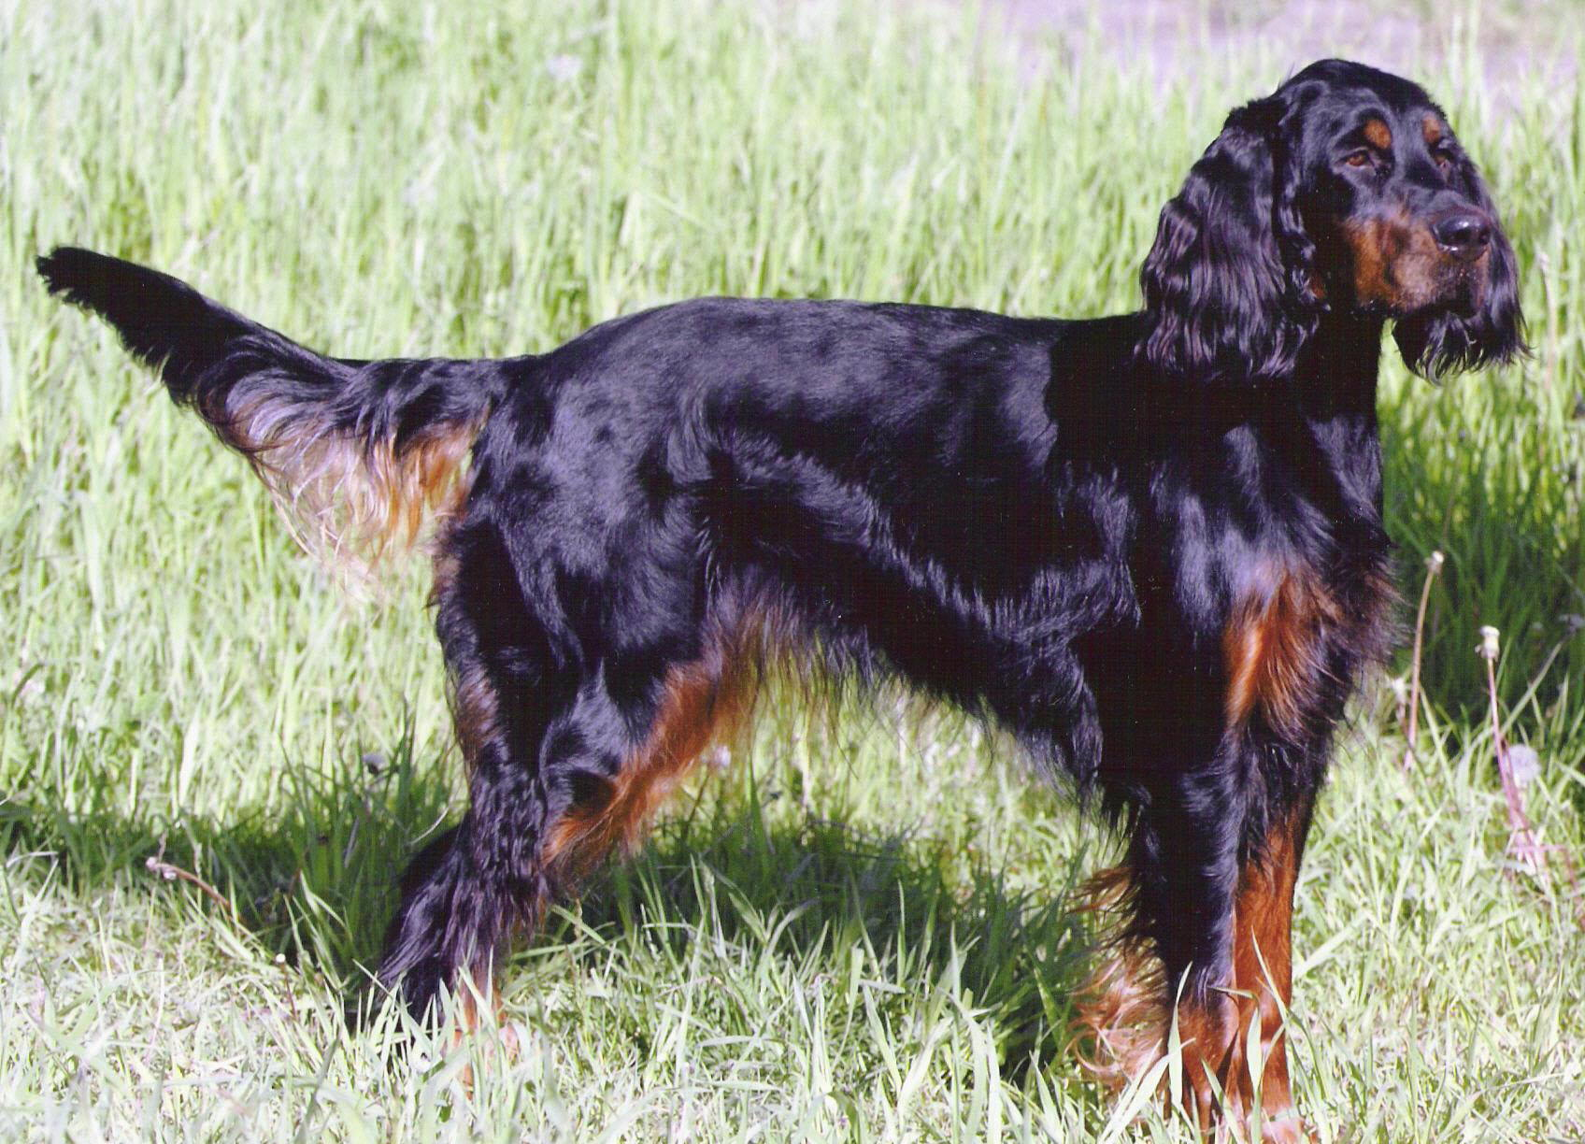
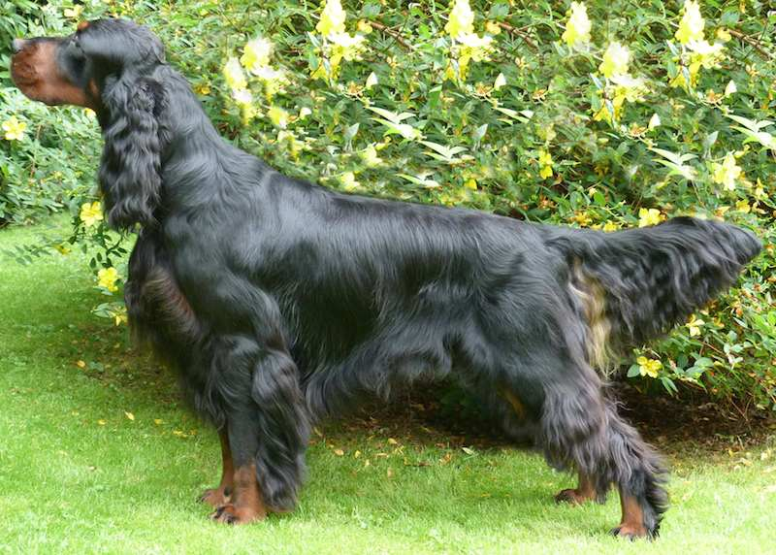
English Setter
Gordon Setter
Red and White setter

Slide 20
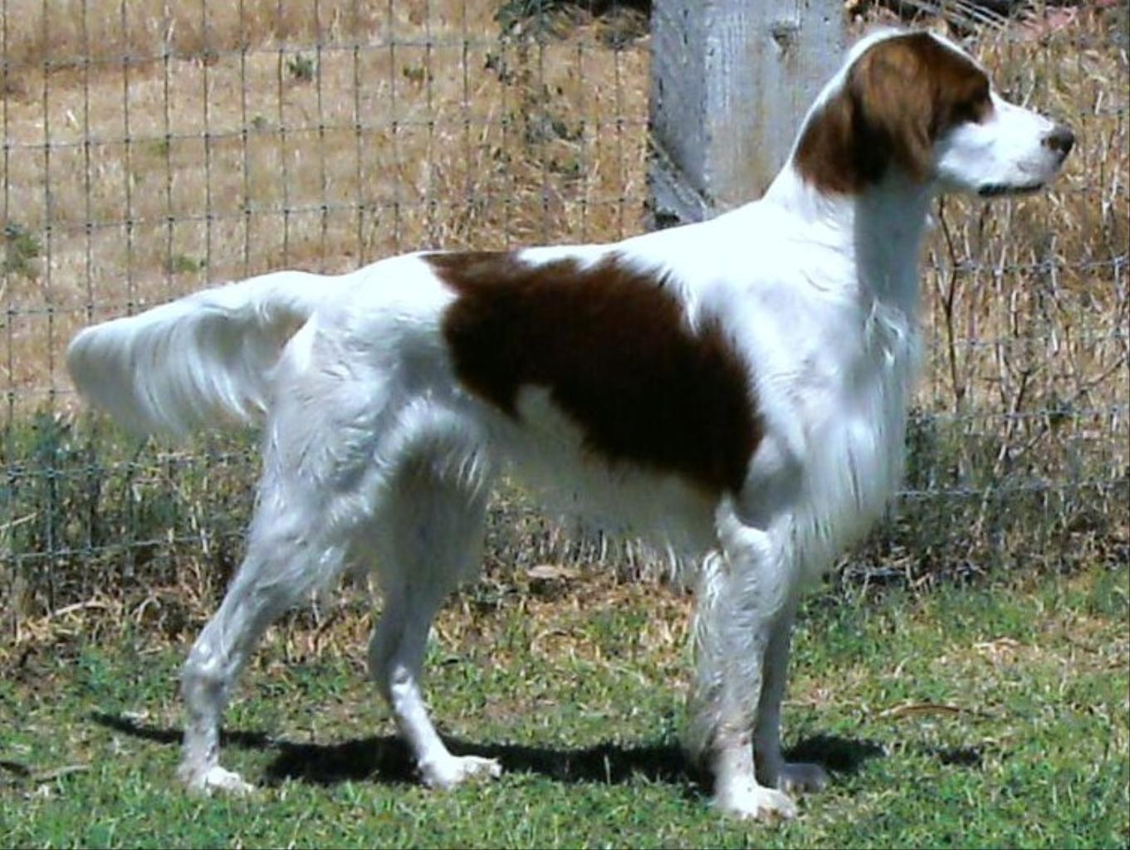
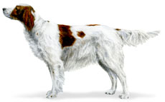
English Setter
Irish Red and White Setter
Flat coated setter

Slide 21
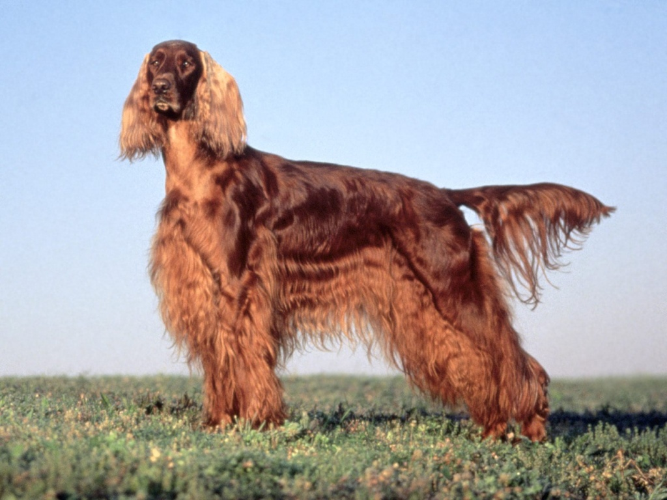
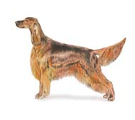
Gordon Setter
Irish Setter
Red and White Setter

Slide 22
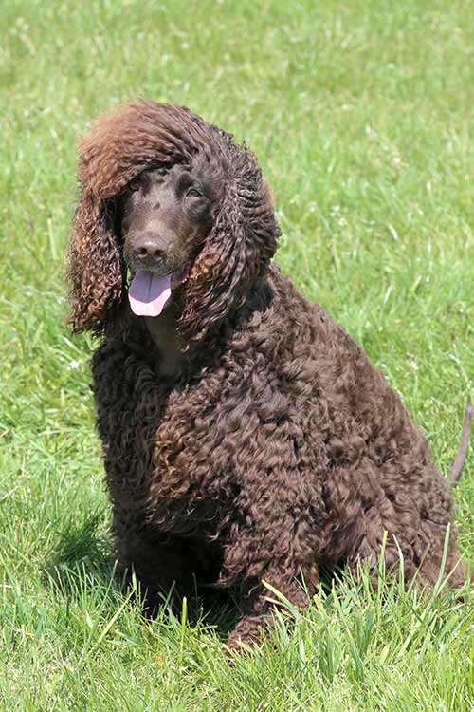
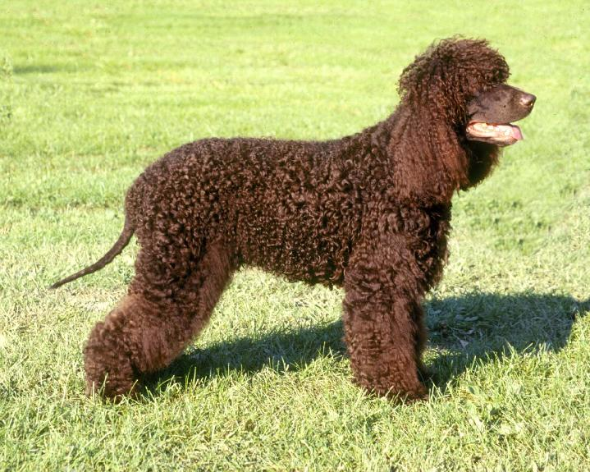
Portugese Water Dog
Irish Water Spaniel
English Spaniel

Slide 23
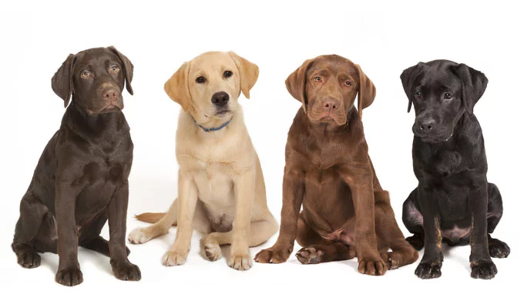
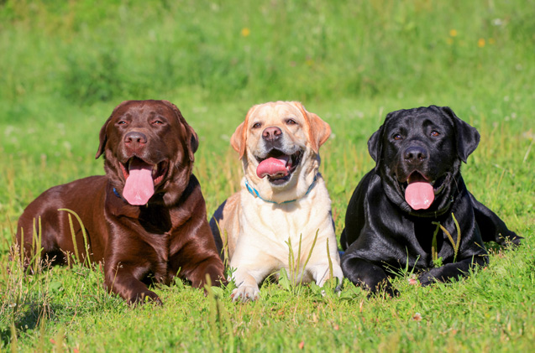
Labrador Retriever
Flat Coated Retriever
Pointer

Slide 24
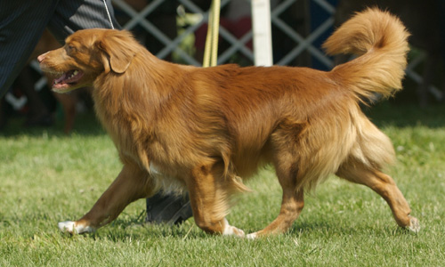
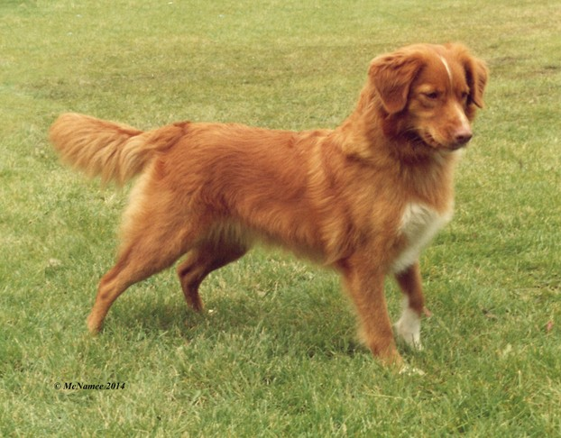
Nova Scotia Duck Tolling Retriever
Golden Retriever
Flat Coated Retriever

Slide 25
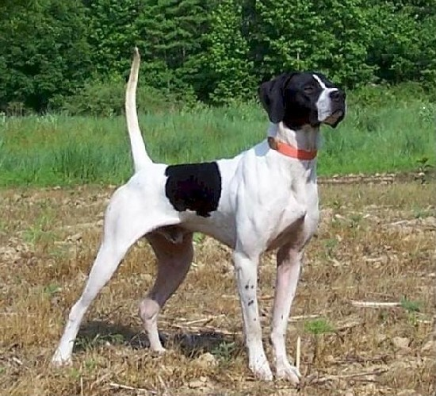
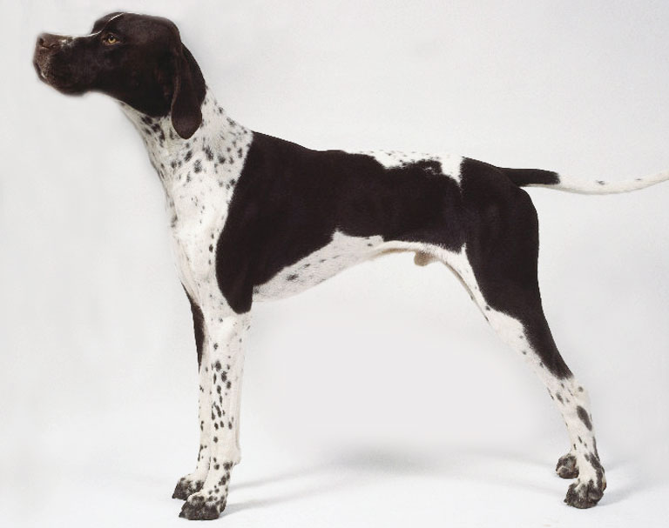
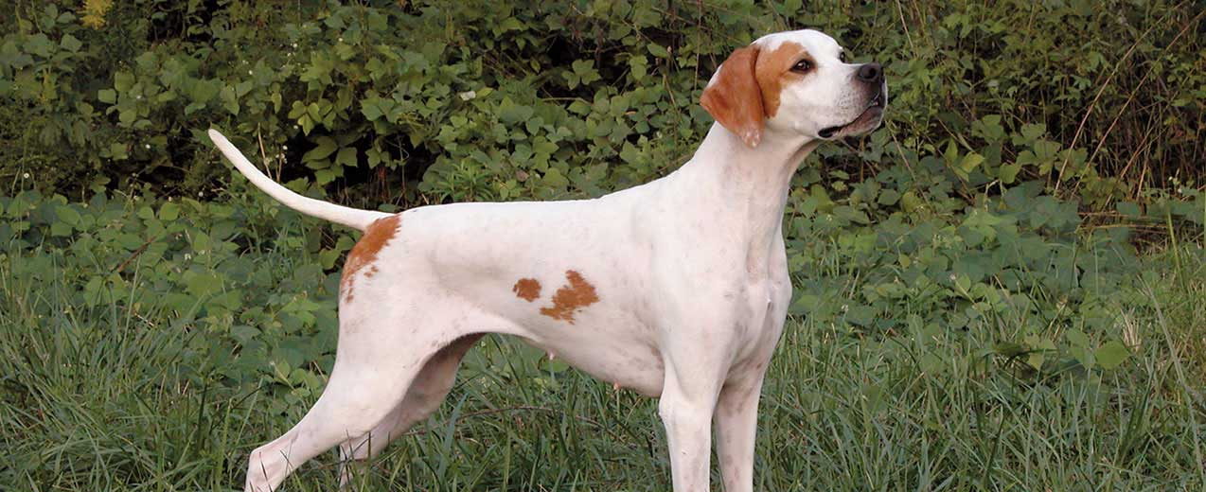
Pointer
German Shorthaired Pointer
Brittany

Slide 26
German Wirehaired Pointer
Spinone Italiano
Pudelpointer

Slide 27
Sussex Spaniel
Clumber Spaniel
Nederlandse Kooikerhondje

Slide 28
Vizsla
Pointer
Red Setter

Slide 29
Vizsla
Weimaraner
3. Pointer

Slide 30
Welsh Springer Spaniel
Brittany Spaniel
English Springer

Slide 31
German Wirehaired Pointer
Wirehaired Pointing Griffon
German Shorthaired Pointer

Slide 32
Nederlandse
Kooikerhondje
2. Pointer
3. Cocker Spaniel

Slide 33
Citations
21. Wirehaired Vizsla. Digital image. Mitsueki.wordpress.com. N.p., n.d. Web. 16 Dec. 2014.

