Slide 1
Surgical Instruments Review
Vet Science CDE

Slide 2
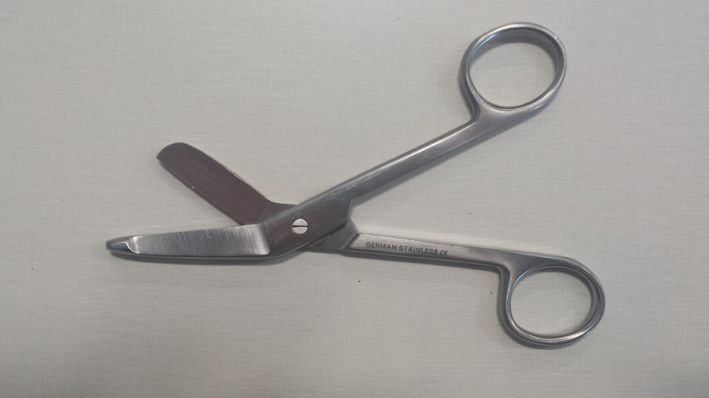
Lister Bandage
Scissors

Slide 3
Suture Removal Scissors

Slide 4
Mayo Scissors

Slide 5
Metzenbaum Scissors

Slide 6
Mayo Hegar
Needle Holders

Slide 7
Olsen Hegar
Needle Holders

Slide 8
Brown Adson
Thumb Forcep

Slide 9
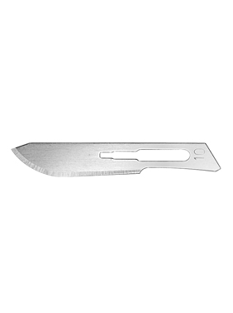
#10 Scalpel Blade

Slide 10
#11 Scalpel Blade

Slide 11
#15 Scalpel Blade

Slide 12
Rat Tooth Thumb Forcep

Slide 13
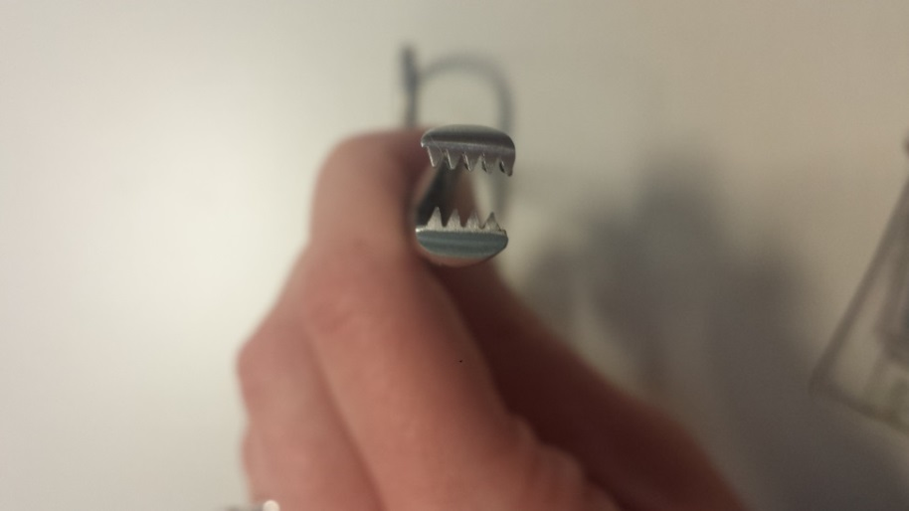
Allis Tissue Forcep

Slide 14
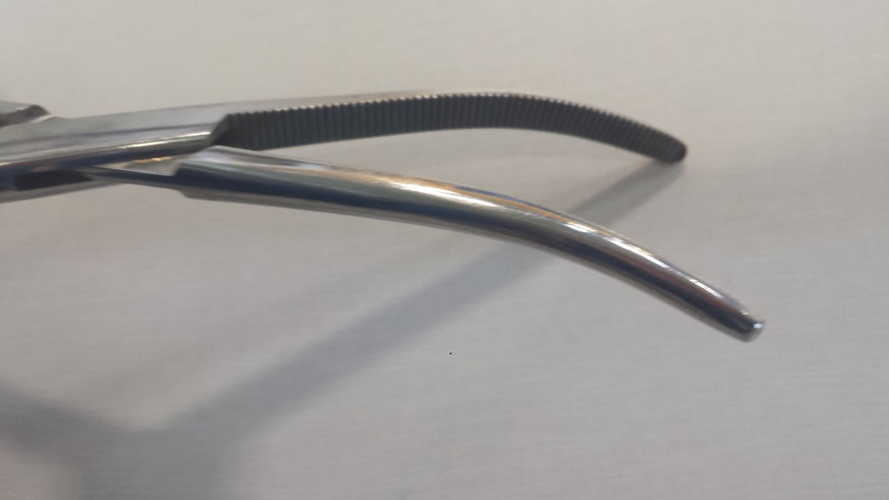
Crile Forcep

Slide 15
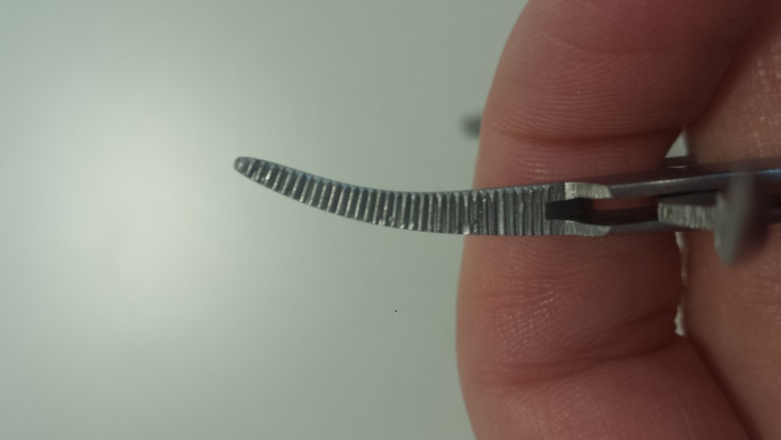
Halstead Mosquito Hemostat
(very small)

Slide 16
Kelly Hemostat
Ridges half way

Slide 17
Backhaus Towel Clamp

Slide 18
Snook Hook or Spay Hook

Slide 19
Scalpel Handle

Slide 20
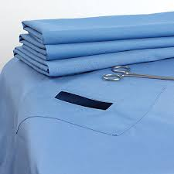
Veterinary Surgical Drapes

