Slide 1
Terrier Group

Slide 2
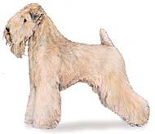
What breed?
1. Bedlington Terrier
2. Staffordshire Terrier
3. Soft Coated Wheaten Terrier

Slide 3
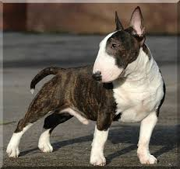
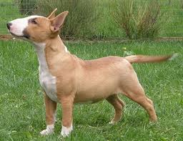
1. Jack Russell Terrier
2. Miniature Bull Terrier
3. Wheaten Terrier

Slide 4
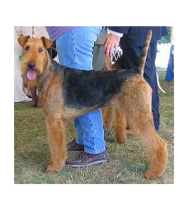
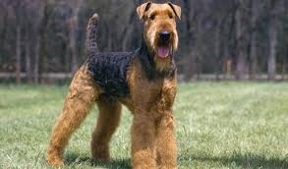
1. Cesky Terrier
2. Airedale Terrier
3. Yorkshire Terrier

Slide 5
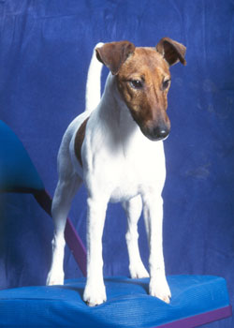
Name the Breed
1. Jack Russell Terrier
2. Australian Terrier
3. Smooth Fox Terrier

Slide 6
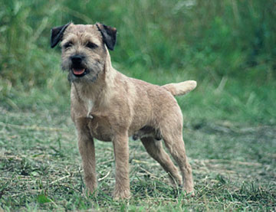
What breed is this?
1. Border Terrier
2. Wirehaired Fox Terrier
3. Parson Russell Terrier

Slide 7
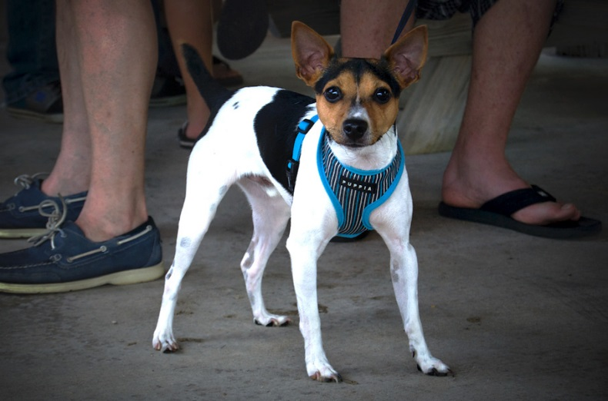
Name the breed
1. Sealyham
2. Rat Terrier
3. Cairn Terrier

Slide 8
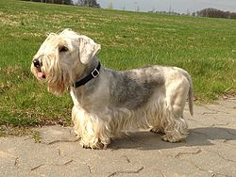
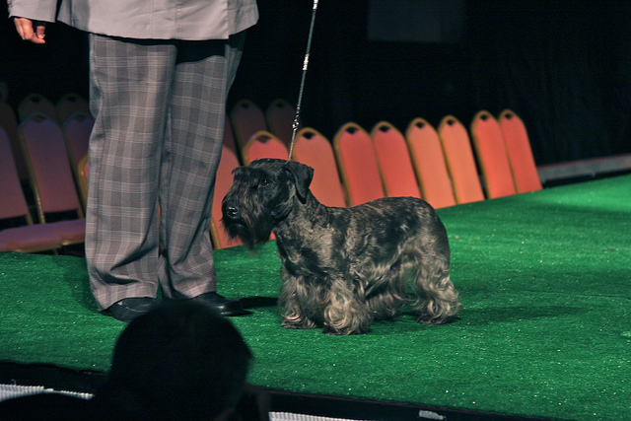
Which Terrier is it?
A. Sealyham
B. Cesky
C. Borzoi

Slide 9
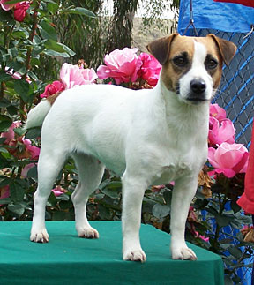
Which Terrier?
1. Rat Terrier
2. Norwich Terrier
3. Russell Terrier

Slide 10
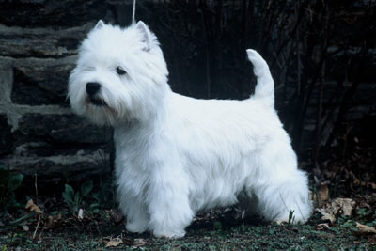
Which Terrier is this?
1. West Highland White Terrier
2. Cairn Terrier
3. Soft Coated Wheaten Terrier

Slide 11
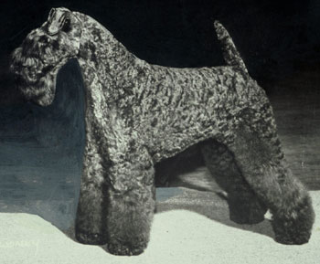
Name the Breed
1. Kerry Blue Terrier
2. American Staffordshire Terrier
3. Australian Terrier

Slide 12
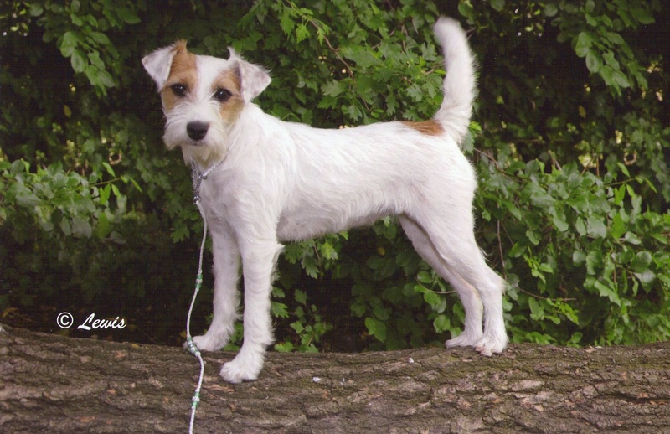
Which Terrier is it?
1. Norwich Terrier
2. Parson Russell Terrier
3. West Highland White Terrier

Slide 13
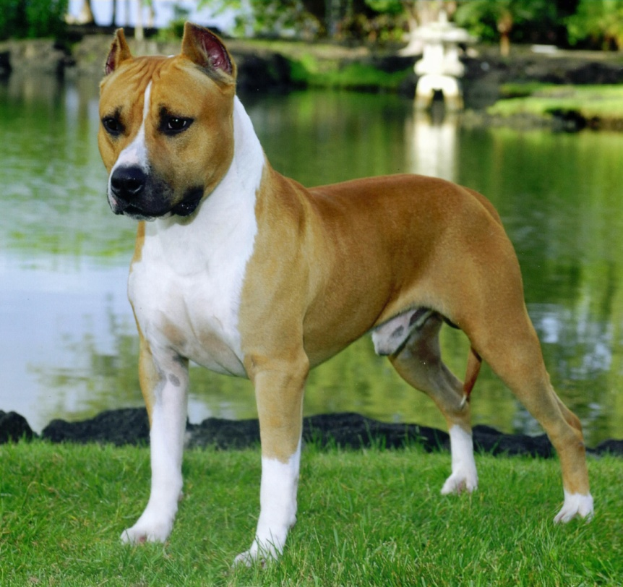
Name this Terrier
1. American Staffordshire Terrier
2. Airedale Terrier
3. Bull Terrier

Slide 14
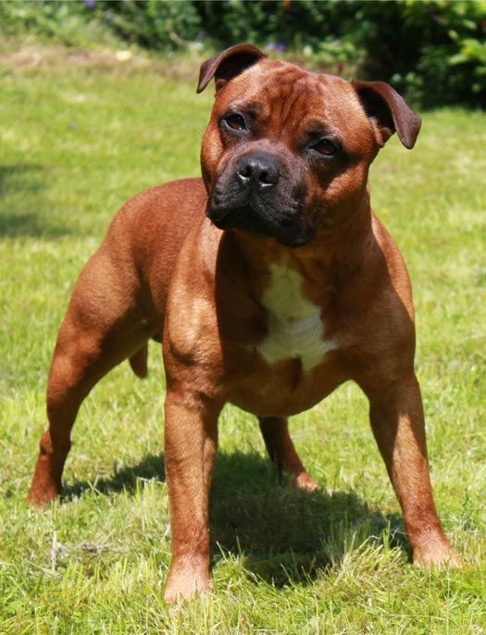
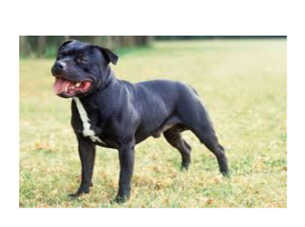
Name the Breed
1. Staffordshire Bull Terrier
2. Kerry Blue Terrier
3. Sealyham Terrier

Slide 15
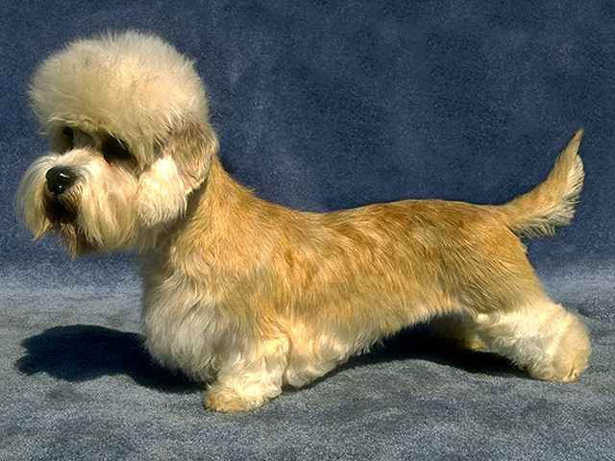
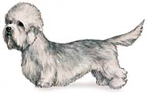
Which Terrier is it?
1. Dandie Dinmont Terrier
2. Bedlington Terrier
3. Sealyham Terrier

Slide 16
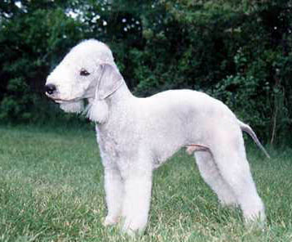
Name the breed
1. Dandie Dinmont Terrier
2. Bedlington Terrier
3. Sealyham Terrier

Slide 17
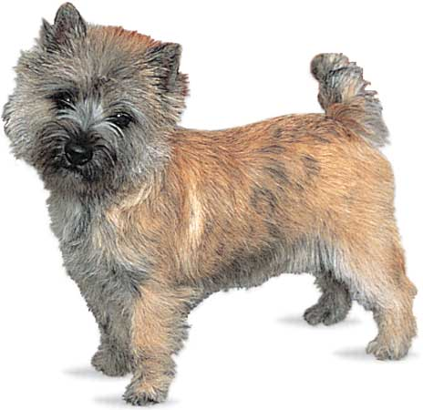
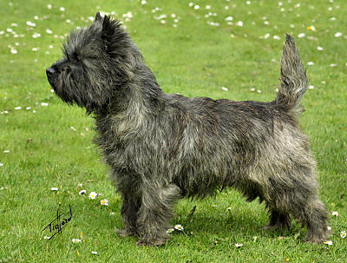
Name that Terrier
1. Miniature Schnauzer
2. Cairn Terrier
3. West Highland White Terrier

Slide 18
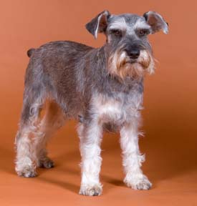
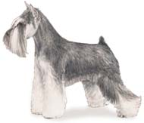
Which Terrier is it?
1. Cairn Terrier
2. Miniature Schnauzer
3. Scottish Terrier

Slide 19
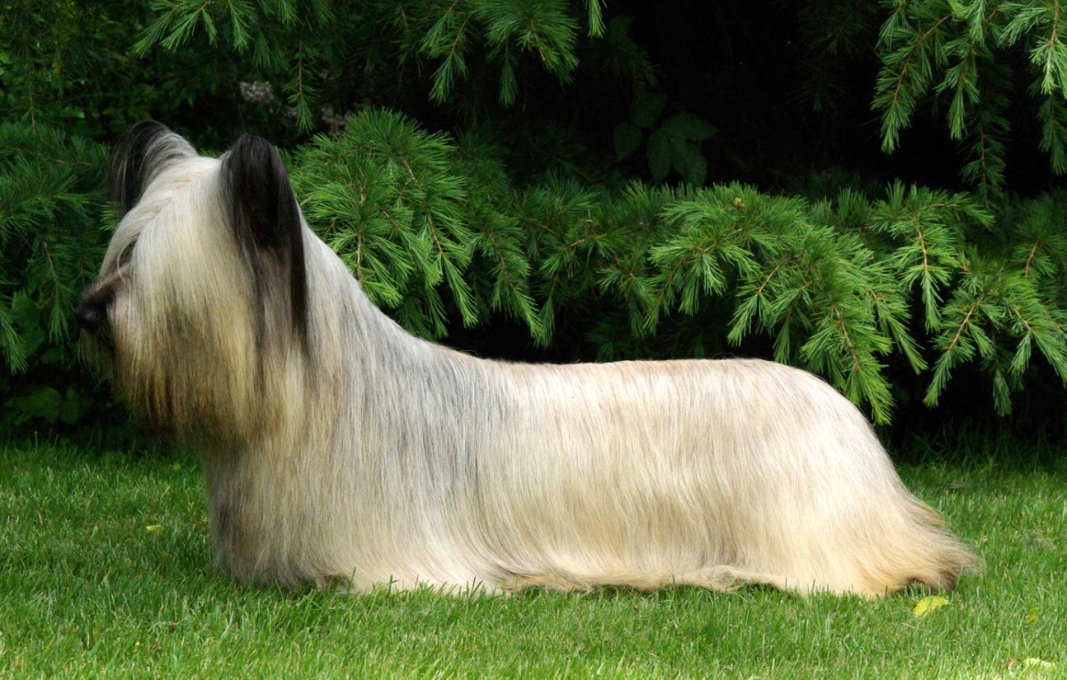
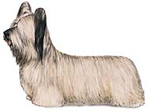
Name the Terrier
1. Irish Terrier
2. Manchester Terrier
3. Skye Terrier

Slide 20
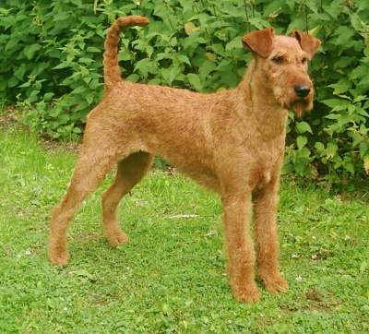
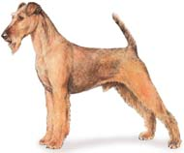
Which Terrier is it?
1. Irish Terrier
2. Manchester Terrier
2. Skye Terrier

Slide 21
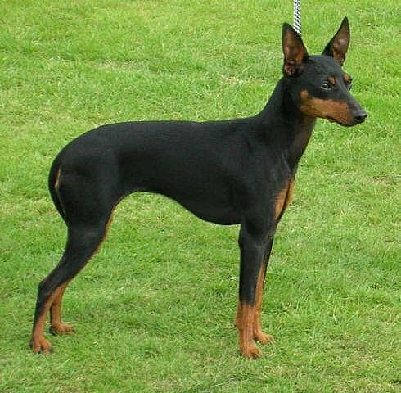
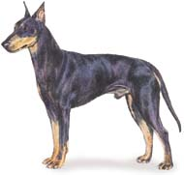
Name the Breed
1. Manchester Terrier
2. Glen of Imaal Terrier
3. Scottish Terrier

Slide 22
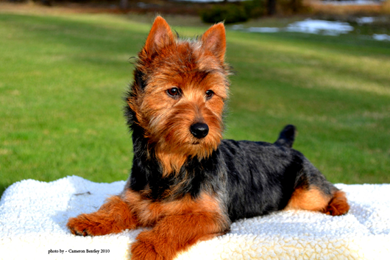
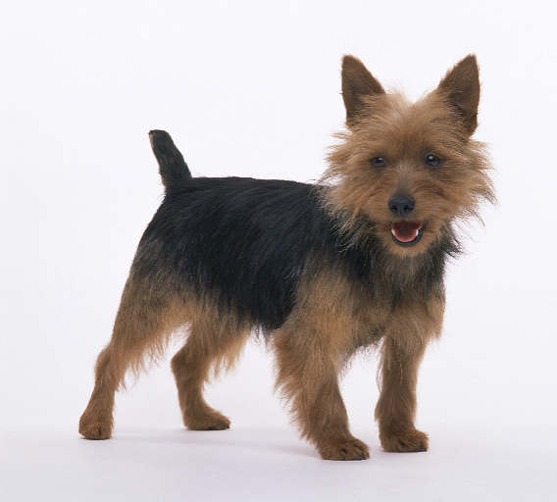
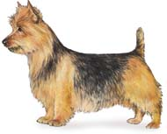
Name this Terrier
1. Norwich Terrier
2. Norfolk Terrier
3. Australian Terrier

Slide 23
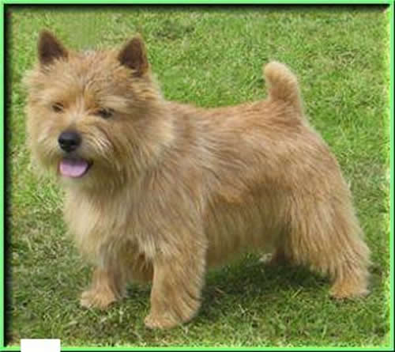
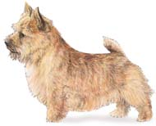
Yet more Terriers..Which one?
1. Norwich Terrier
2. Norfolk Terrier
3. Australian Terrier

Slide 24
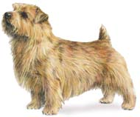
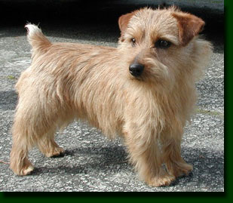
And STILL more..which one?
1. Norwich Terrier
2. Norfolk Terrier
3. Scottish Terrier

Slide 25
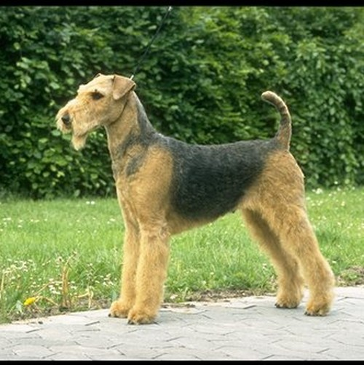
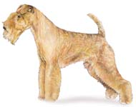
Which Terrier is it?
1. Bull Terrier
2. Wire Fox Terrier
3. Lakeland Terrier

Slide 26
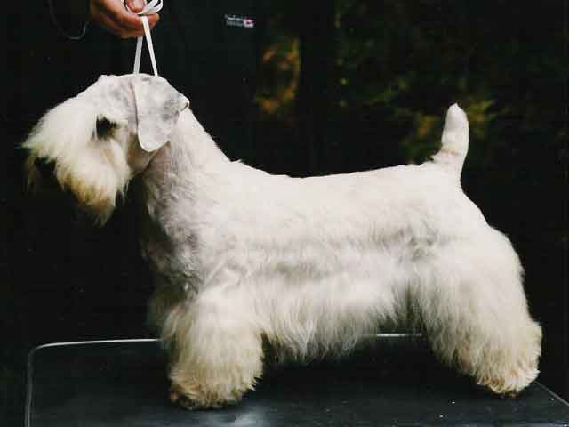
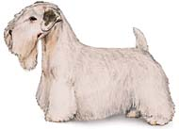
Name this Terrier!
1. Border Terrier
2. Kerry Blue Terrier
3. Sealyham Terrier

Slide 27
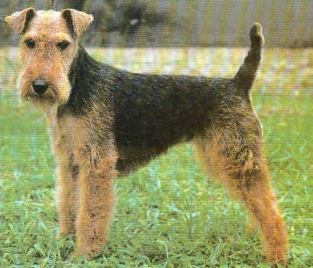
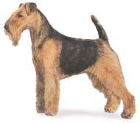
Name more Terriers…
1. Welsh Terrier
2. Sealyham Terrier
3. Smooth Fox Terrier

Slide 28
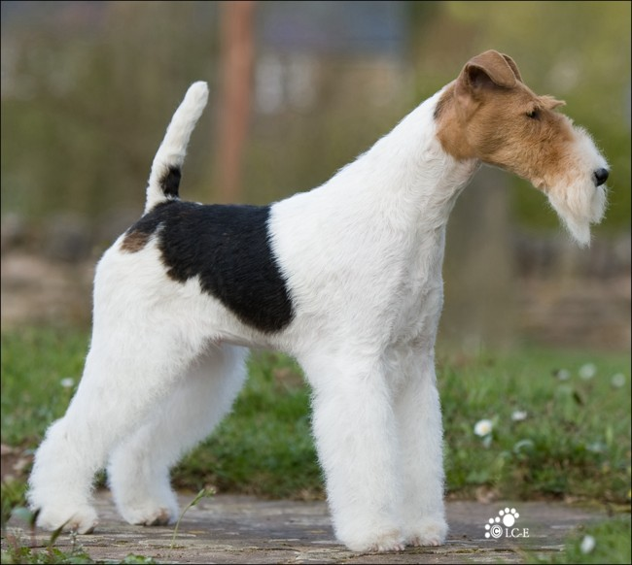
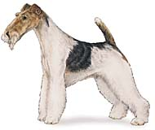
Guess What? More Terriers….Which one is it?
1. Lakeland Terrier
2. Wire Fox Terrier
3. Bull Terrier

Slide 29
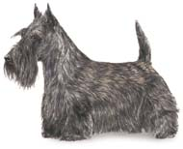
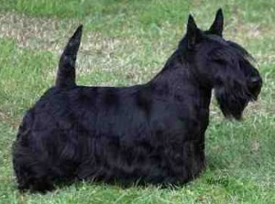
Which Terrier is it?
1. Glen of Imaal Terrier
2. Scottish Terrier
3. Border Terrier

Slide 30
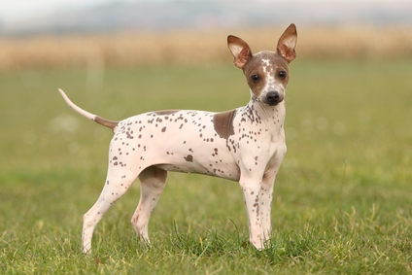
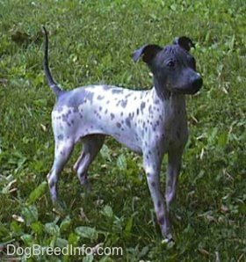
1. Chihuahua
2. American Hairless Terrier
3. Sealyham Terrier

Slide 31
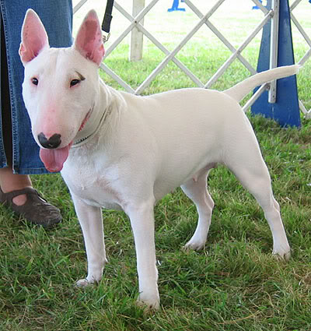
Are We done yet…nope! Name this Terrier..
1. Staffordshire Terrier
2. Bull Terrier
3. Kerry Blue Terrier

Slide 32
Name the last Terrier….
1. Glen of Imaal Terrier
2. Border Terrier
3. Dandie Dinmont Terrier

Slide 33
Citations
Cesky Terrier- Katrina. Digital image. Www.flickr.com. Www.flickr.com, n.d. Web. 18 Dec. 2014.

