Slide 1
Toy Group

Slide 2
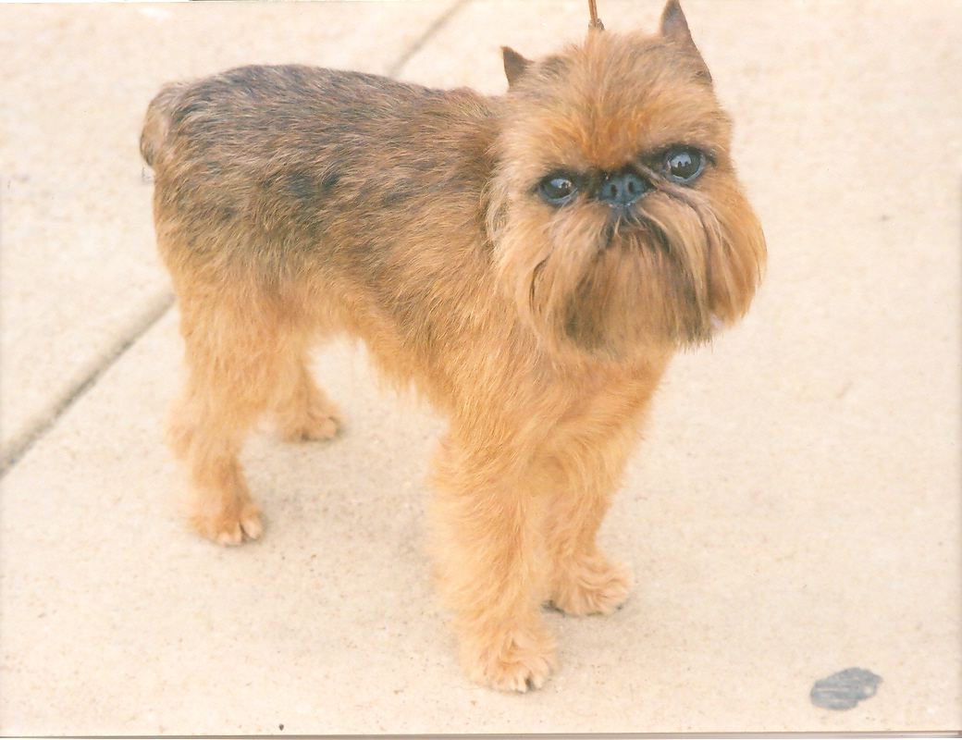
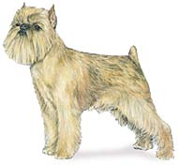
Name this Breed
1. Brussels Griffon
2. Affinpinscher
3. Pug

Slide 3
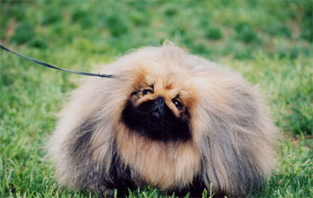
Which Breed is It?
1. Shih Tzu
2. Havanese
3. Pekingese

Slide 4
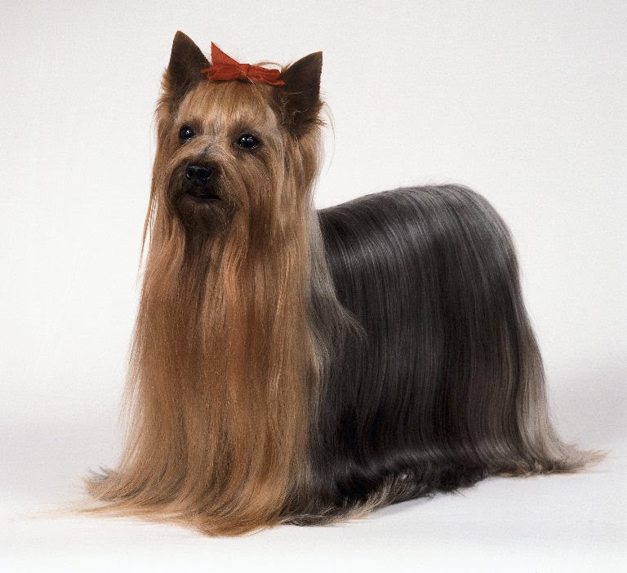
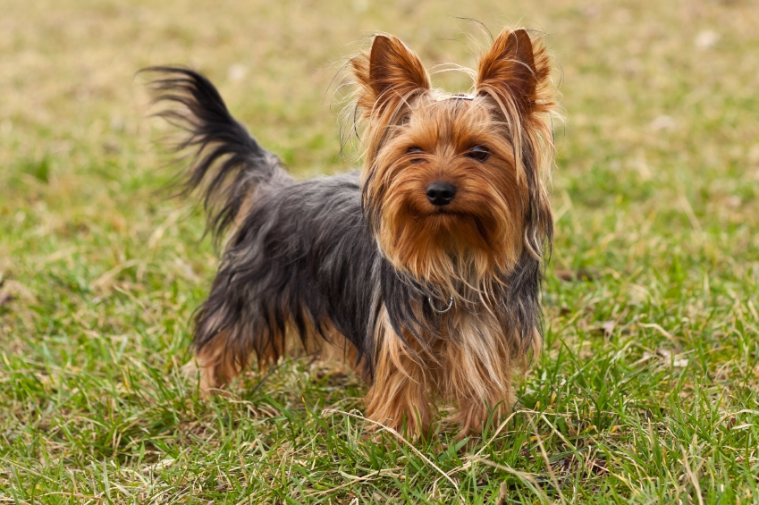
Which Breed?
1. Cairn Terrier
2. Miniature Pinscher
3. Yorkshire Terrier

Slide 5
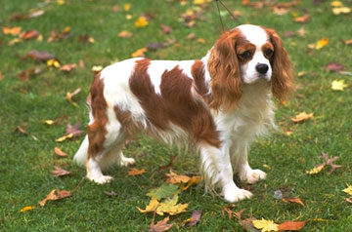
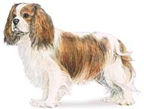
Which Toy Breed is it?
1. Cocker Spaniel
2. Cavalier King Charles Spaniel
3. English Toy Spaniel

Slide 6
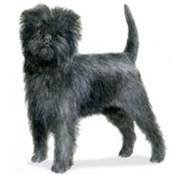
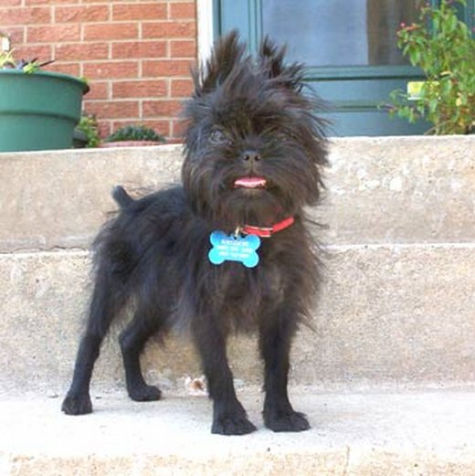
Name the Breed
1. English Toy Spaniel
2. Affinpinscher
3. Brussels Griffon

Slide 7
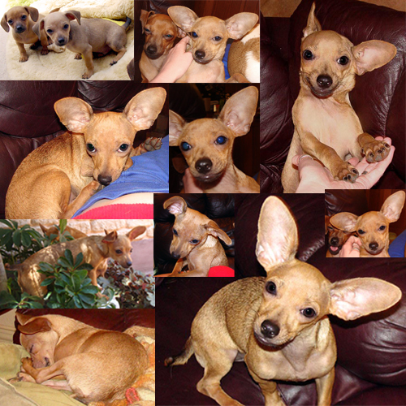
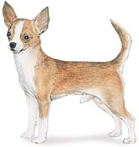
Name this Toy Breed
1. Chihuahua
2. Chinese Crested

Slide 8
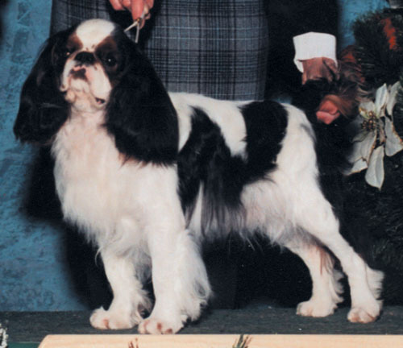
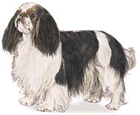
Name this Breed
1. Cocker Spaniel
2. Papillion
3. English Toy Spaniel

Slide 9
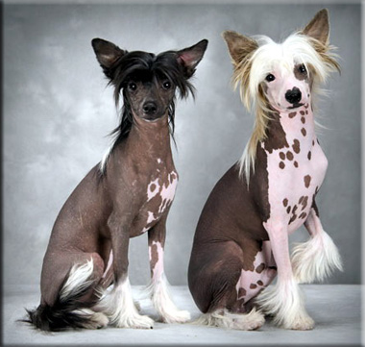
What Breed?
1. Brussels Griffon
2. Chinese Crested

Slide 10
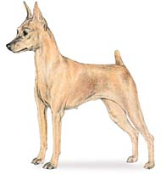
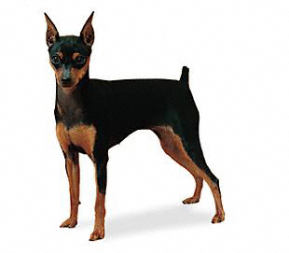
What Toy Breed?
1. Miniature Pinscher
2. Manchester Terrier
3. Medium Pinscher

Slide 11
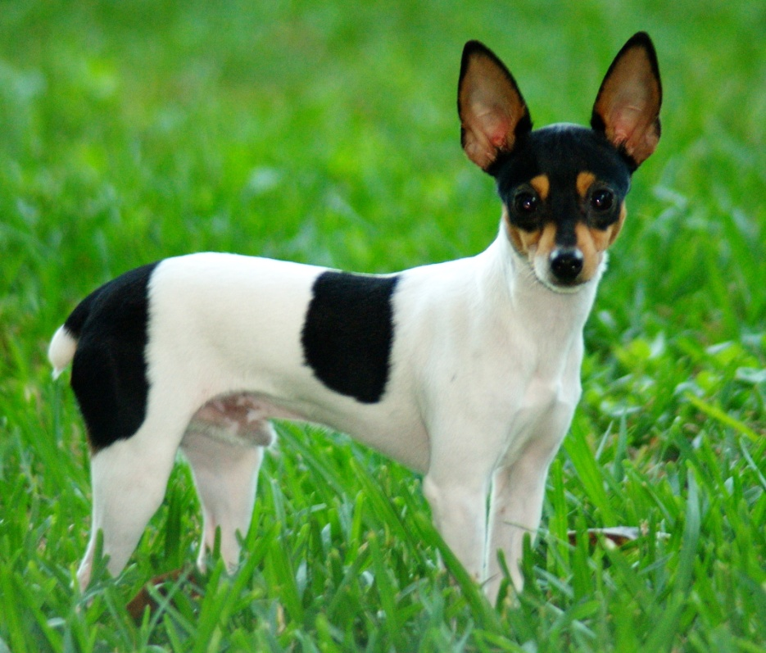
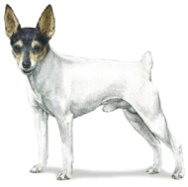
Name the Breed
1. Manchester Terrier
2. Toy Fox Terrier
3. Wirehaired Jack Russell

Slide 12
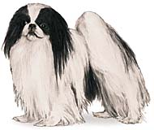
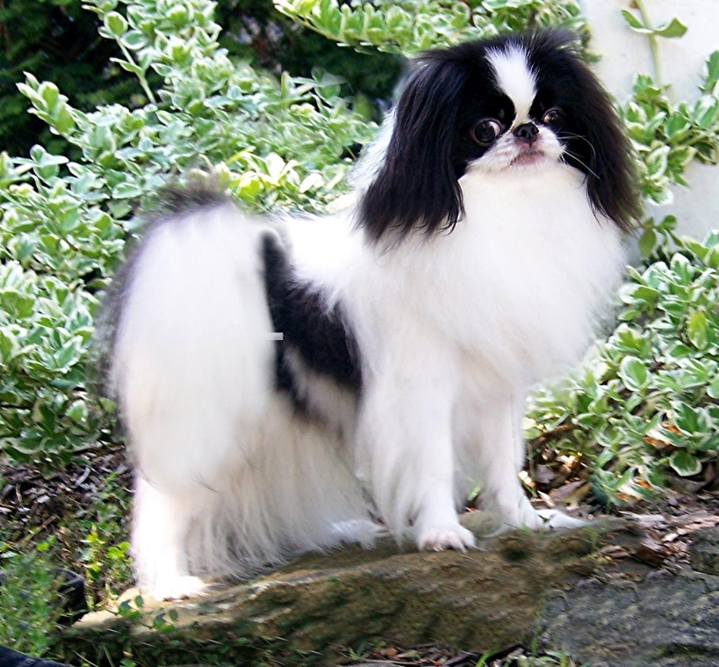
What Breed?
1. Havanese
2. Japanese Chin
3. English Spaniel

Slide 13
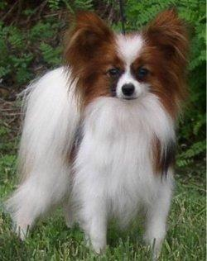
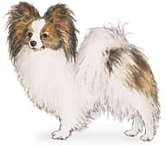
Name the Breed
1. Havanese
2. Papillion
3. Japanese Chin

Slide 14
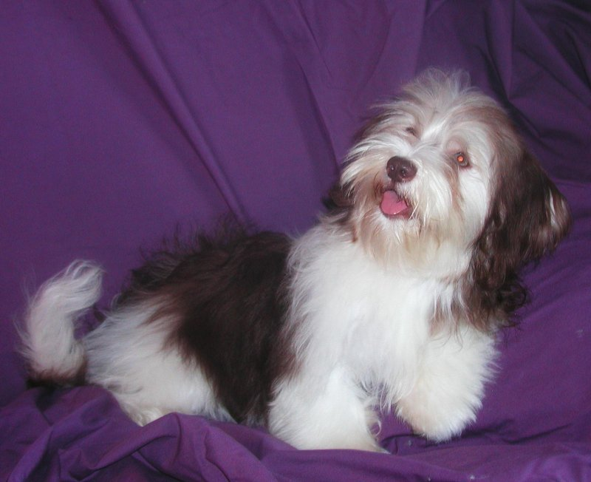
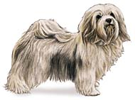
What Breed?
1. Shih Tzu
2. Havanese
3. Lhasa Apso

Slide 15
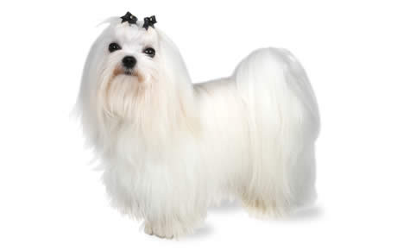
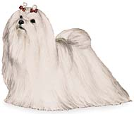
What Breed?
1. Maltese
2. Yorkshire Terrier
3. Shih Tzu

Slide 16
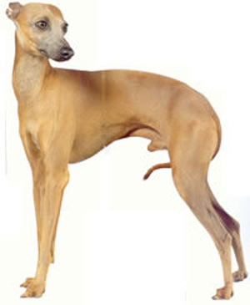
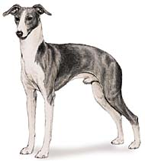
Name The Breed
1. Yorkshire Terrier
2. Manchester Terrier
3. Italian Greyhound

Slide 17
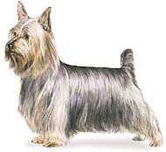
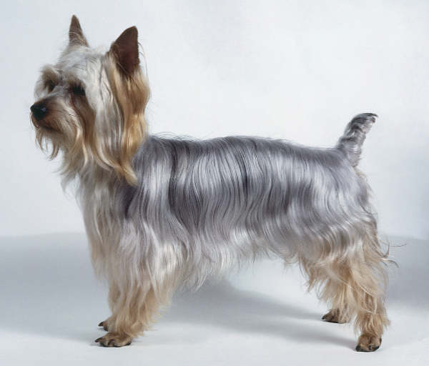
What Breed?
1. Cairn Terrier
2. Silky Terrier
3. Sealyham

Slide 18
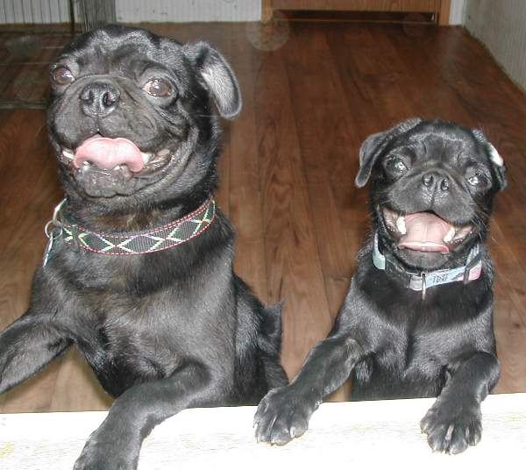
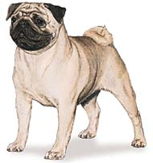
What Breed? (almost done!)
1. Boston Terrier
2. Pug
3. Pekingese

Slide 19
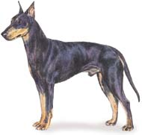
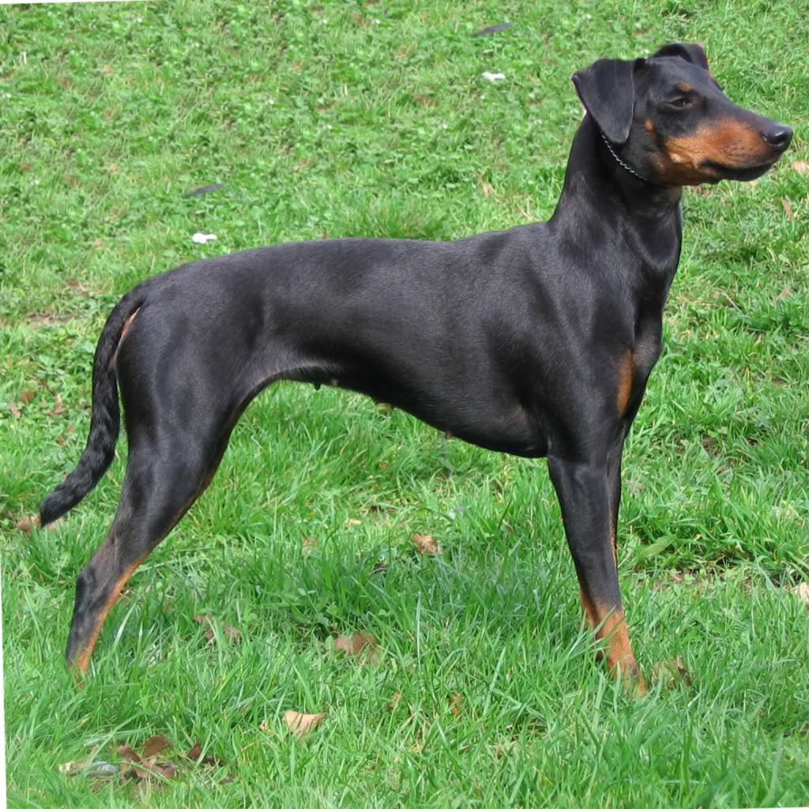
Getting closer to done…What is this one?
1. Miniature Pinscher
2. Manchester Terrier
3. Black and Tan Pinscher

Slide 20
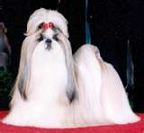
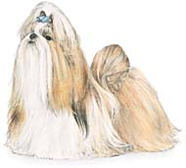
What Breed?
1. Shih Tzu
2. English Toy Spaniel
3. Cocker Spaniel

Slide 21
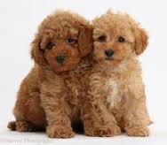
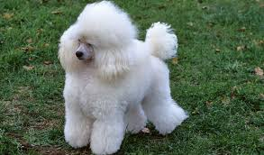
Toy Breeds…Name this one..
1. Pomeranian
2. Poodle
3. Portuguese Water Dog

Slide 22
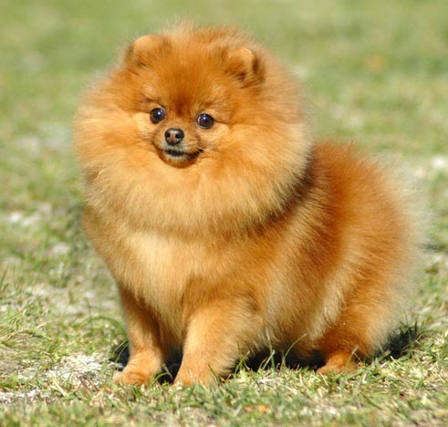
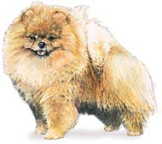
Last one…name this breed
1. Pomeranian
2. Pekingese
3. Papillion

